Slide 1
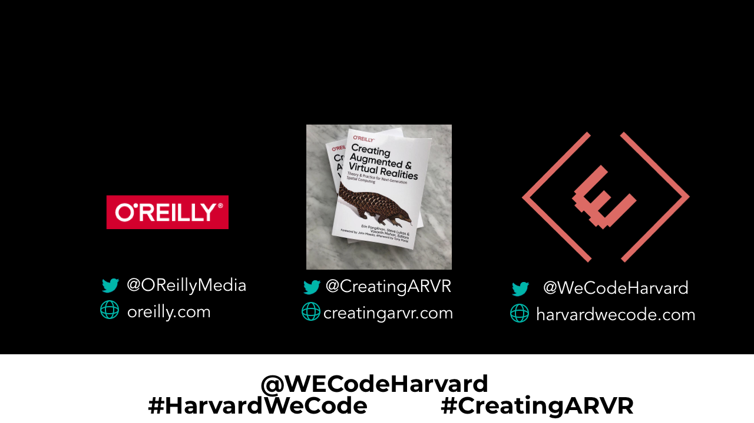
Welcome to Perspectives
Creating Augmented and Virtual Realities

Slide 2
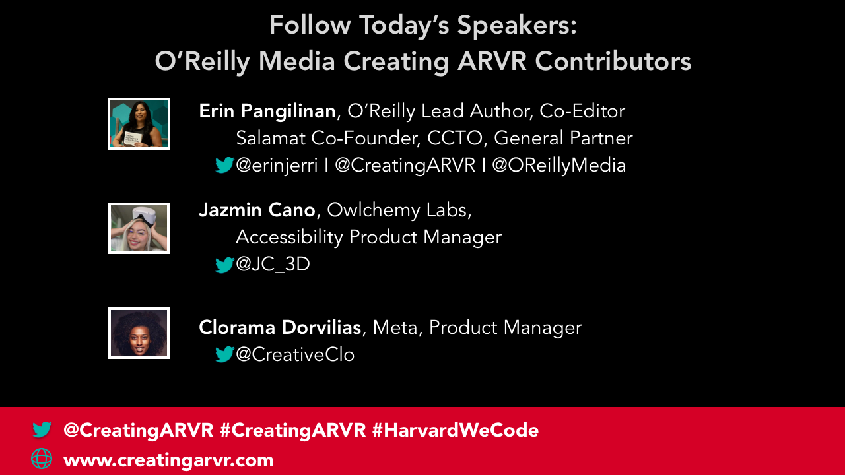

Slide 3

Before the metaverse was a thing
(before Facebook renamed the company to Meta),
we published a book on the subject in 2019
(before the pandemic).
#TechIntersections
@erinjerri

Slide 4

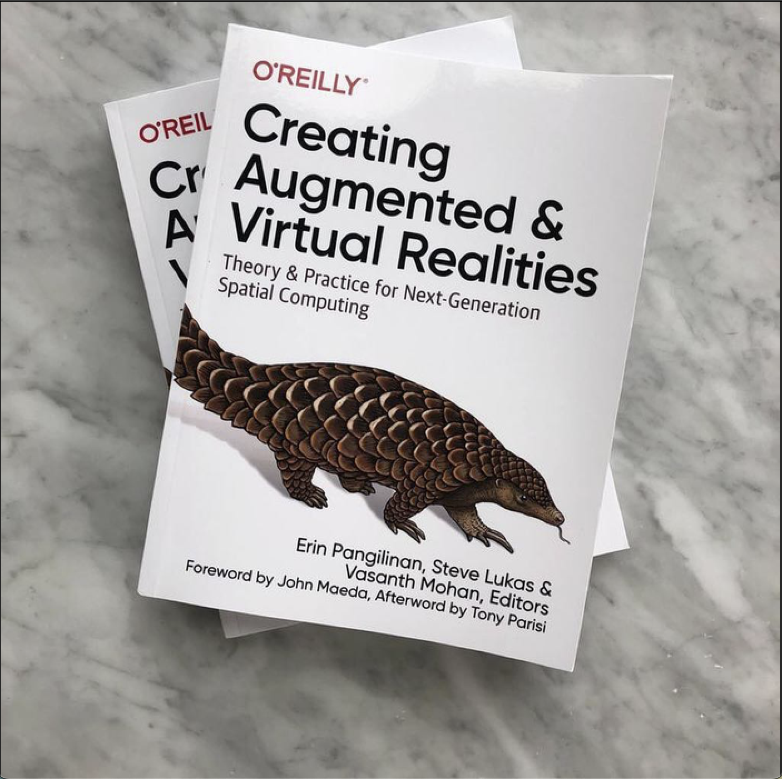
Behind the Making of O’Reilly Media’s First-of-its-kind Anthology: Creating Augmented and Virtual Realities
#TechIntersections
@erinjerri

Slide 5
TERMINOLOGY
1
I use AR VR MR XR / Spatial Computing and Metaverse interchangeably.
2
I use Cryptocurrency/Blockchain/Web3 interchangeably.
3
I use Artificial Intelligence (AI), Machine Learning (ML), Deep Learning (DL), and Data Science interchangeably.
Notes:
Anyone who told you differently, is lying to you, or has not lived this life or was probably rich and famous before it due to privilege, or years of long and grueling hard work and has forgotten where they come from and that this period of a pandemic has sucked like no other.

Slide 6
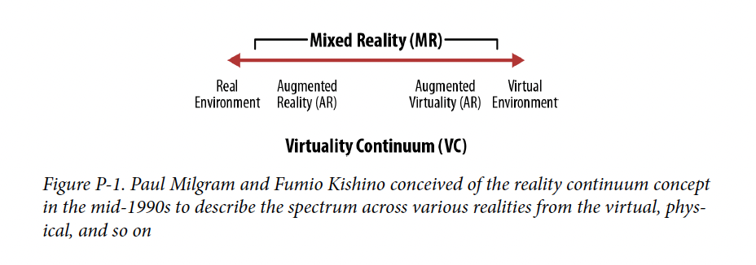
The Metaverse is a spectrum
I use AR VR MR XR / Spatial Computing and Metaverse interchangeably.
I use Cryptocurrency/Blockchain/Web3 interchangeably.
Creating Augmented and Virtual Realities: Preface

Slide 7
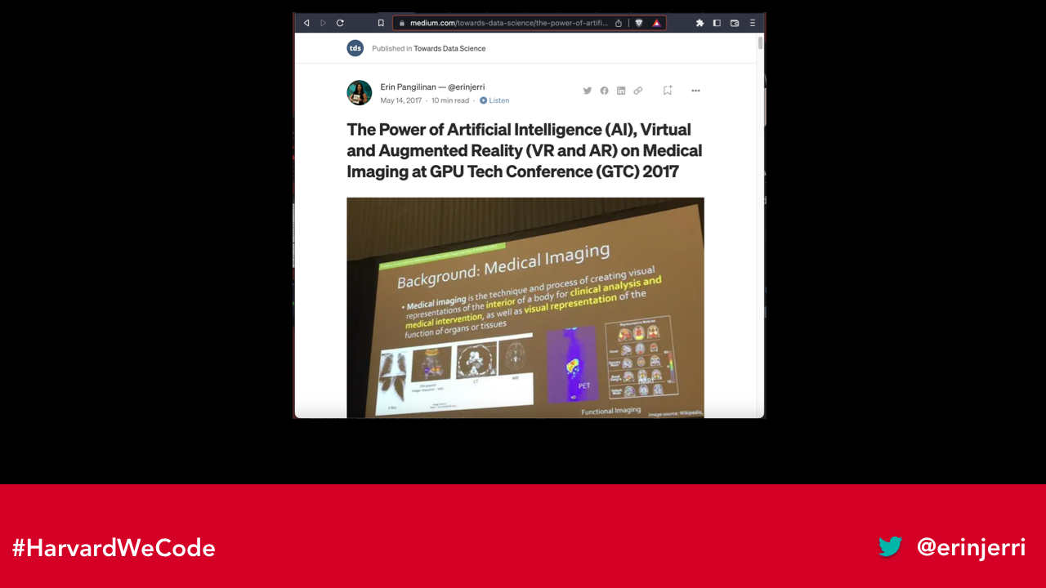
Writing on Medium in Towards Data Science Magazine
https://bit.ly/TowardsDS-GTC17

Slide 8
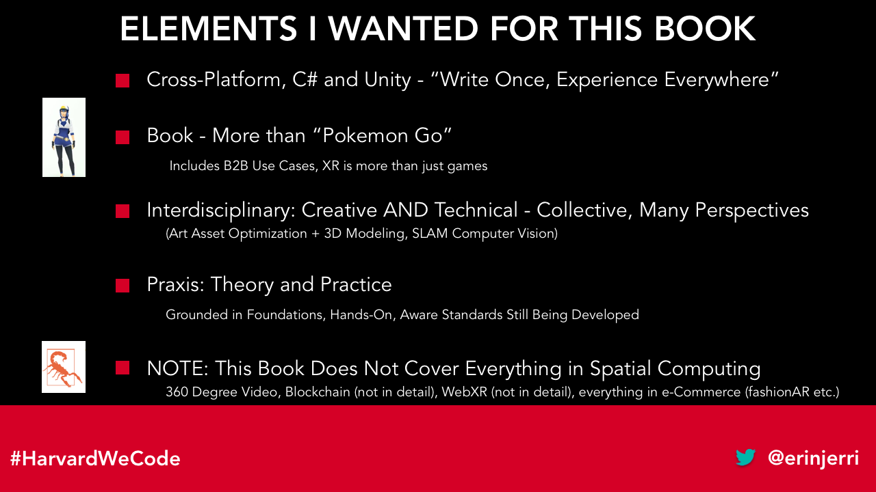

Slide 9
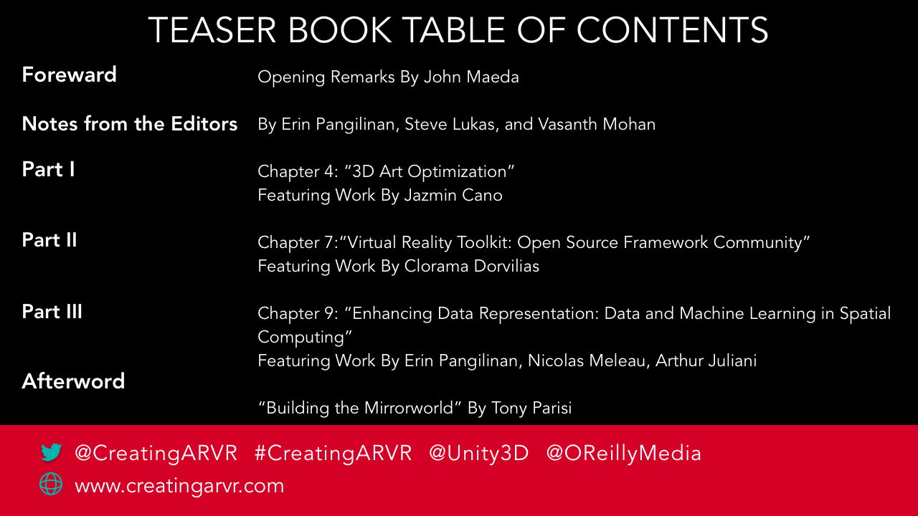

Slide 10
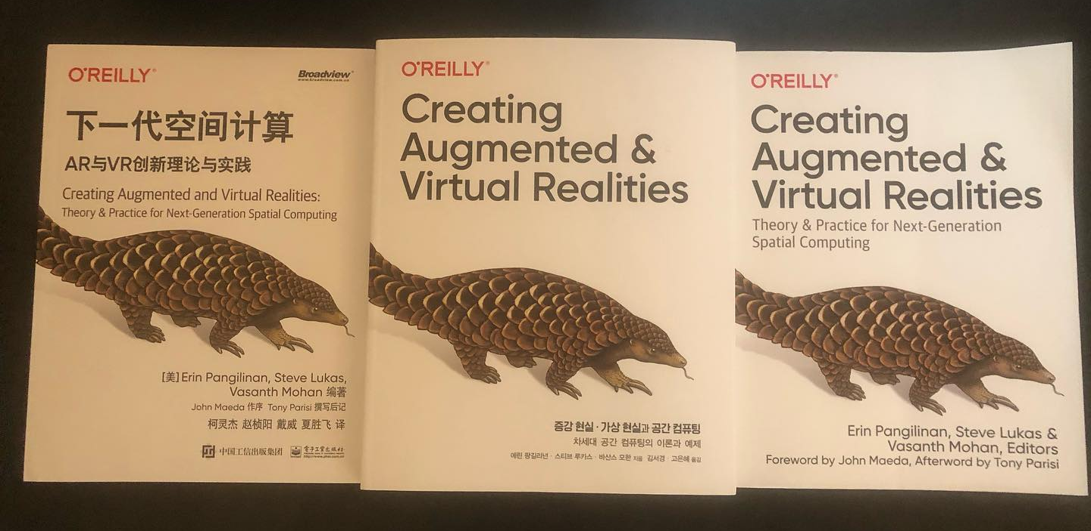

Slide 11
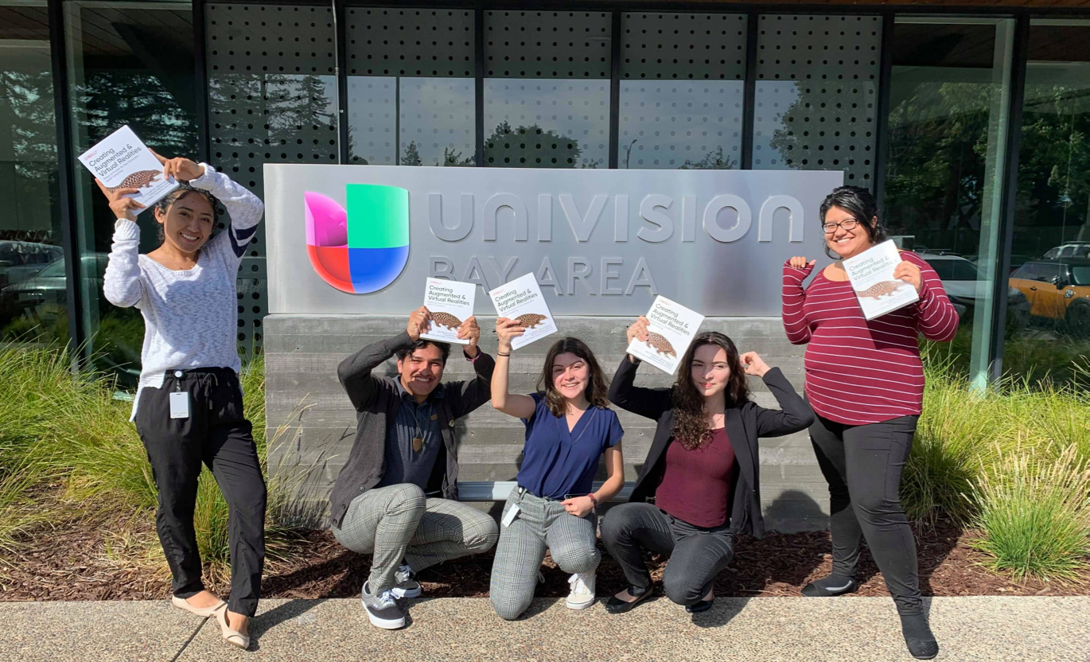

Slide 12

STORY OF SELF
1
STORY OF SELF
MY STORY

Slide 13


Silicon Valley born (in Santa Clara) and raised (in Fremont).
My Pilipinx/a/o/@ Heritage:
Mom is from Pampanga and Dad is from Manila.
WHO WHAT WHERE WHEN
2nd generation Pilipina American / Pinay and Asian American woman from the South Bay.
@erinjerri

Slide 14

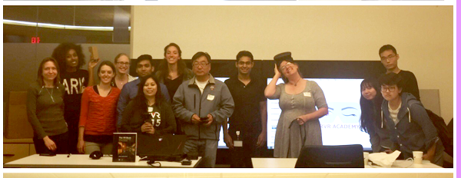

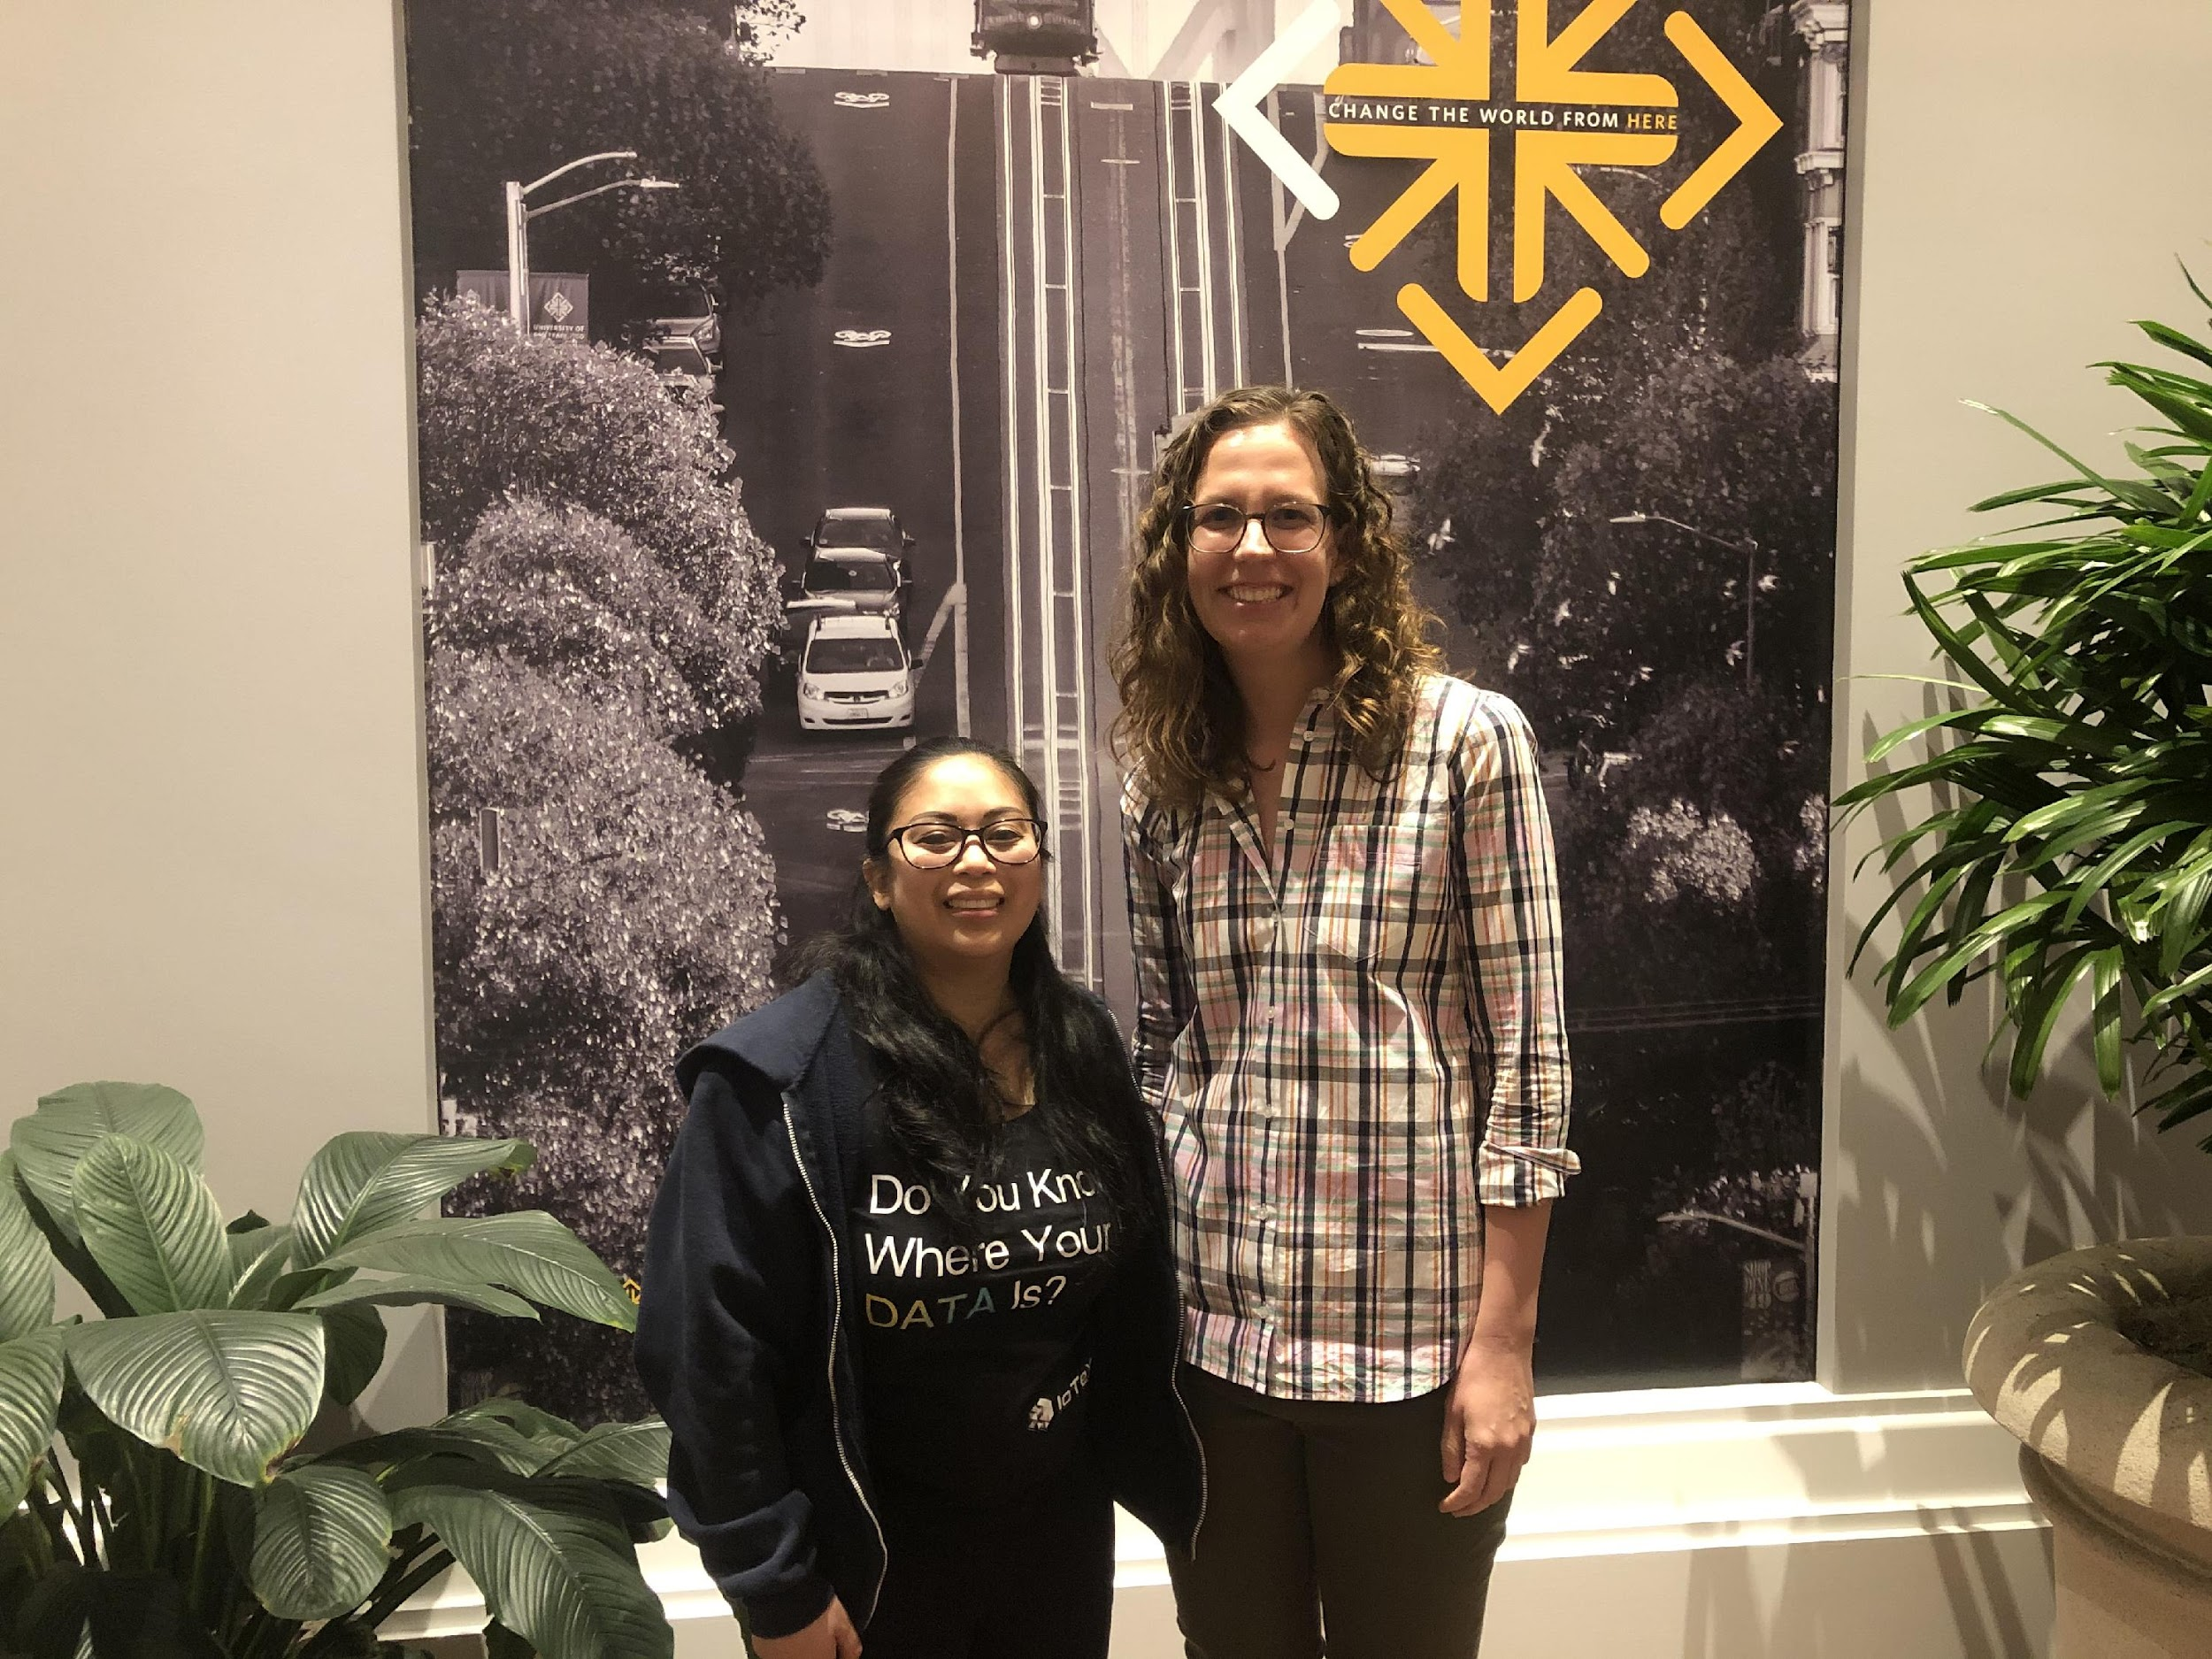
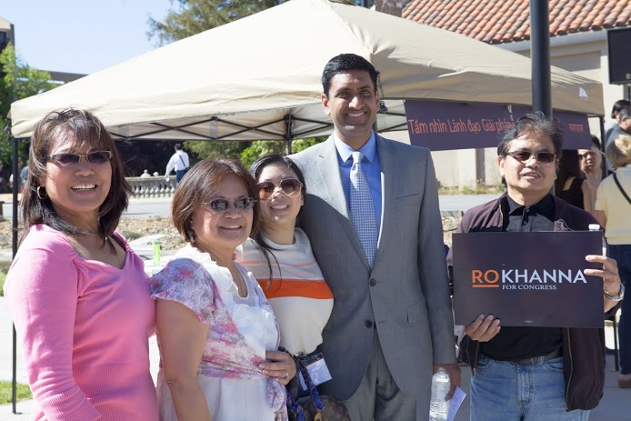
Campaigns/Civic Tech
2008
2012
2016
Hired as official campaign staff Obama for America,
Teaching AR VR at Cisco
through AR VR Academy
Campaigned through Obama for America and Filipinos For Obama 2008 as a UC Berkeley undergraduate student.
2013-2014
Hired as official electoral campaign staff for Ro Khanna for Congress Campaign
2017-2018, 2020, 2023
University of San Francisco Diversity Fellow - Deep Learning (2017-2018), Data Ethics (2020), Generative Art (2023)

Slide 15
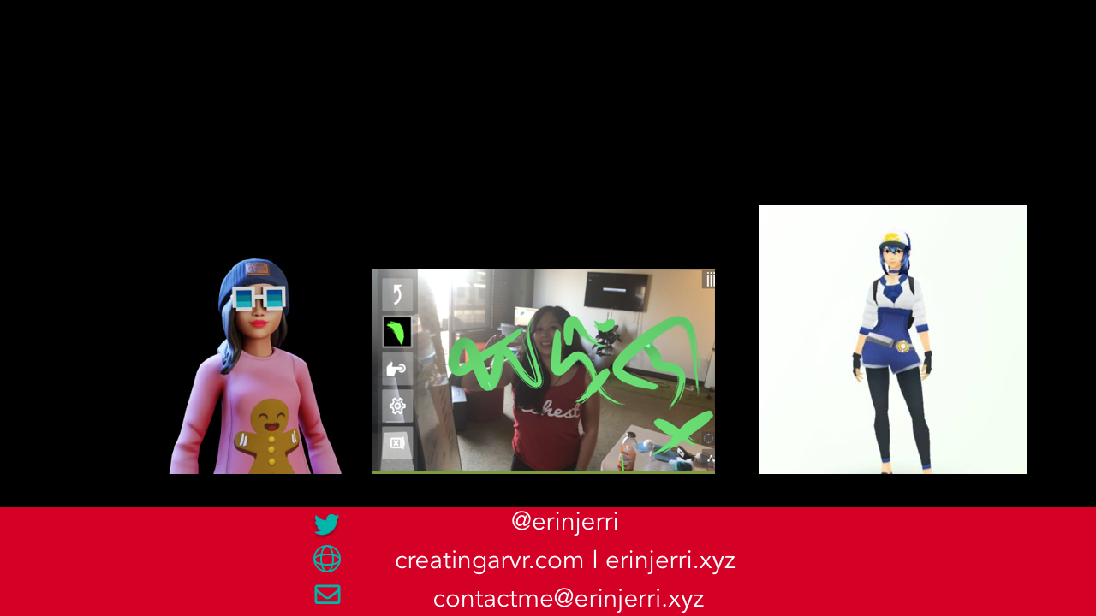
ABOUT ME
#TechIntersections
#HarvardWeCode
@erinjerri

Slide 16

#TechIntersections
#HarvardWeCode
@erinjerri

Slide 17
👩🏻‍💻
I write code and design experiences for 👾metaverse I 🎮games I web3💎I 🤖AI
📚
I write books
🎥 📺
I write scripts for TV/film

Slide 18


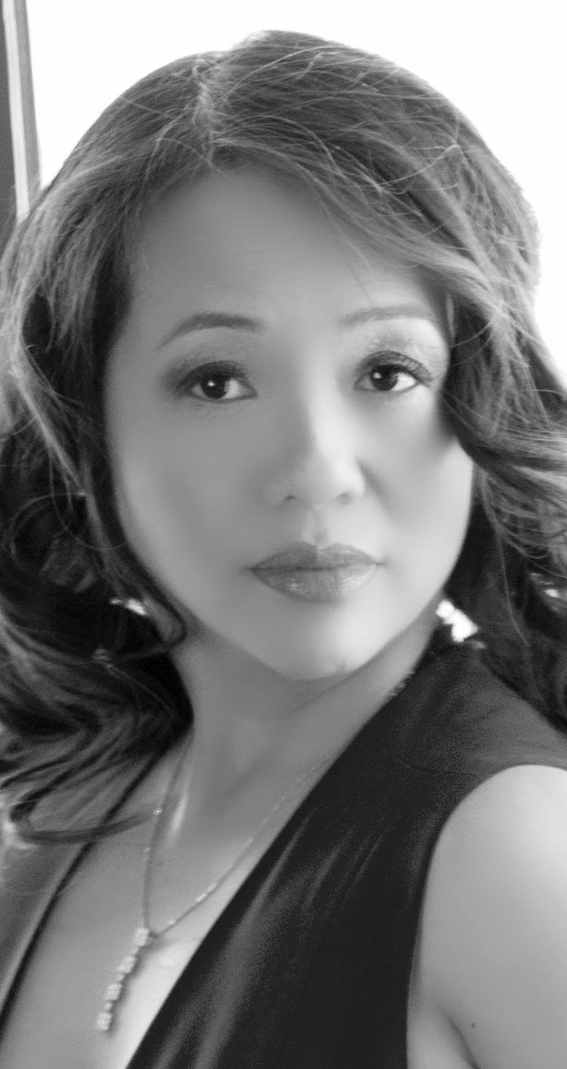







Team with extensive industry experience in television, film, the metaverses, and community organizing.
Ardees Rabang
Erin Pañgilinan
Co-Founder and Chief Production Officer
Co-Founder and Chief Technology Officer
@erinjerri

Slide 19
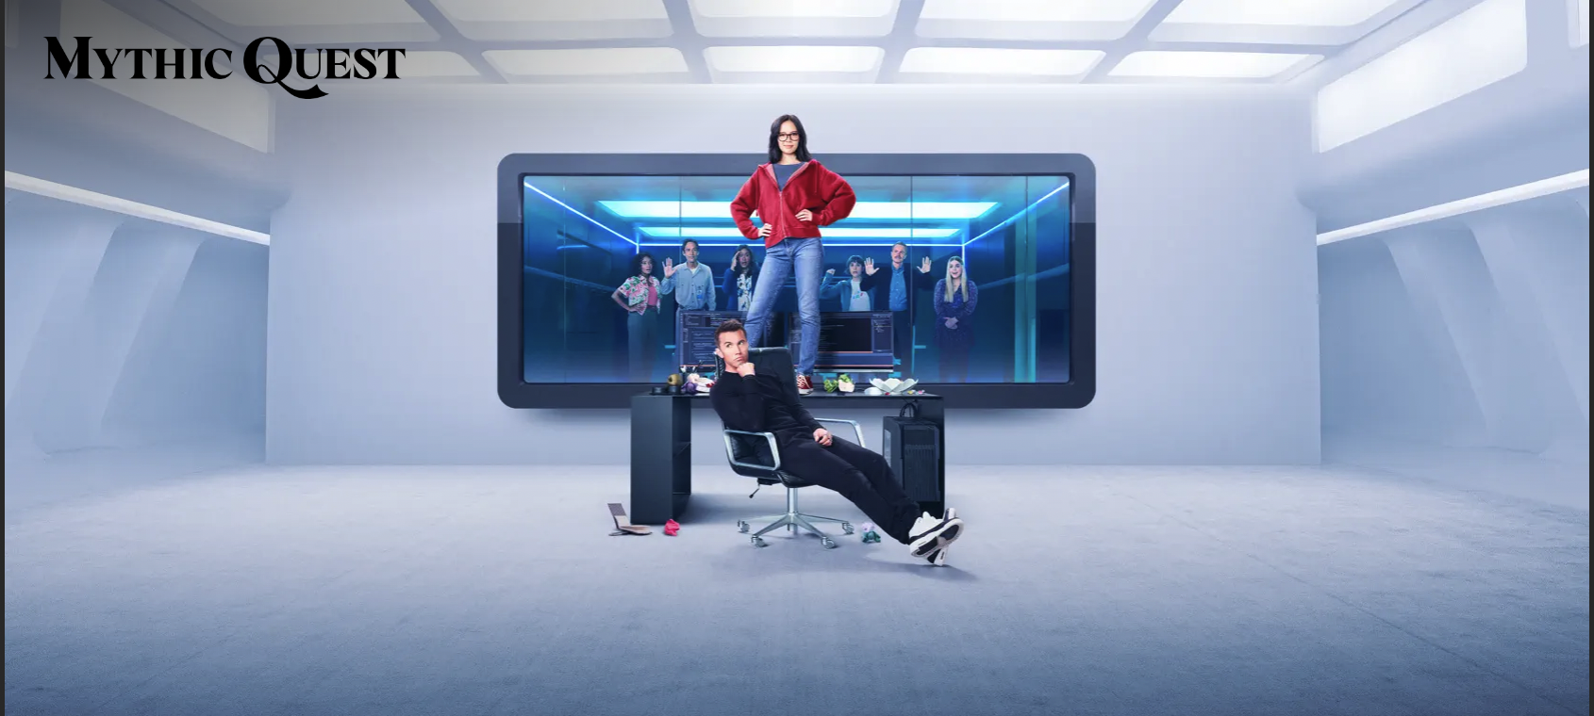
THE FANTASY
@erinjerri

Slide 20


When coding and designing, project management, screenwriting
THE REALITY
When coding and designing, project management, screenwriting
@erinjerri

Slide 21


FUTURE COMPUTING STACK
Experience layer
Automation layer
Ownership layer
#HarvardWeCode
@erinjerri

Slide 22
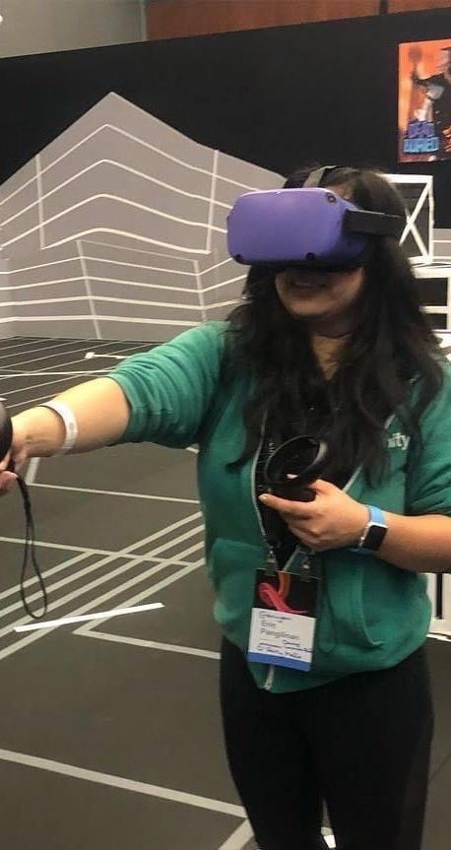
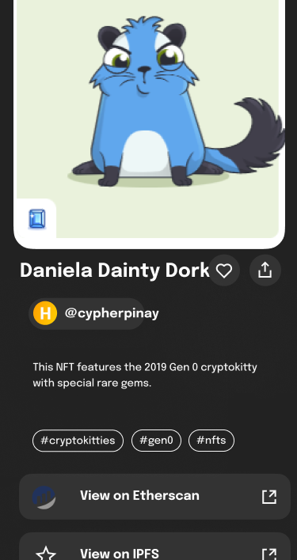
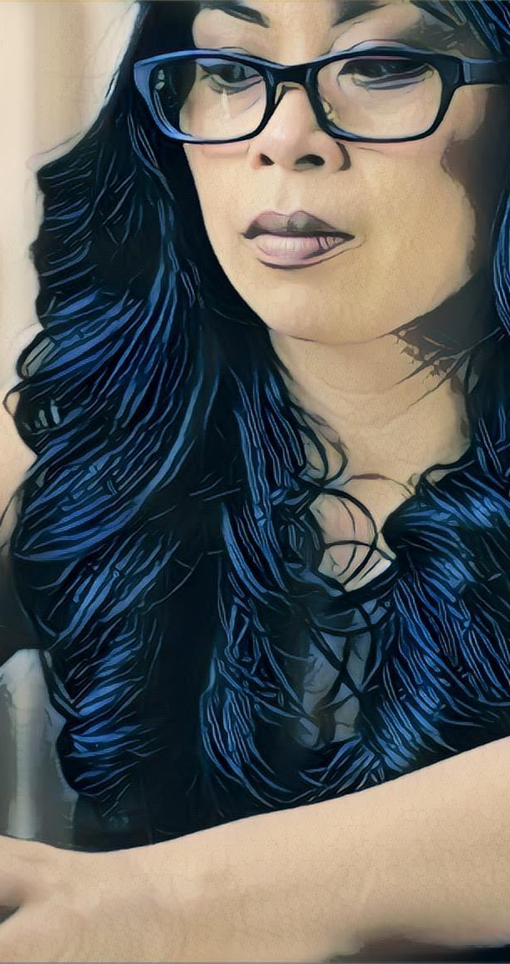
SOLUTION
Our Collective Solutions
Together, we create technology solutions to the challenges our society.
Metaverse
(Erin at OC5)
Web3
NFTs (Cryptokitties)
AI
(style transfer, GANs)
Embodied Reality
Shared Collective Ownership
Human Augmentation
#HarvardWeCode
@erinjerri

Slide 23
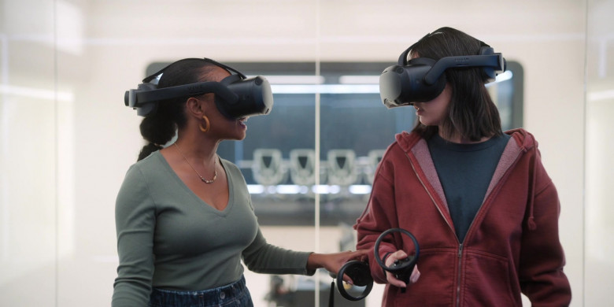
FICTIONAL METAVERSE
COVID19 DYSTOPIA?

Slide 24
TECHNOLOGISTS MAKING HXSTORY.
MOVEMENTS AND MOMENTS.

Slide 25
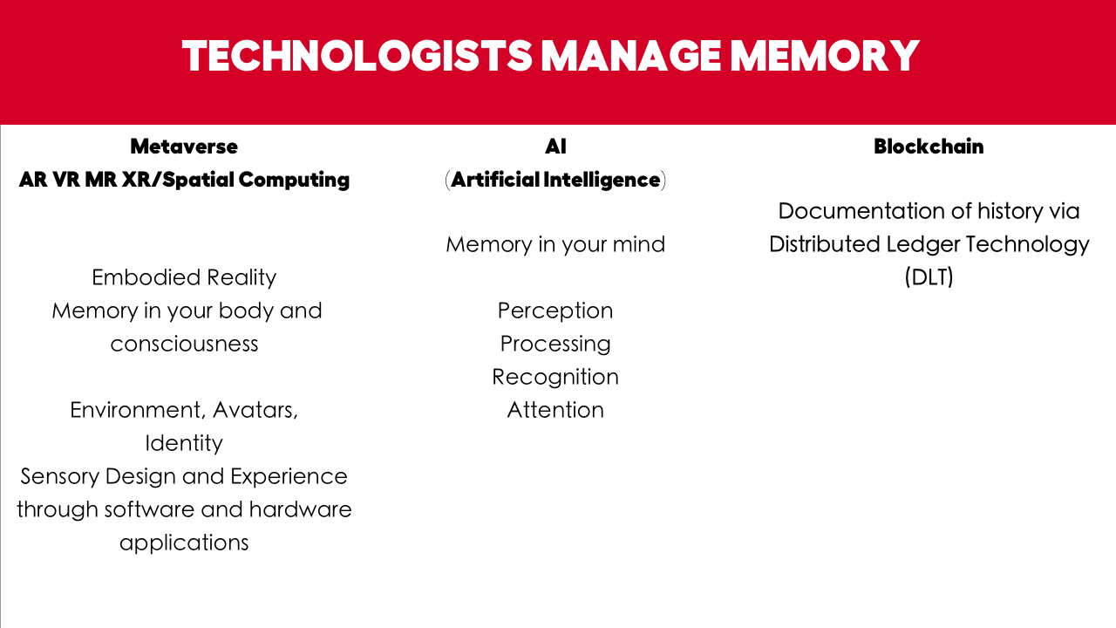
#HarvardWeCode
@erinjerri
Notes:
Anyone who told you differently, is lying to you, or has not lived this life or was probably rich and famous before it due to privilege, or years of long and grueling hard work and has forgotten where they come from and that this period of a pandemic has sucked like no other.

Slide 26
HXSTORY
Technology is a marker of various points in time and space, movements and moments.
How do we view our role in cultural preservation in content, in being on the “right” side of hxstory?
How do we create technology solutions to mark our story?
Notes:
Anyone who told you differently, is lying to you, or has not lived this life or was probably rich and famous before it due to privilege, or years of long and grueling hard work and has forgotten where they come from and that this period of a pandemic has sucked like no other.

Slide 27
UX Design with Humans In Mind
(from the beginning)
Design with virtual environments (ex. Tiltbrush, Gravity Sketch, Blocks)
Design for virtual environments…(affordances for the user)
Design of virtual environments… (the actual synthetic thing) – focuses on content creation
(Jason Jerald, the VR Book, 383)
Create/Engineer/Design/Develop technology businesses with people
Create/Engineer/Design/Develop technology businesses for people
Create/Engineer/Design/Develop technology businesses of people
Notes:
Anyone who told you differently, is lying to you, or has not lived this life or was probably rich and famous before it due to privilege, or years of long and grueling hard work and has forgotten where they come from and that this period of a pandemic has sucked like no other.

Slide 28
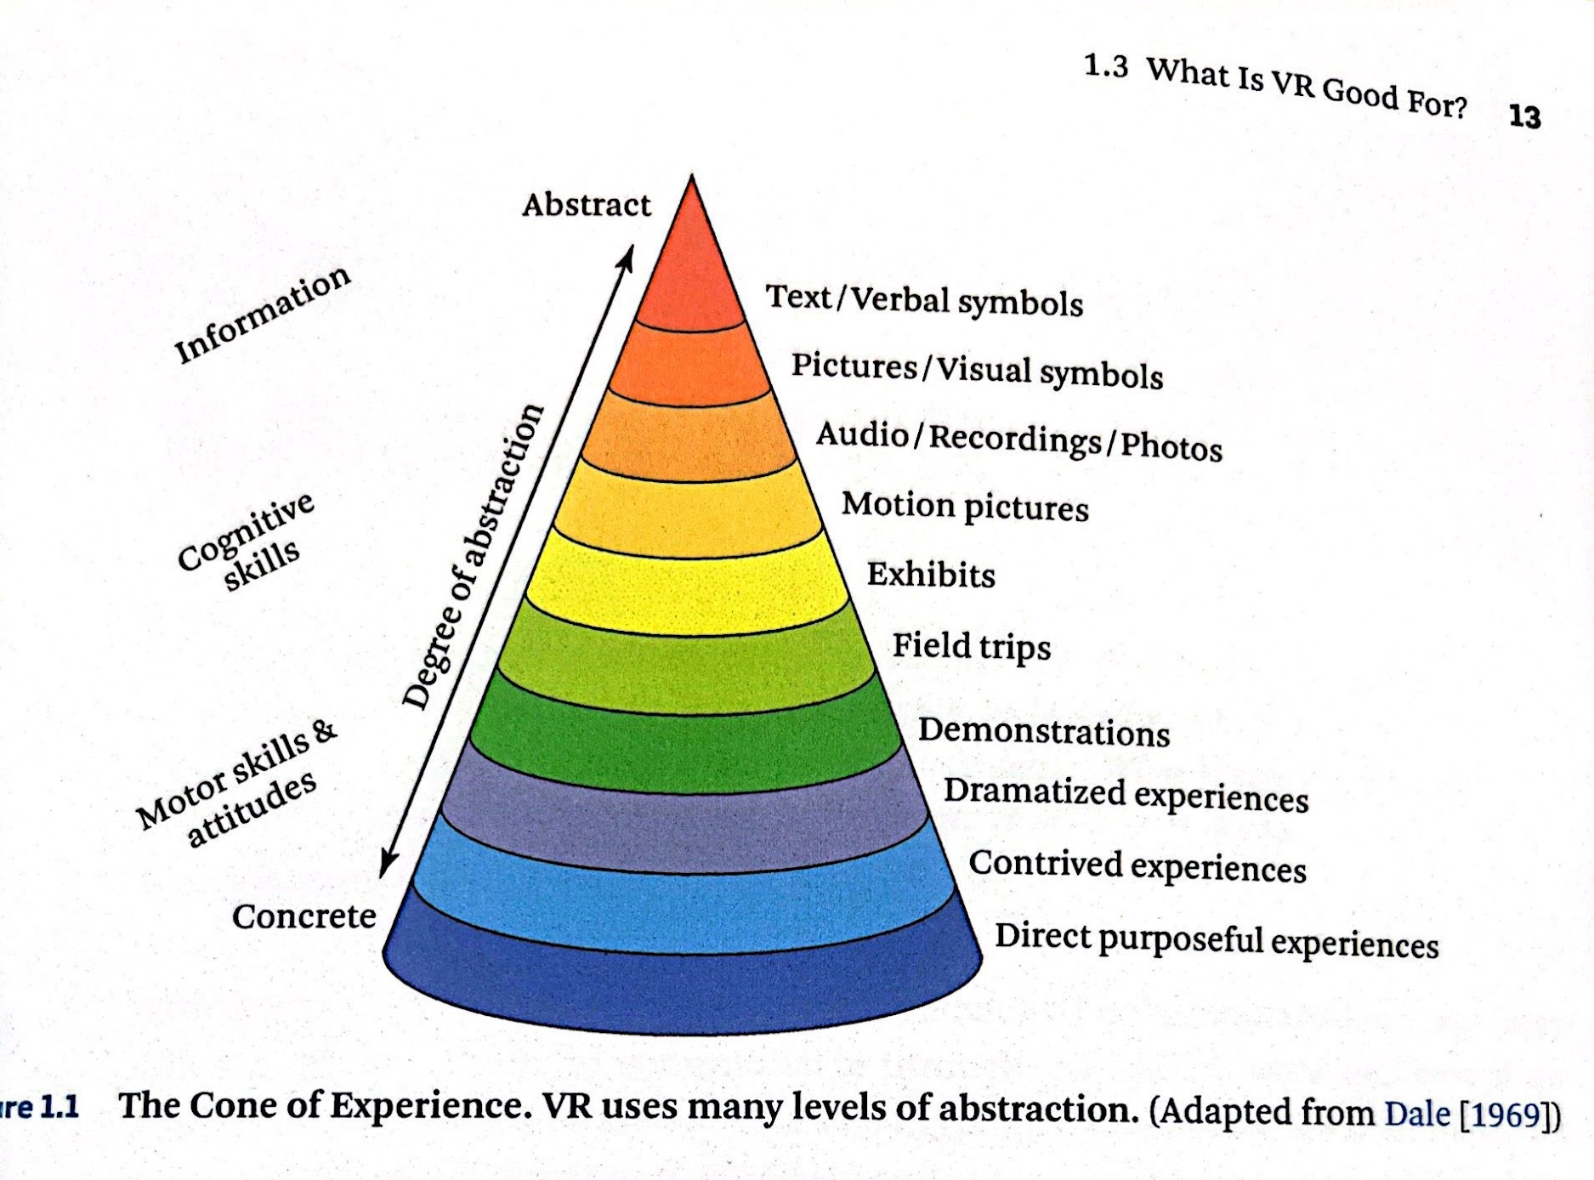
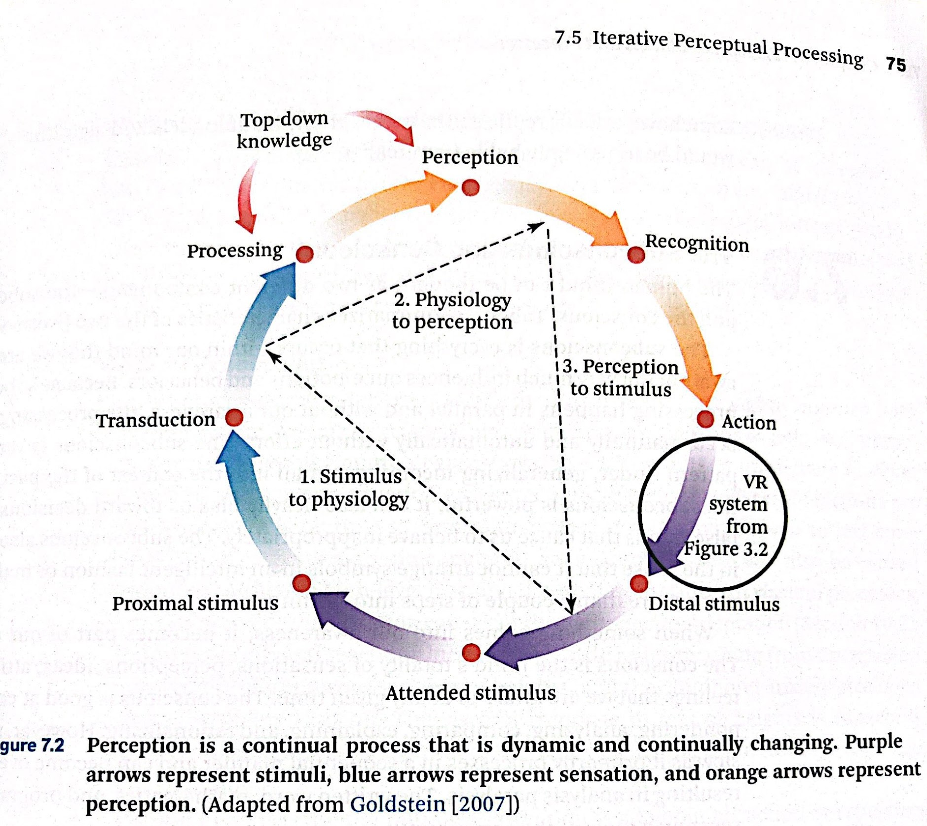
DEFINE YOUR STORY
CREATING MEMORY PERCEPTION
The Cone of Experience.
(Jason Jerald, the VR Book).
Notes:
Anyone who told you differently, is lying to you, or has not lived this life or was probably rich and famous before it due to privilege, or years of long and grueling hard work and has forgotten where they come from and that this period of a pandemic has sucked like no other.

Slide 29
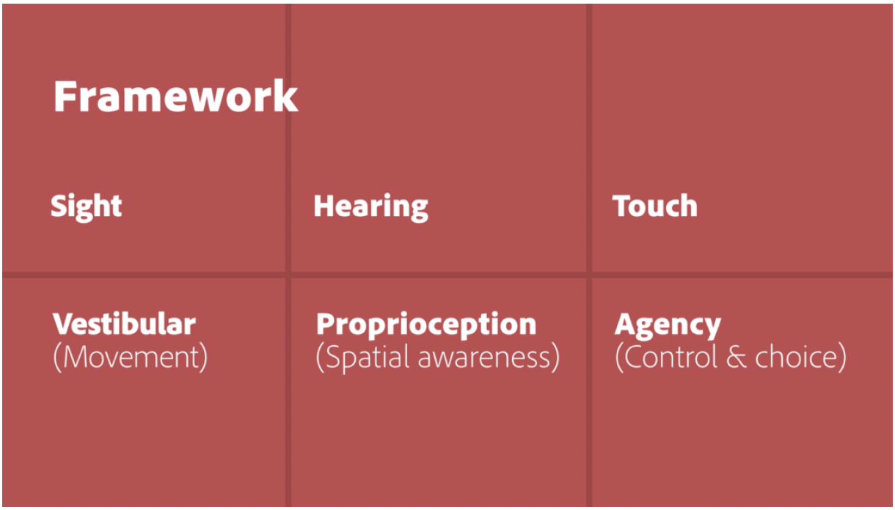
SENSORY DESIGN
Silka Sietsma, former Head of Emerging Design, Adobe
“ Designing for Our Senses, Not Our Devices.
Creating Augmented and Virtual Realities.
O’Reilly Media.
Pg 36. 2019.
Notes:
Anyone who told you differently, is lying to you, or has not lived this life or was probably rich and famous before it due to privilege, or years of long and grueling hard work and has forgotten where they come from and that this period of a pandemic has sucked like no other.

Slide 30
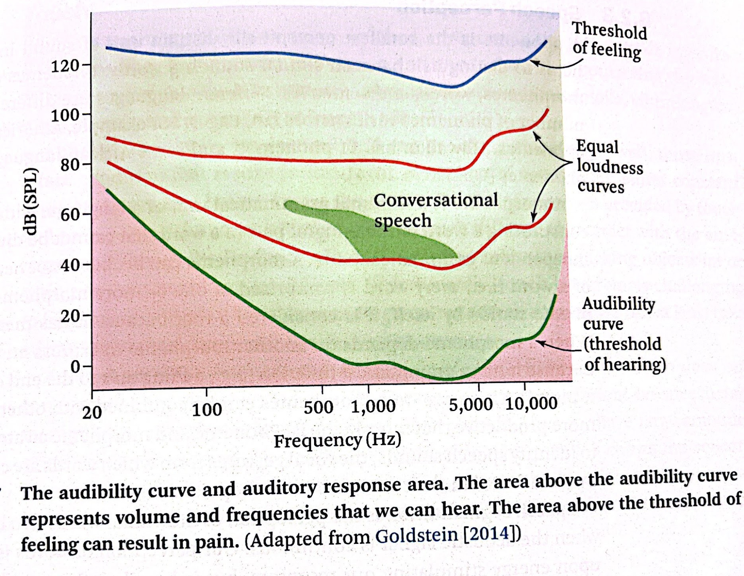
FEELING AND HEARING
Jason Jerald, The VR Book, Audibility Curve
Notes:
Anyone who told you differently, is lying to you, or has not lived this life or was probably rich and famous before it due to privilege, or years of long and grueling hard work and has forgotten where they come from and that this period of a pandemic has sucked like no other.

Slide 31
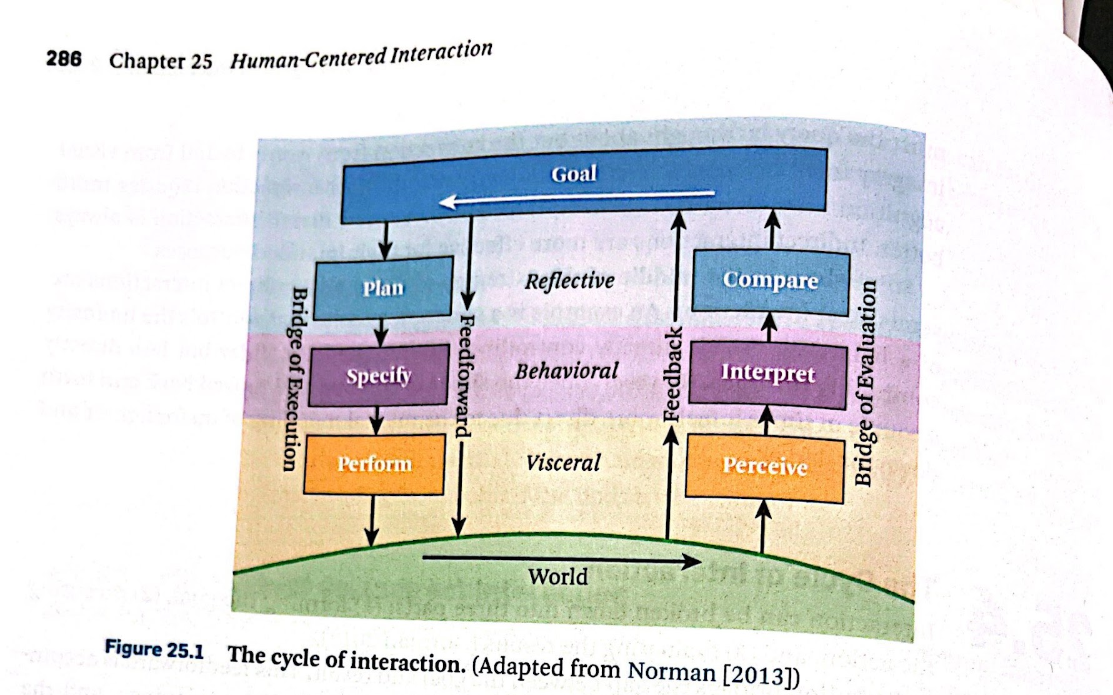
CYCLE OF INTERACTION
(Jason Jerald, the VR Book, Don Norman inspired graphic).
Notes:
Anyone who told you differently, is lying to you, or has not lived this life or was probably rich and famous before it due to privilege, or years of long and grueling hard work and has forgotten where they come from and that this period of a pandemic has sucked like no other.

Slide 32
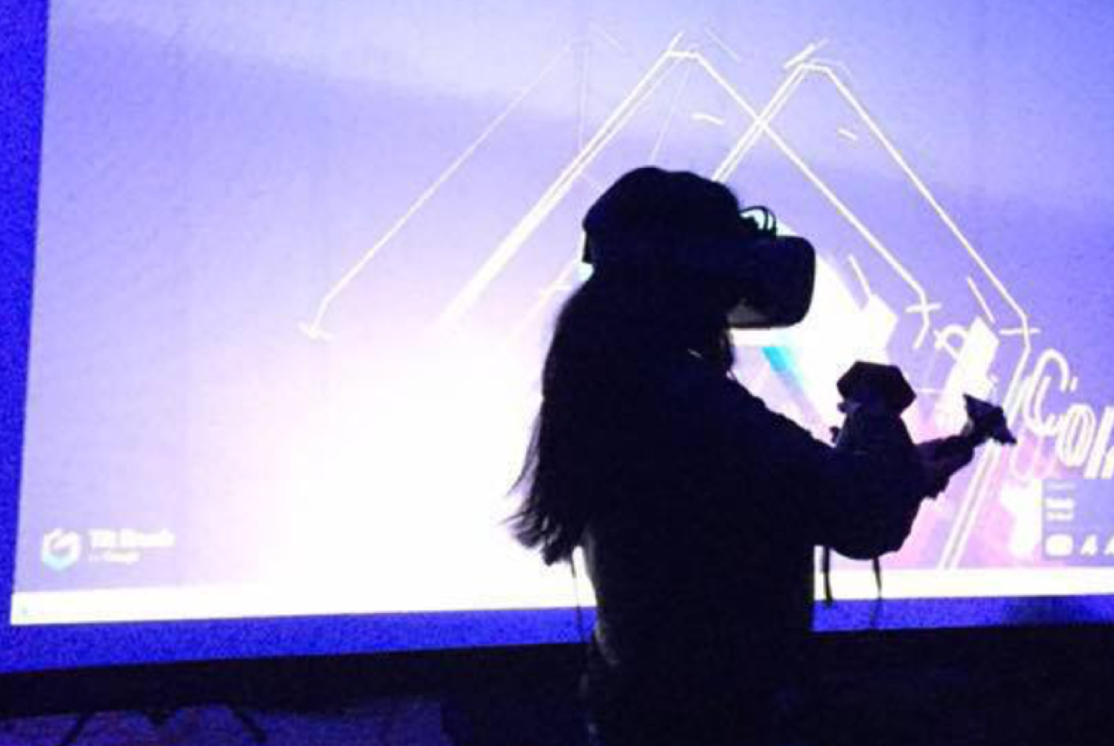
“
Enter the oasis
”
Ready Player One
#HarvardWeCode
@erinjerri

Slide 33
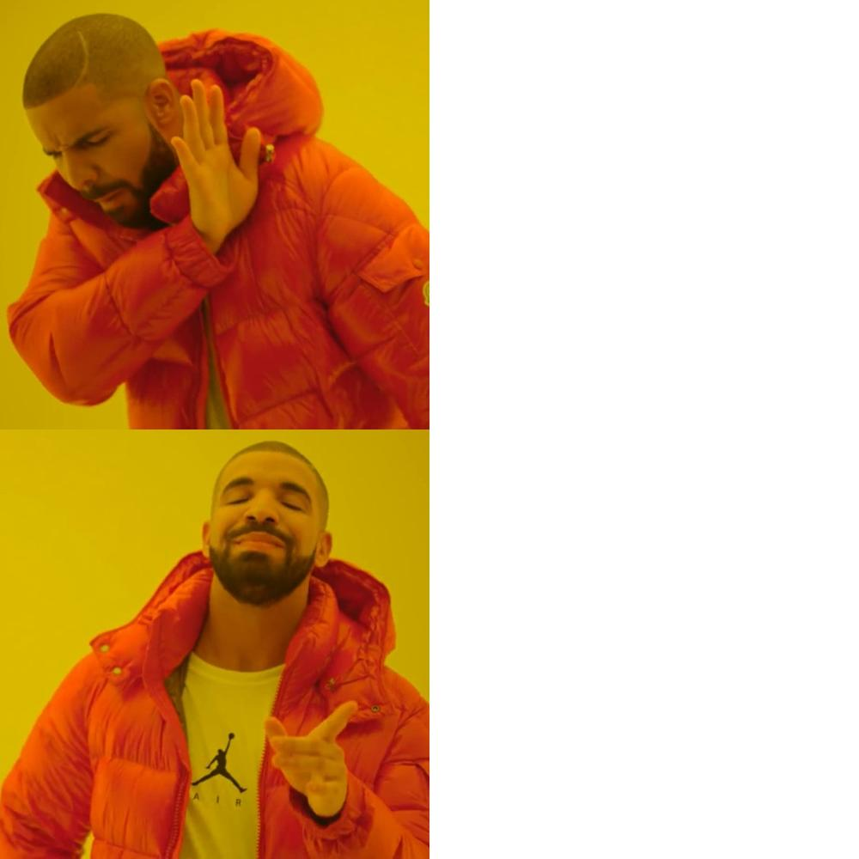
CHALLENGES
🔲 Ergonomics.
🔲 Affordability/Accessibility.
🔲 Dominant violent and oversexualized content.
METAVERSE
SOLUTIONS
✅ Improved Human Centered Design practices, more
inclusive UX testing,
✅ Price drops and rental programs.
✅ Holograms in public spaces.
✅ Culturally relevant content.
@erinjerri

Slide 34
CHALLENGES
🔲 Displacement from automation.
🔲 Lack of data governance and oversight, lack of accountability or ownership by subjects of datasets.
🔲 High level of inaccuracy.
AI
SOLUTIONS
✅ Creation of new jobs that work in collaboration with AI, human tasks will be more creative and less mundane.
✅ Data DAOs in web3.
✅ We are smarter than robots, AI will need humans
to improve.
@erinjerri

Slide 35
CHALLENGES
🔲 Bad actors like SBF and FTX, Terra, 3AC, Celsius.
🔲 Identity theft, hacking, stealing of money.
🔲 Silk Road.
WEB3
SOLUTIONS
✅ Defining securities law, enforcement,regulation
✅ Teaching privacy, cybersecurity best practices
✅ Collectively owned and run companies
✅ Regenerative creator economy
✅ Transparent hxstorical record
@erinjerri

Slide 36
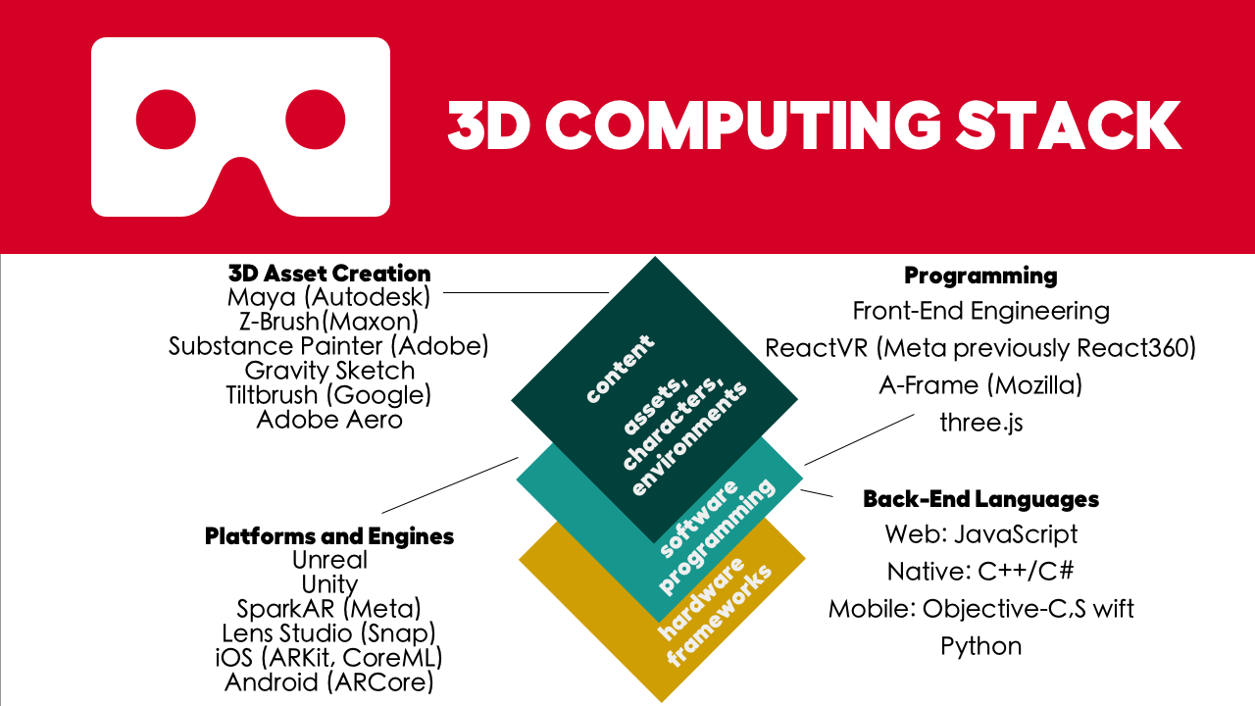
@erinjerri

Slide 37

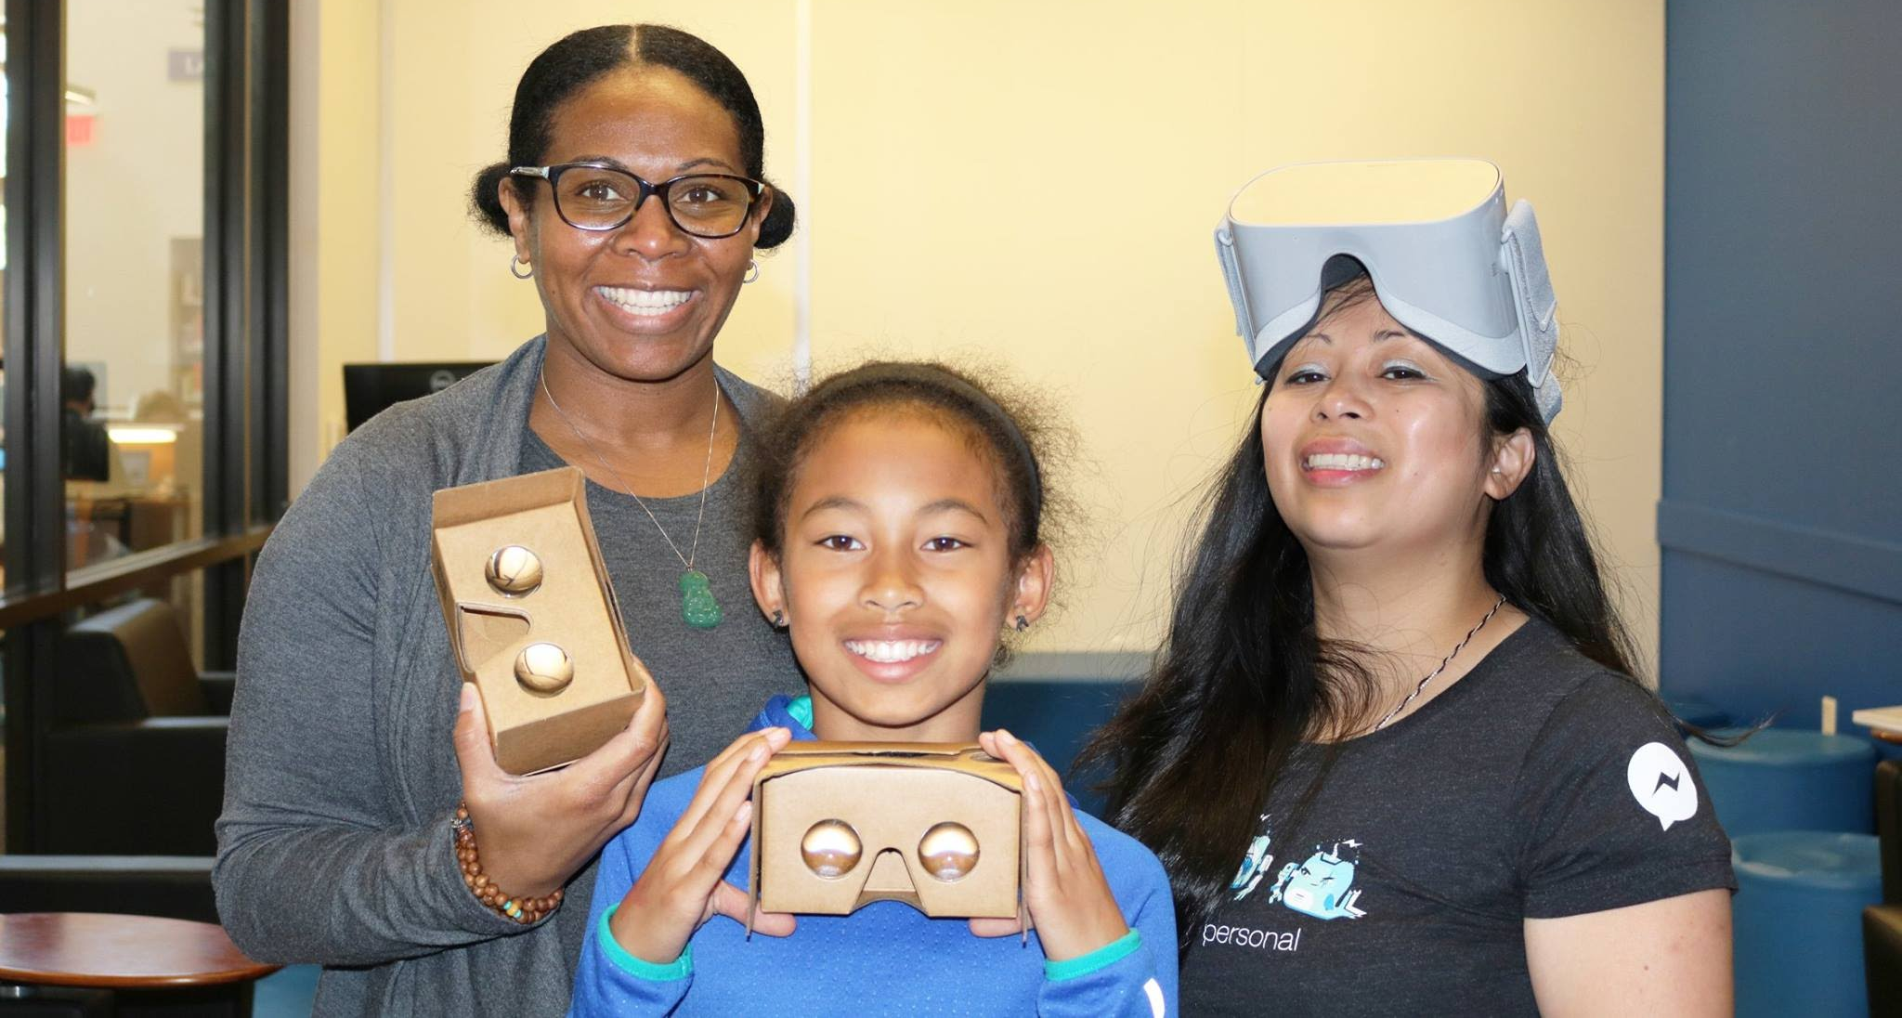
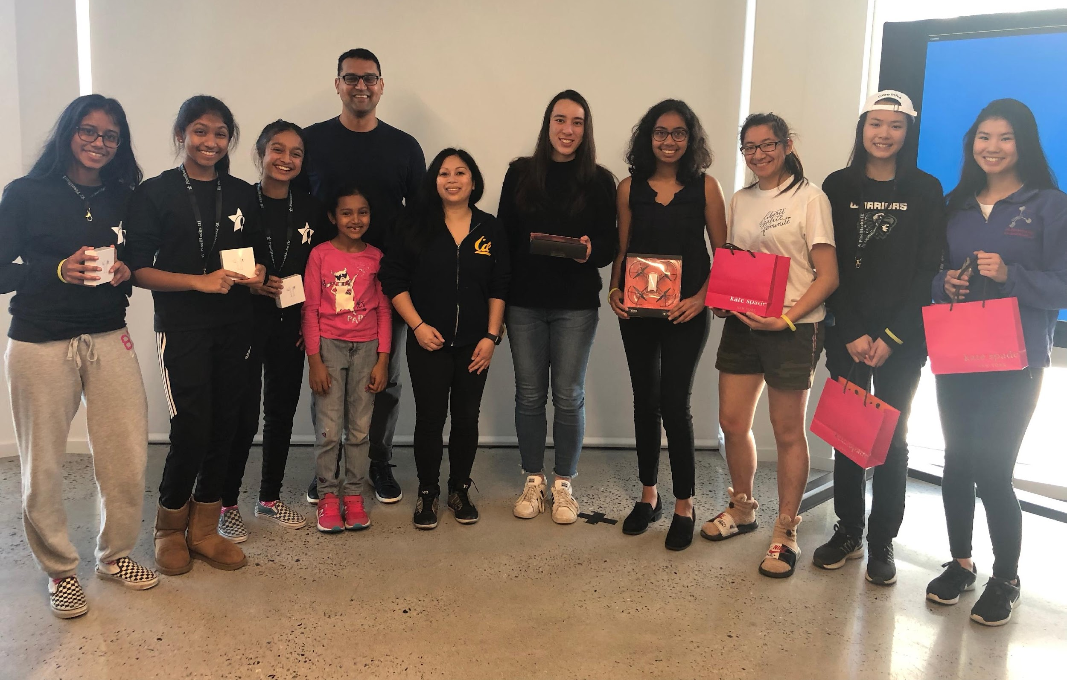
Teaching next generation spatial computing
Cisco 2016
Girls Who Code 2018
PixelHacks 2019
#HarvardWeCode
@erinjerri
Notes:
Anyone who told you differently, is lying to you, or has not lived this life or was probably rich and famous before it due to privilege, or years of long and grueling hard work and has forgotten where they come from and that this period of a pandemic has sucked like no other.

Slide 38
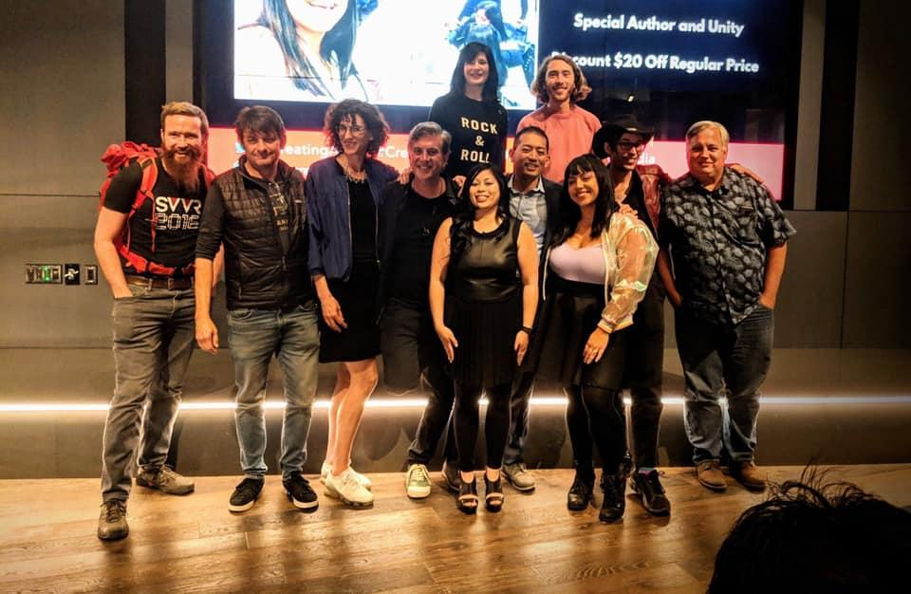
It takes a network state.
#HarvardWeCode
@erinjerri

Slide 39
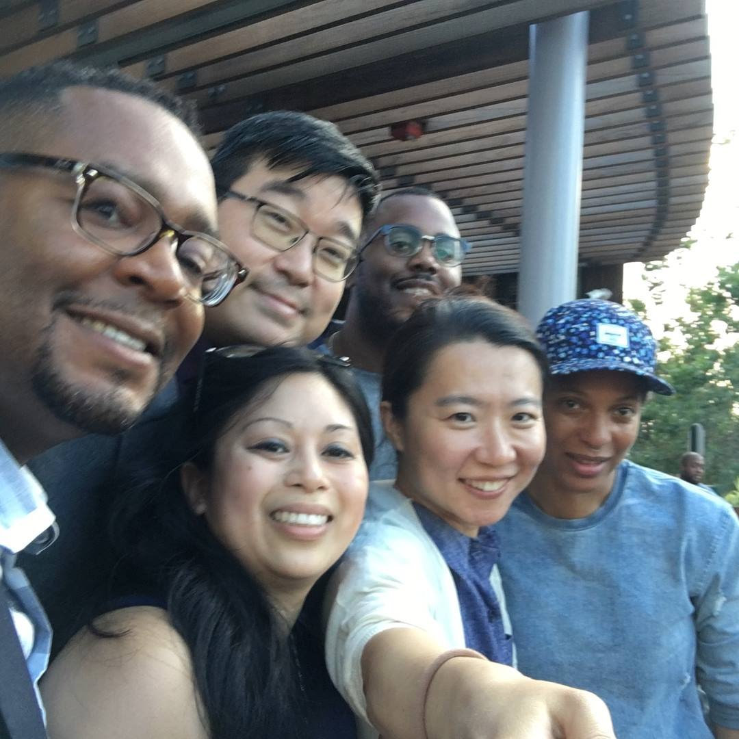
STORY OF NOW
@erinjerri

Slide 40

BREONNA’S GARDEN:
BREONNA TAYLOR
METAVERSE EXPERIENCE
By Breonna Taylor Family and Lady Pheonix
STORY OF NOW
#HarvardWeCode #SayHerName

Slide 41
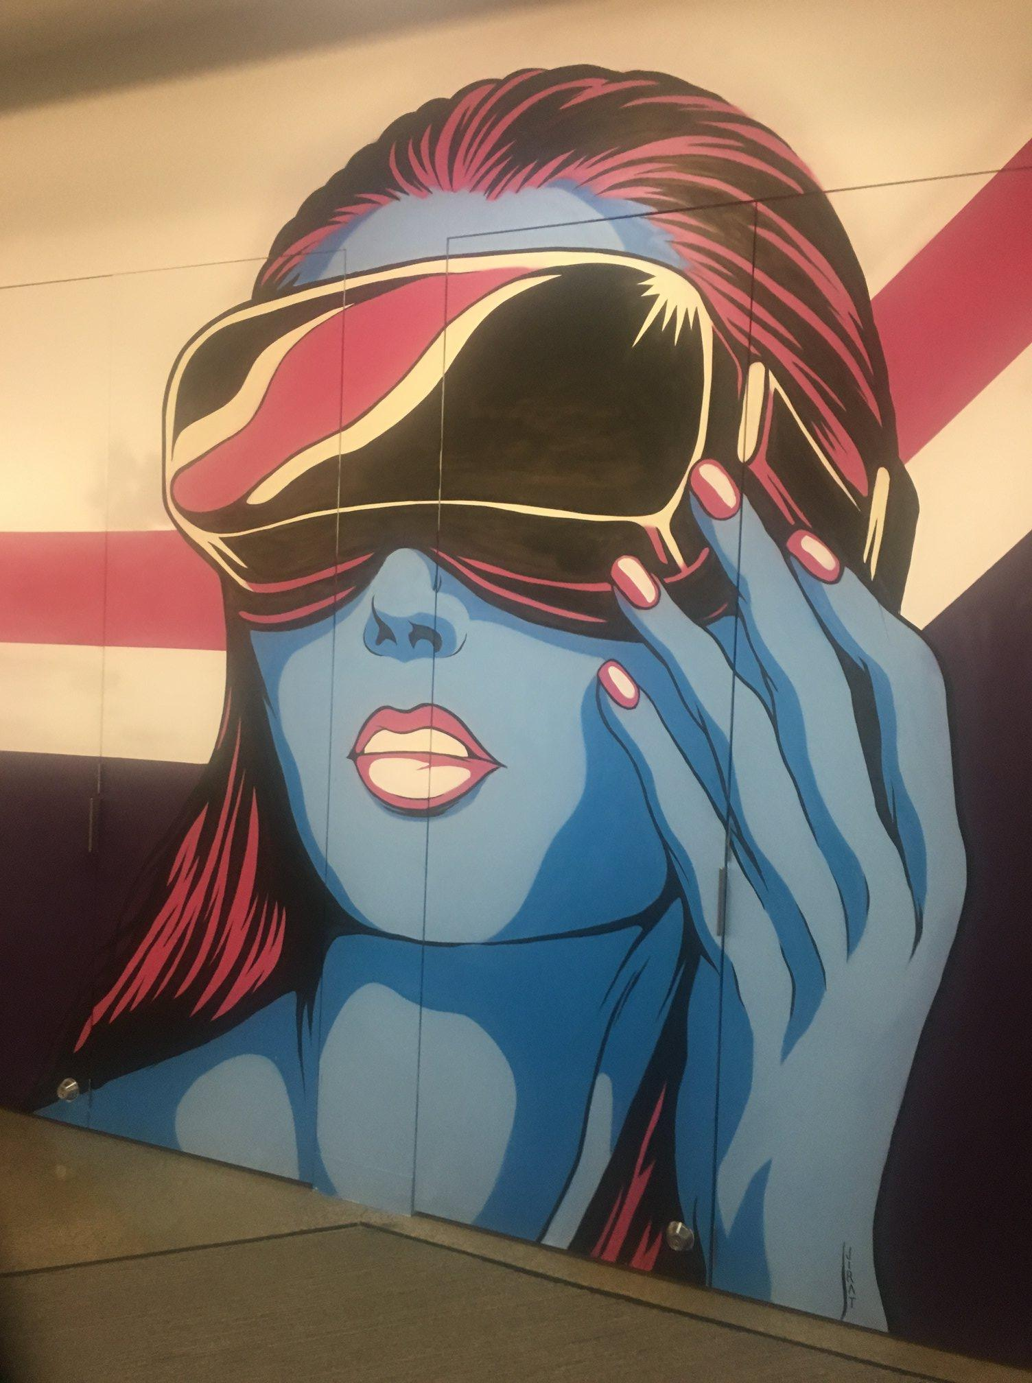
STORY OF NOW
3
STORY OF NOW
YOUR STORY
@erinjerri

Slide 42
IDENTIFY TO ACT
Identify to Act
✅ Cause / Passion / Purpose / Mission
✅ Create Solution
✅ Compose Expression
#HarvardWeCode
@erinjerri
Notes:
Anyone who told you differently, is lying to you, or has not lived this life or was probably rich and famous before it due to privilege, or years of long and grueling hard work and has forgotten where they come from and that this period of a pandemic has sucked like no other.

Slide 43
We are the new electricity.

Slide 44
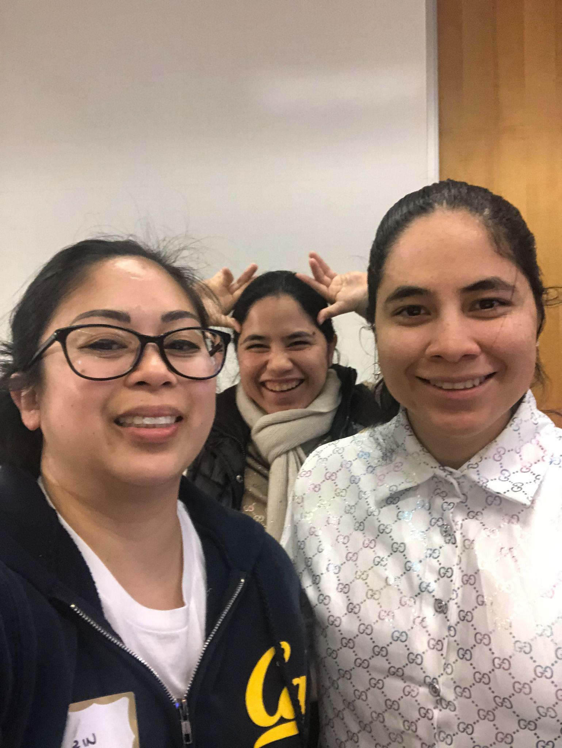
WACMI.
We All Can try and Make It.
All
Can Try
Make
It.

Slide 45
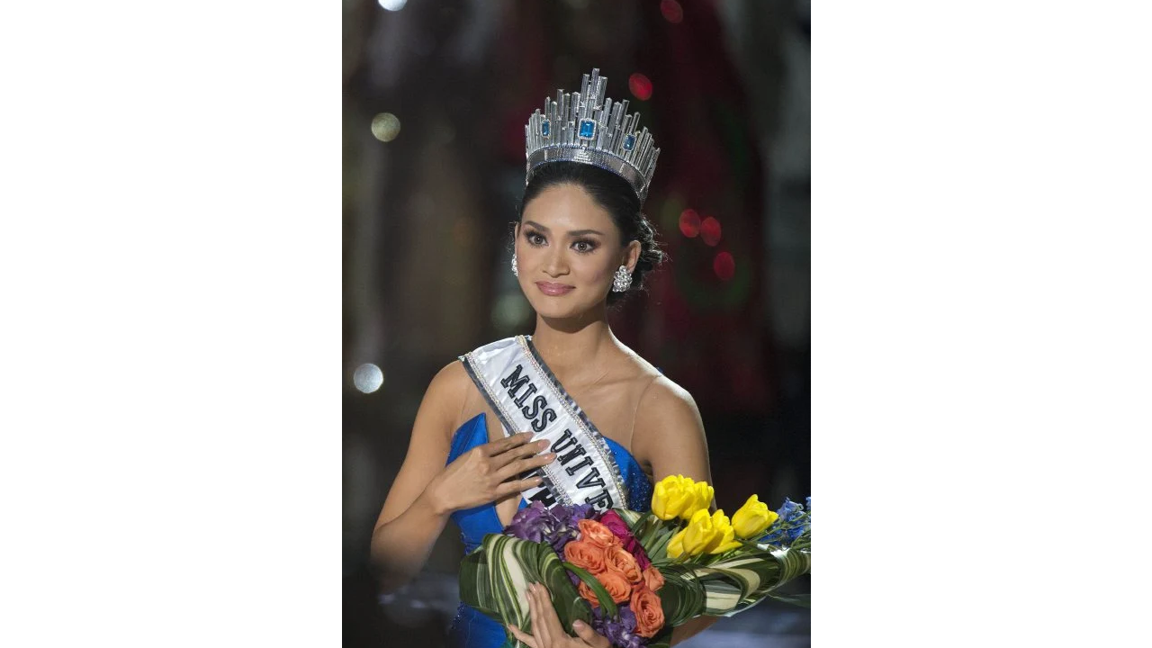

We can rule
over as queens
and princesses
of the universe.
THE FANTASY IS REAL.

Slide 46
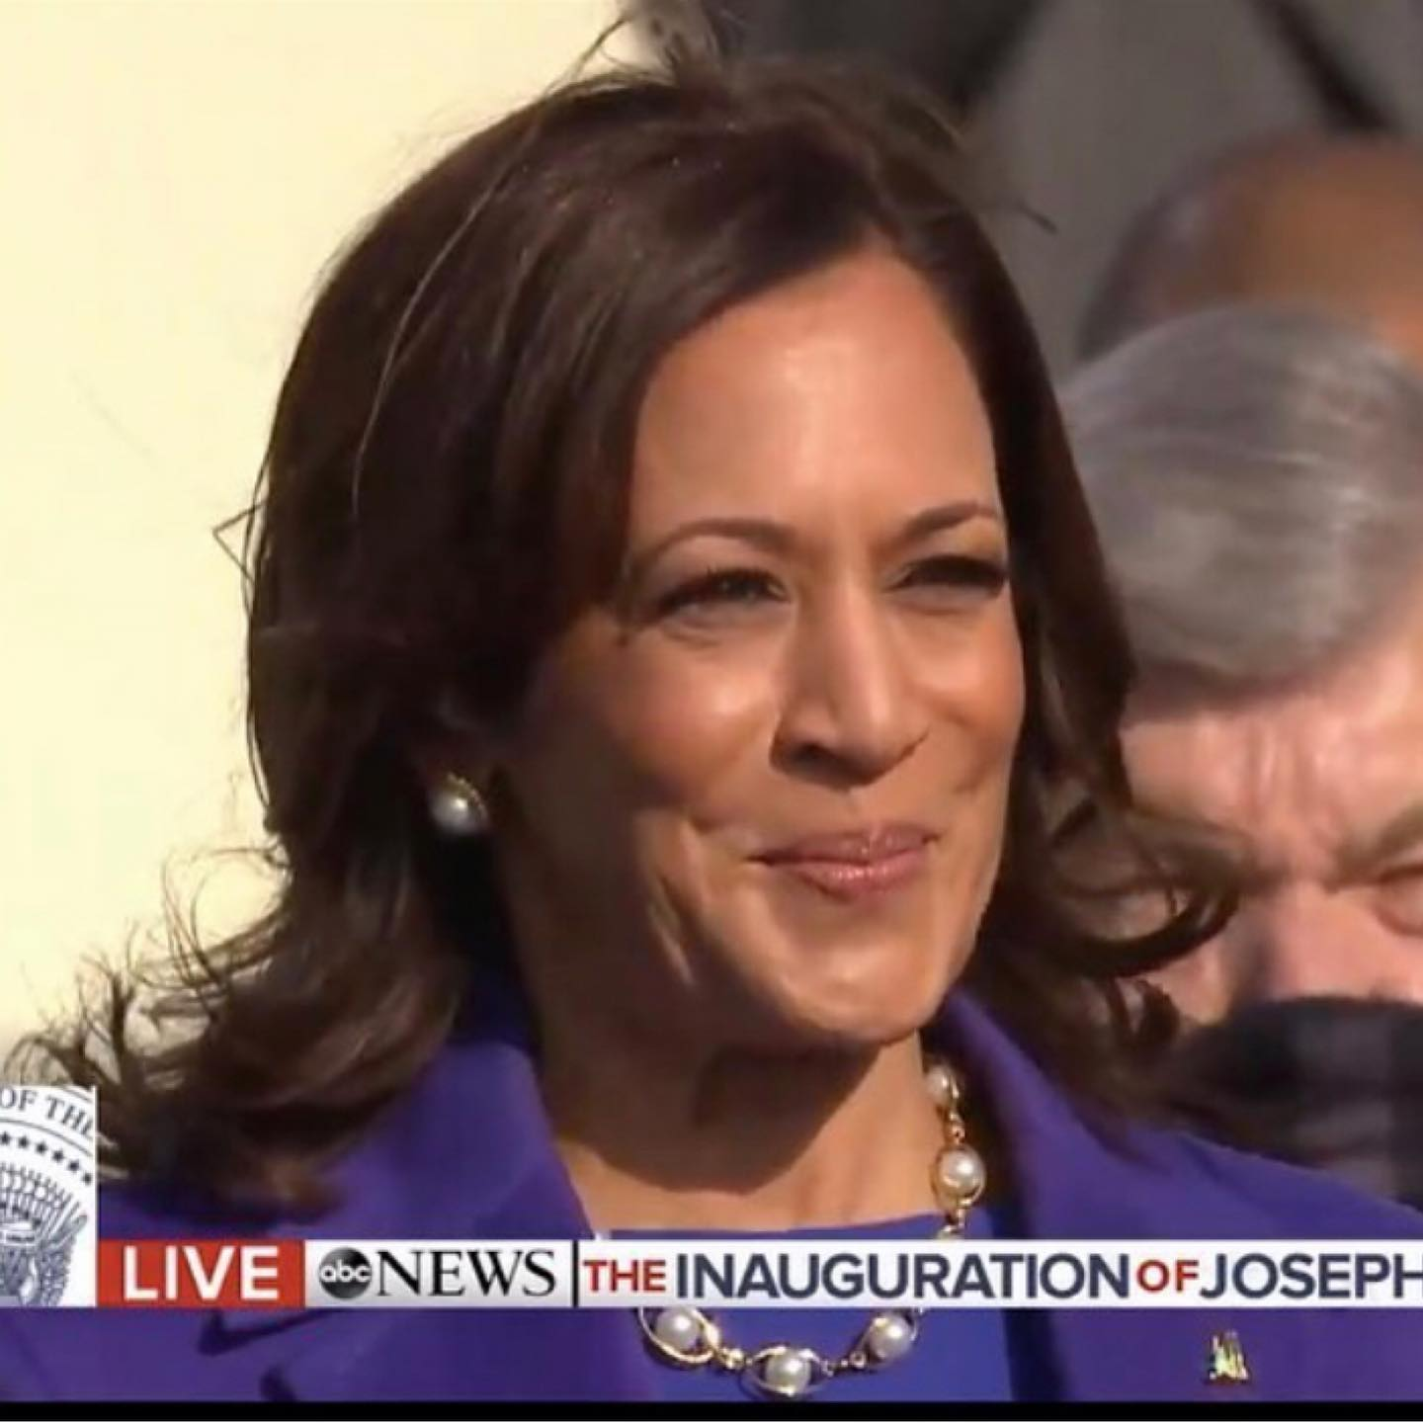
We can lead
the country.
THE REALITY IS BETTER.

Slide 47

We can build
and lead
the metaverse
grounded in reality.
THE REALITY IS BETTER.
@erinjerri

Slide 48


Slide 49
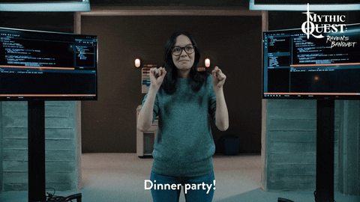
Salamat. Thank you.

Slide 50


Hi, I’m Jazmin Cano!
Accessibility Product Manager
AR/VR Panel at WeCode 2023
18 February 2023
Notes:
Game studio: some of our games include
Job Simulator,
Rick & Morty Virtual Rick:ality
Vacation Simulator
Cosmonious High

Slide 51


For the next few mins, I’ll cover:
1. What I do
2. How I got here
3. What I’m doing now
Owlchemy Labs // AR/VR Panel at WeCode 2023

Slide 52
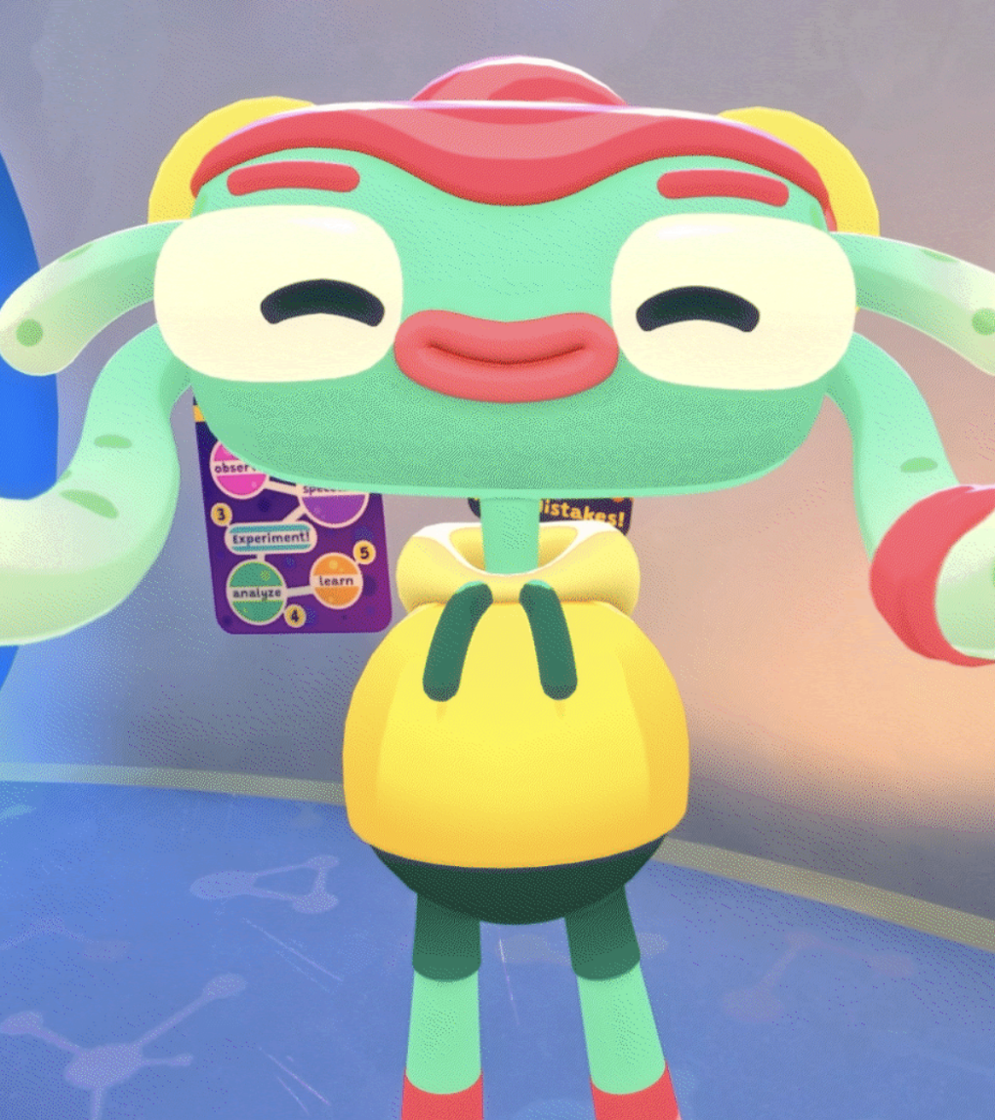

What I do:
Accessibility - The quality of being easily reached, entered, or used by people with disabilities.
I ensure accessibility features are researched and prioritized so players with disabilities aren’t excluded from our games.
At Owlchemy Labs, we make
VR for everyone!
Owlchemy Labs // AR/VR Panel at WeCode 2023
Notes:
Ask! Who here is familiar with what Accessibility means? (Raise your hand or nod your head)
(define)
Research: Industry News (A11y, VR, games)
Collaborate w/ engineers, QA, Art, and Marketing.
Keeping the projects on track. I’m currently on 3 teams while owning 2.

Slide 53
How I got here:
2015
School, Discovr Labs, Games Company, other startups,
Hackathons!
2016
High Fidelity
3D art, Marketing
Hackathons!
Owlchemy Labs // AR/VR Panel at WeCode 2023
Notes:
2015 - I graduated with a BoS in Game Art. Doing environment modeling.
Last few months of college, I joined a startup! Discovr - Mission: Provide learning experience for kids who had long stays at the hospital.
2016 - HF social vr platform where hundreds of people could be in VR together at the same time. Here, people could be any avatar they wanted, build any world they wanted, and develop whatever experience they’d like.

Slide 54
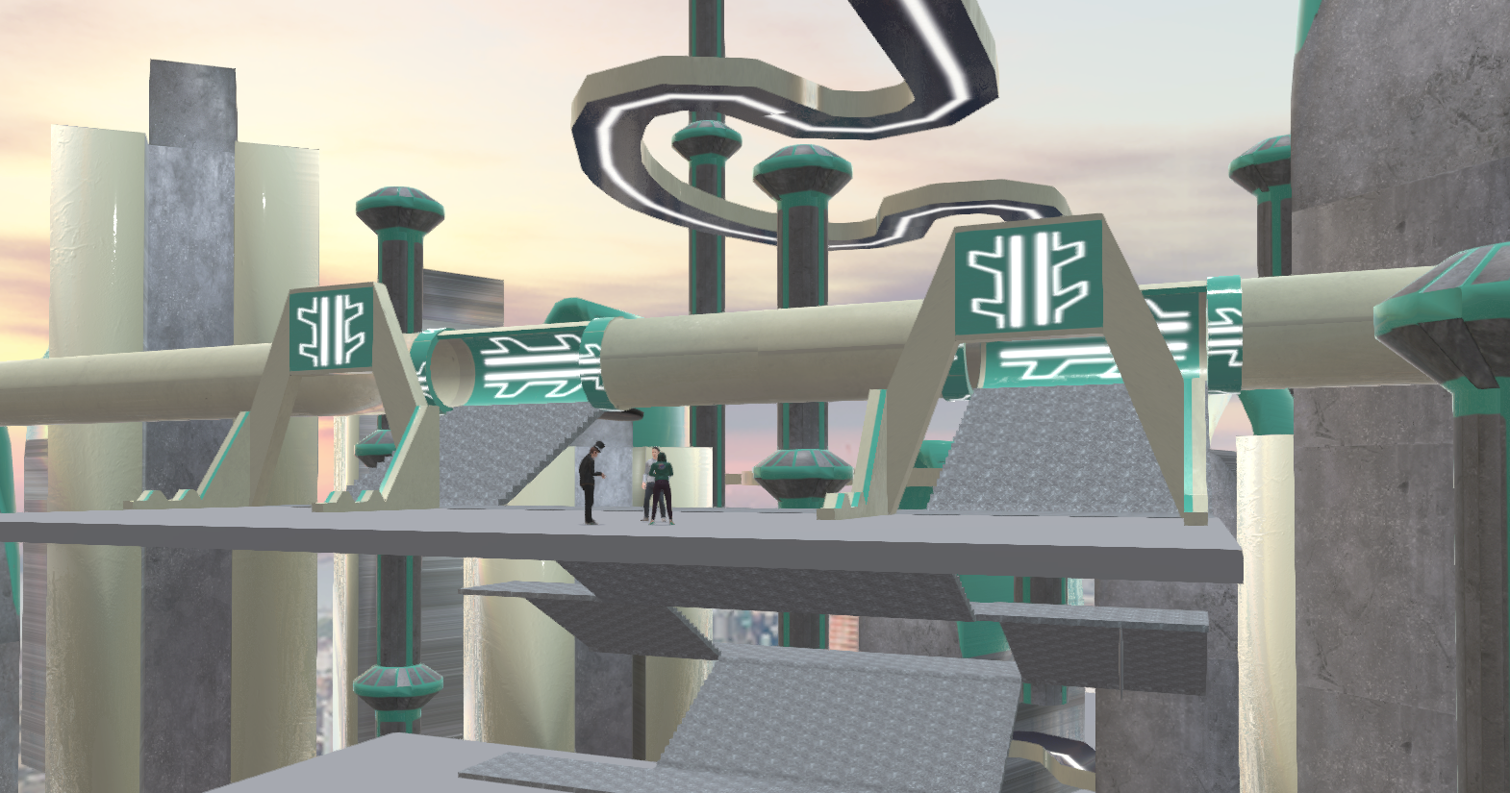
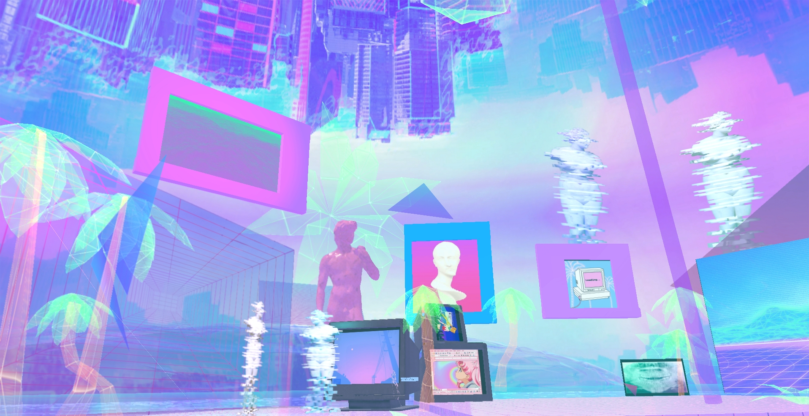
Owlchemy Labs // AR/VR Panel at WeCode 2023

Slide 55
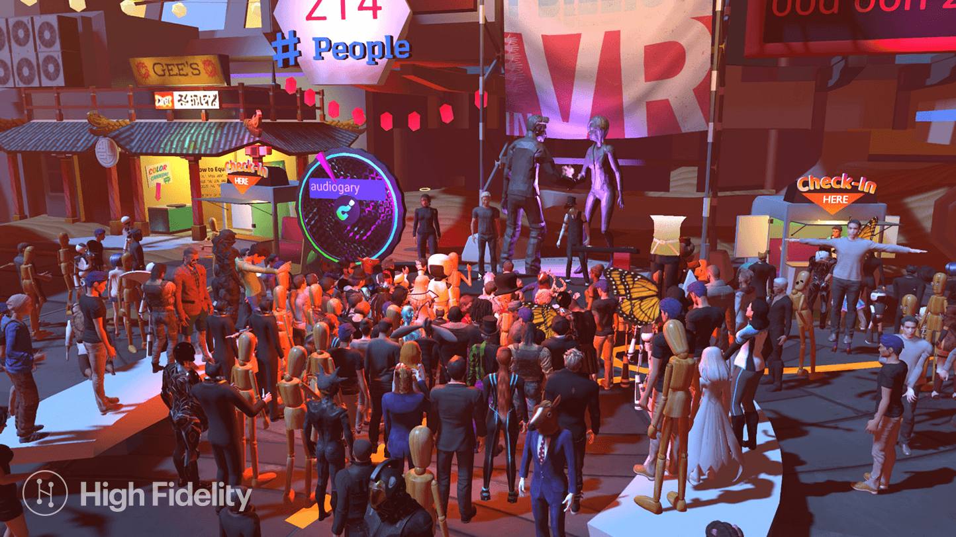
Owlchemy Labs // AR/VR Panel at WeCode 2023

Slide 56
How I got here:
2015
School, Discovr Labs, Games Company, other startups,
Hackathons!
2020
HF, Accessibility Product Manager
2016
High Fidelity
3D art, Marketing
Hackathons!
Owlchemy Labs // AR/VR Panel at WeCode 2023
Notes:
Later on, I tried a new role where I focused on the users. Biggest lesson learned: No matter how cool a product is, High barriers of entry will block most people from using it.
2020- Focus moved to: A11y where I learned how to make virtual worlds more accessible to people with disabilities, especially people who are blind.

Slide 57
How I got here:
2015
School, Discovr Labs, Games Company, other startups,
Hackathons!
2020
HF, Accessibility Product Manager
2016
High Fidelity
3D art, Marketing
Hackathons!
2022
Owlchemy Labs!
Accessibility Update for Cosmonious High
Owlchemy Labs // AR/VR Panel at WeCode 2023
Notes:
2022- I leave High Fidelity and join Owlchemy! Owlchemy is an amazing team that is very well known in the industry for making accessible VR Games so I’m so excited I get to be with them today.

Slide 58
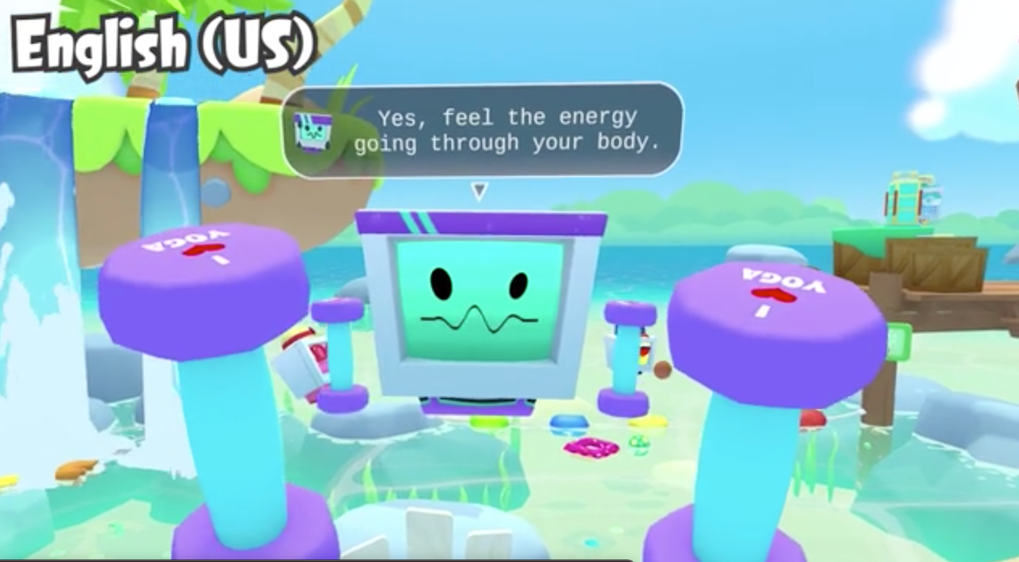
Owlchemy Labs // AR/VR Panel at WeCode 2023
Notes:
Here’s a look at one of the a11y features in a previous owlchemy game: Vacation Simulator.
It has subtitles! HUGE DEAL
VR is super immersive and audio is a big part of that. Unfortunately, there’s a lot of VR that doesn’t have subtitles in it. Owlchemy hade these great subtitles and has set a really good standard for other teams to copy. Thankfully, we’re seeing more subtitles today.

Slide 59
How I got here:
2015
School, Discovr Labs, Games Company, other startups,
Hackathons!
2020
HF, Accessibility Product Manager for online virtual world.
2023
Owlchemy Labs!
Vision accessibility on Cosmonious High
2016
High Fidelity
3D art, Marketing
Hackathons!
2022
Owlchemy Labs!
Accessibility Update for Cosmonious High
Owlchemy Labs // AR/VR Panel at WeCode 2023
Notes:
Now we’re at 2023.
This year, I get to work on vision accessibility again, and this time for Cosmonious High

Slide 60

Owlchemy Labs // AR/VR Panel at WeCode 2023
Notes:
Cosmonious High is a VR game that takes place in an alien high school, where everything is totally fine! After crash-landing, you can unlock powers, explore the halls, and save the school from cosmic chaos.

Slide 61
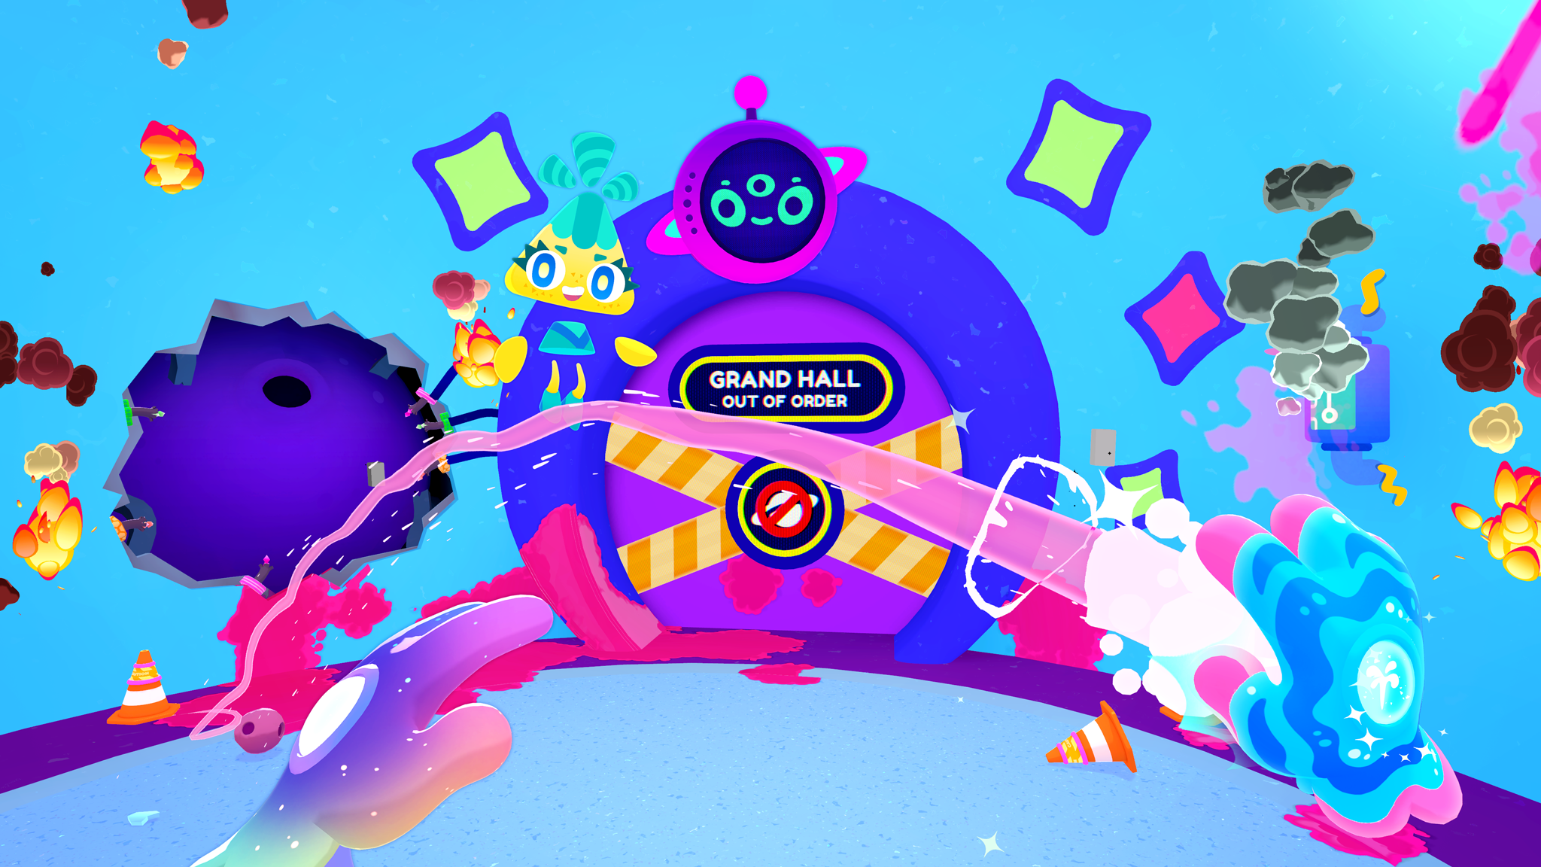
Owlchemy Labs // AR/VR Panel at WeCode 2023
Notes:
Here’s a look at that cosmic chaos.

Slide 62

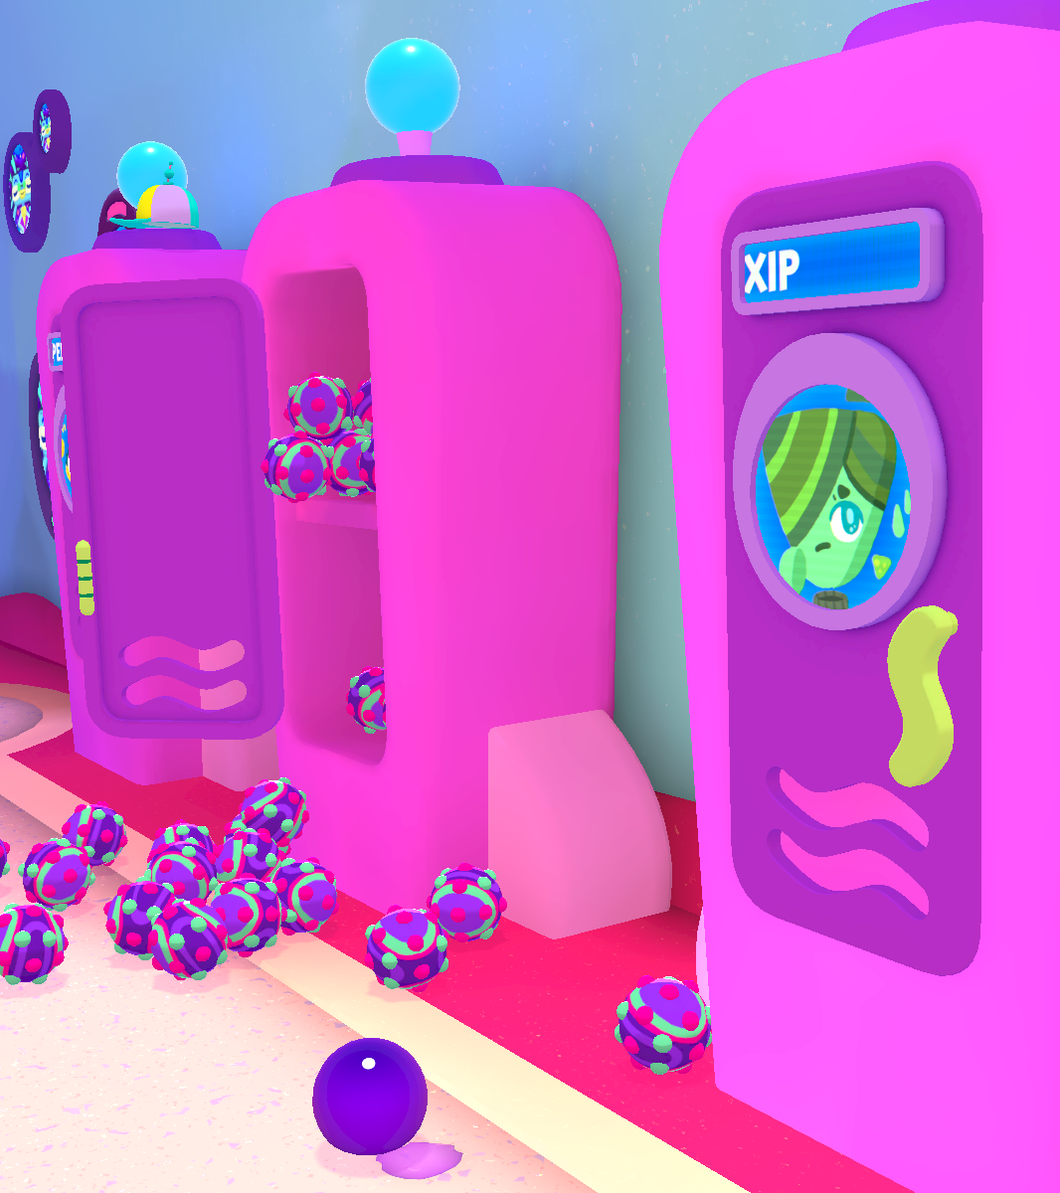
What I’m doing now
Owlchemy Labs // AR/VR Panel at WeCode 2023
Notes:
That leads me to what i’m doing now

Slide 63
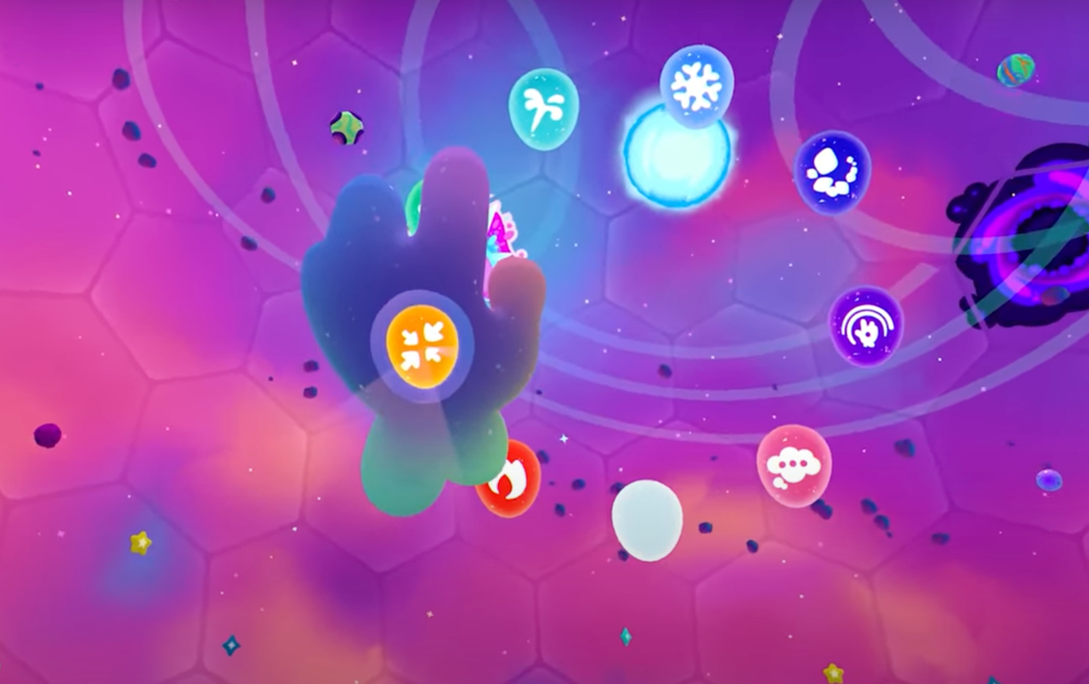
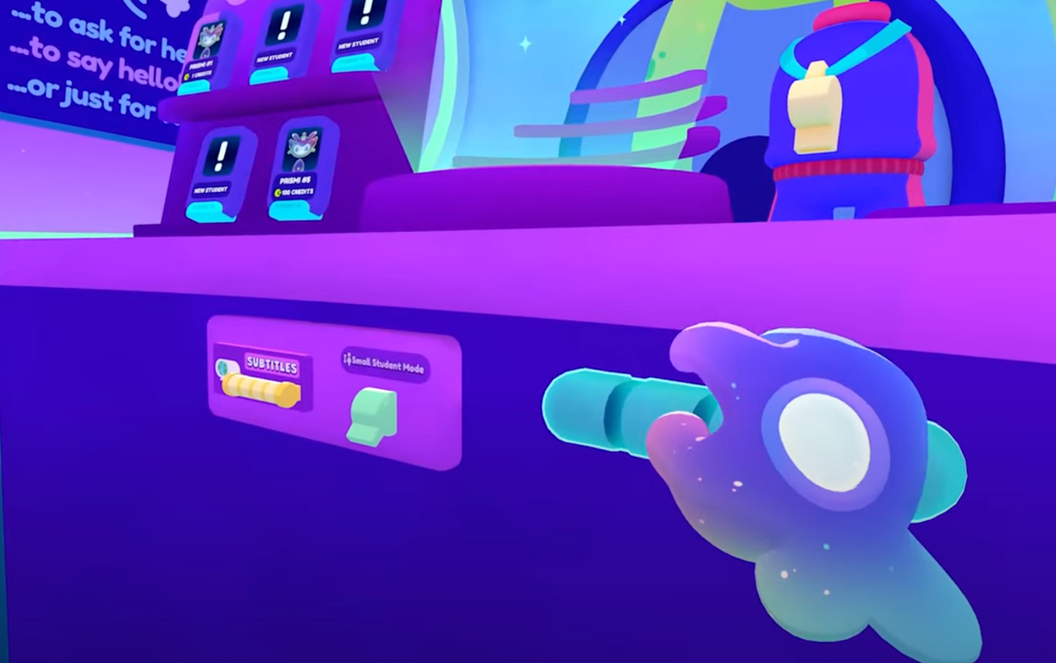
Accessibility Update
Next project…
One-handed mode
Added height-adjustment handles
Colorblindness review
Localization
Object descriptions
Location/landmark descriptions
High Contrast zones
Haptics for object detection
Owlchemy Labs // AR/VR Panel at WeCode 2023
Notes:
As mentioned at the start, I’m doing Accessibility!
On the left, my 1st shipped project was the a11y update for cosmonious high
On the right, is a list of features my team is experimenting with

Slide 64

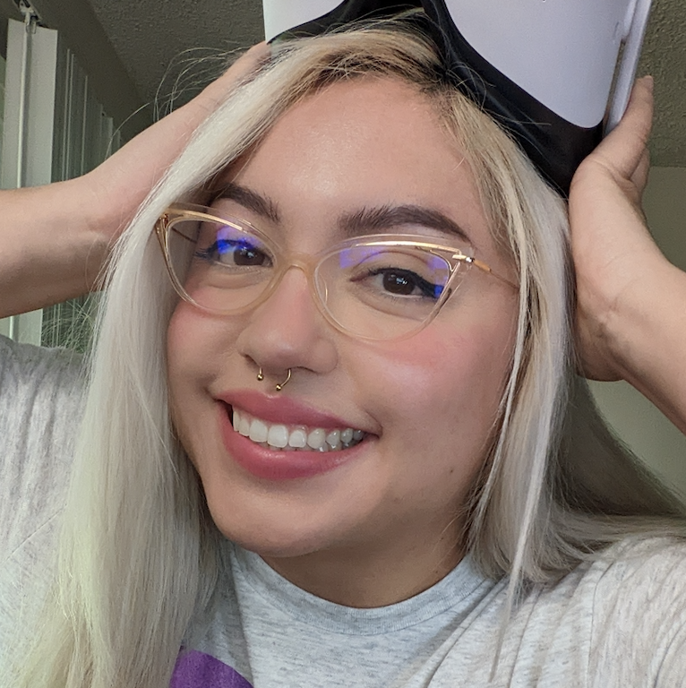
Thank you!
Twitter: @JC_3D
E-mail: JazminCano@OwlchemyLabs.com
Notes:
https://docs.google.com/document/d/16b_vjX-mguC0OJK1SJ-P5GLLwNxAU7GhjEyU8cg5HRk/edit#heading=h.gxioq778jwrq - google conference handbook 2023

Slide 65


Slide 67

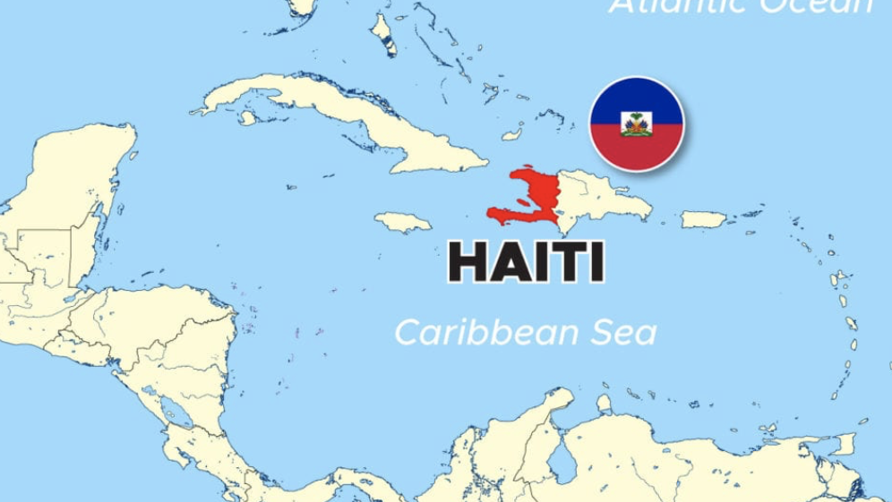
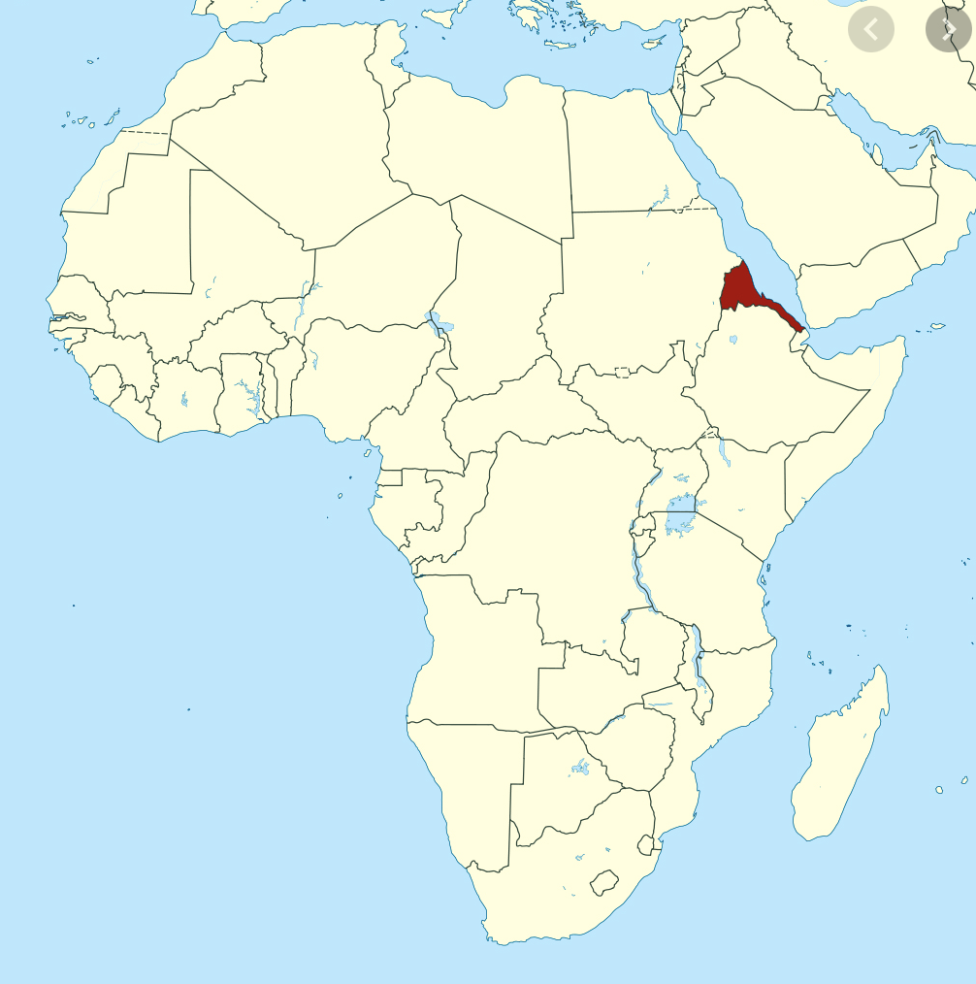


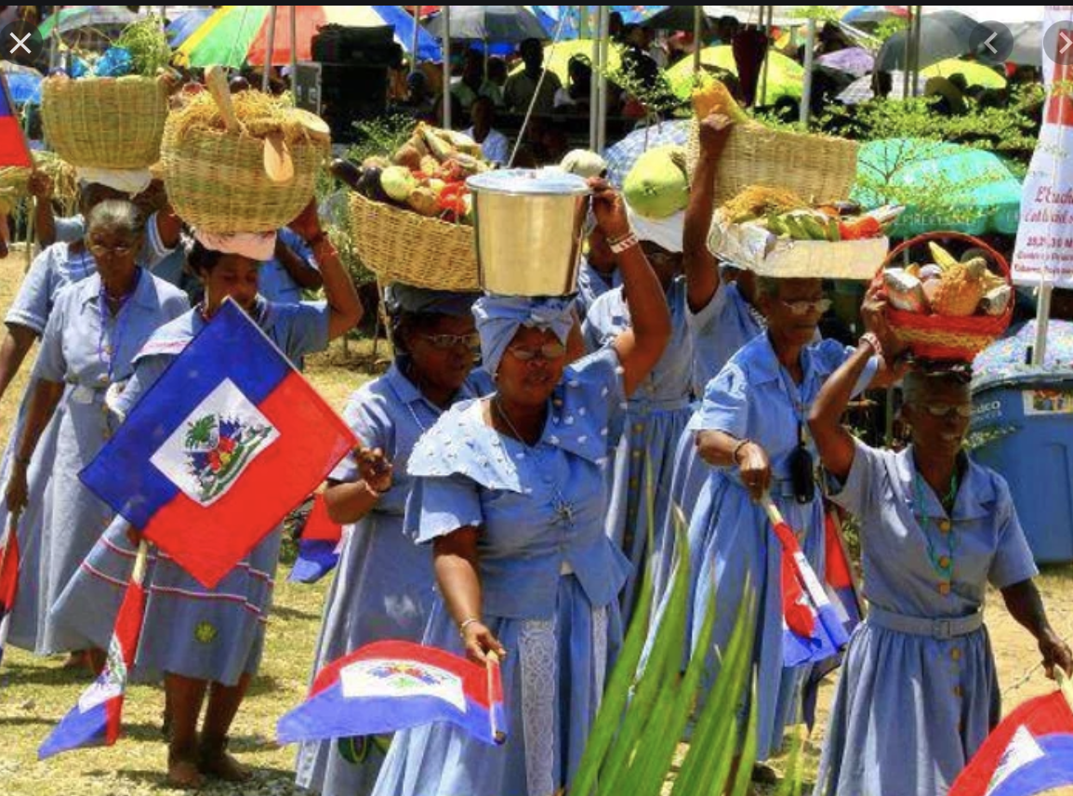






My background
ERITREA

Slide 68

SAN JOSE, CALIFORNIA

Slide 69








Freshman - San Jose State University
Sophomore - DeAnza College

Slide 71


