Slide 1

#TechIntersections
@erinjerri

Slide 2
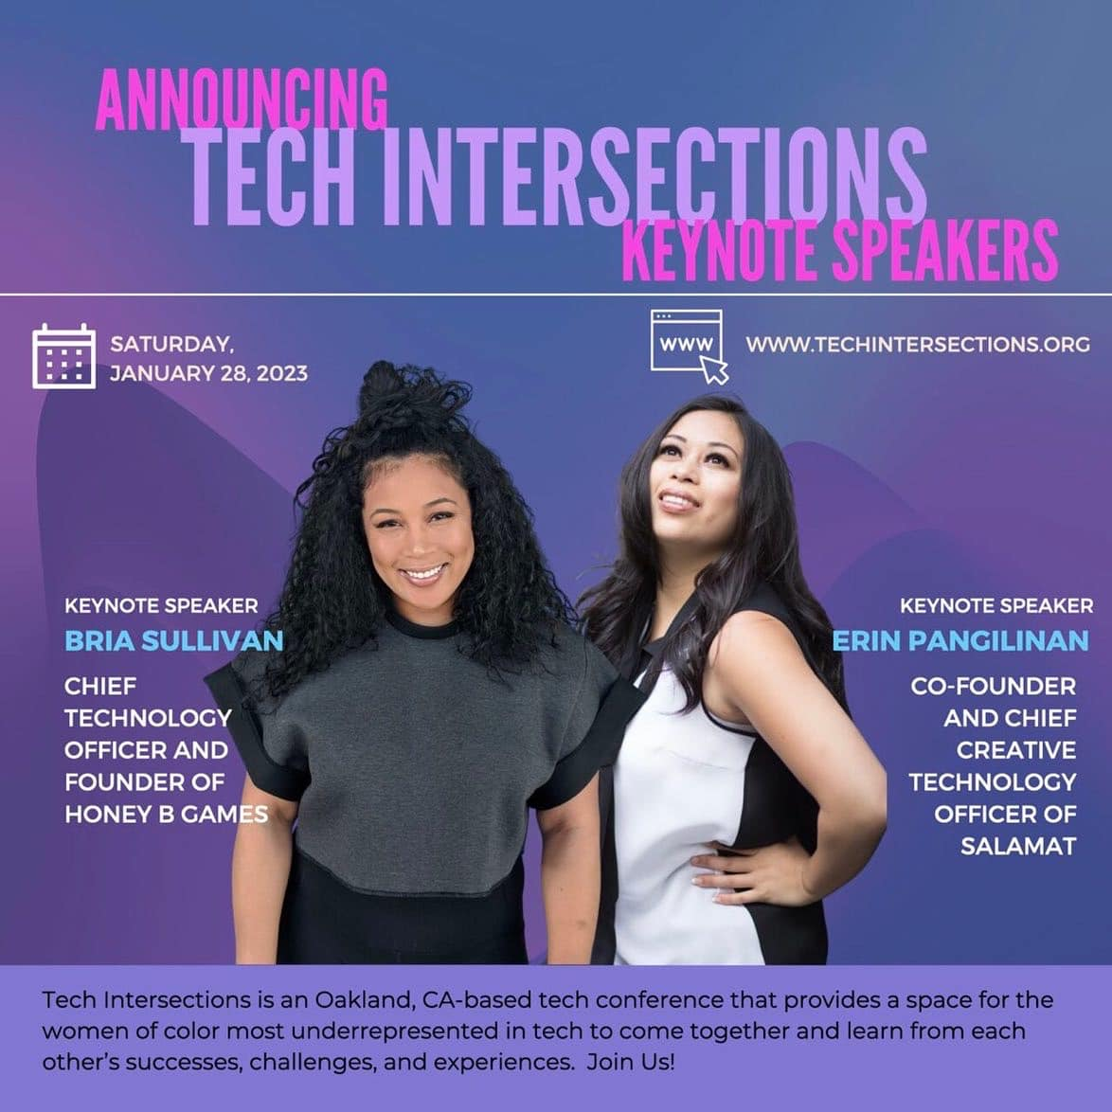

#TechIntersections23
@erinjerri

Slide 3
MABUHAY!
#TechIntersections @TechIntersections @erinjerri

Slide 4
0
1
2
3
SOME NOTES / TERMINOLOGY
STORY OF SELF – MY STORY
STORY OF US – OUR STORY
STORY OF NOW – YOUR STORY
TABLE OF CONTENTS

Slide 5
0
SOME NOTES
SOME NOTES
FYI
@erinjerri

Slide 6
MOMENT OF SILENCE
Please give a momentary silence to honor those who have lost their lives during COVID19 due to the pandemic and of the hate crimes impacting communities of color.
#StopAsianHate #StopAAPIHate #BlackLivesMatter

Slide 7

COMMUNITY AGREEMENTS
1
Land acknowledgement
http://native-land.ca
2
Hella realness - #RealTalk
One Mic, One Diva.
3
Assume the unintentional.
Pardon my use of pronouns as a
light-skinned cis straight
Pinay woman of color from the South Bay.
Colorism is real.
#TechIntersections
@erinjerri
Notes:
Anyone who told you differently, is lying to you, or has not lived this life or was probably rich and famous before it due to privilege, or years of long and grueling hard work and has forgotten where they come from and that this period of a pandemic has sucked like no other.

Slide 8
TERMINOLOGY
1
I use P/F interchangeably for
Filipinx / Pilipinx / Filipin@/a/o (Filipin@ Filipina/Filipino)
/Pin/x/a/oy (Pinxy Pinay Pinoy)
2
I use AANHPI
Asian American Native Hawaiian Pacific Islander.
3
I do not use hyphens.
#TechIntersections
@erinjerri
Notes:
Anyone who told you differently, is lying to you, or has not lived this life or was probably rich and famous before it due to privilege, or years of long and grueling hard work and has forgotten where they come from and that this period of a pandemic has sucked like no other.

Slide 9
TERMINOLOGY
1
My pronouns are she/her/hers.
2
I use HXStory not History.
3
I use womxn interchangeably with women, but not womyn or womin for the term “women”
#TechIntersections
@erinjerri
Notes:
Anyone who told you differently, is lying to you, or has not lived this life or was probably rich and famous before it due to privilege, or years of long and grueling hard work and has forgotten where they come from and that this period of a pandemic has sucked like no other.

Slide 10
TERMINOLOGY
1
I use AR VR MR XR / Spatial Computing and Metaverse interchangeably.
2
I use Cryptocurrency/Blockchain/Web3 interchangeably.
3
I use Artificial Intelligence (AI), Machine Learning (ML), Deep Learning (DL), and Data Science interchangeably.
#TechIntersections
@erinjerri
Notes:
Anyone who told you differently, is lying to you, or has not lived this life or was probably rich and famous before it due to privilege, or years of long and grueling hard work and has forgotten where they come from and that this period of a pandemic has sucked like no other.

Slide 11
ON PRODUCTIVITY
NOTES FOR THE AUDIENCE:
This talk will not be linear.
The framework of this talk will be in multidimensional terms.
#TechIntersections
@erinjerri

Slide 12
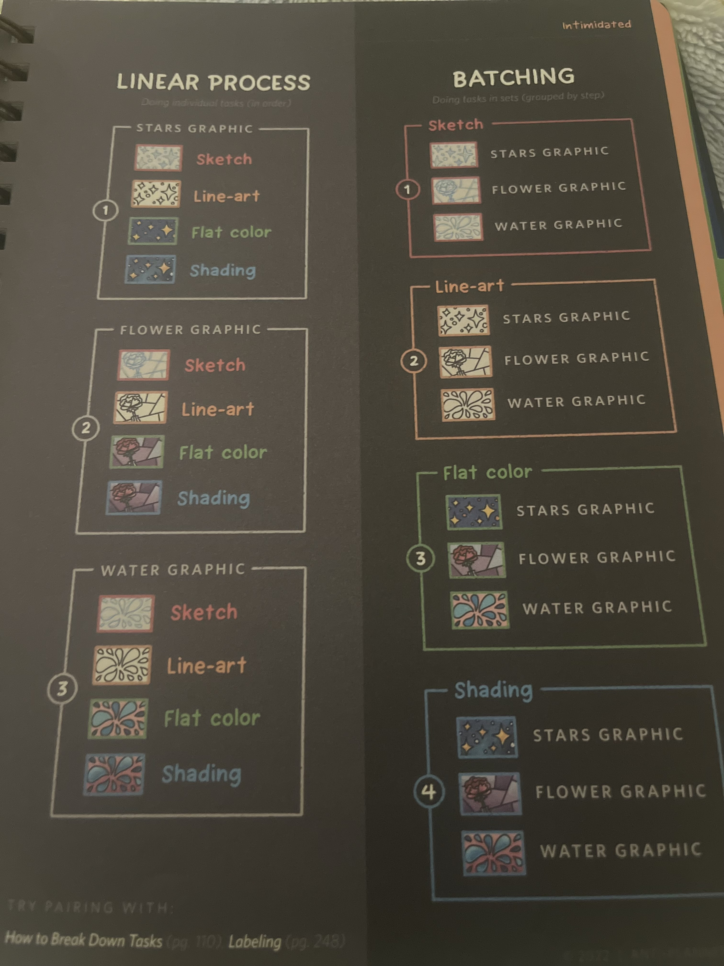
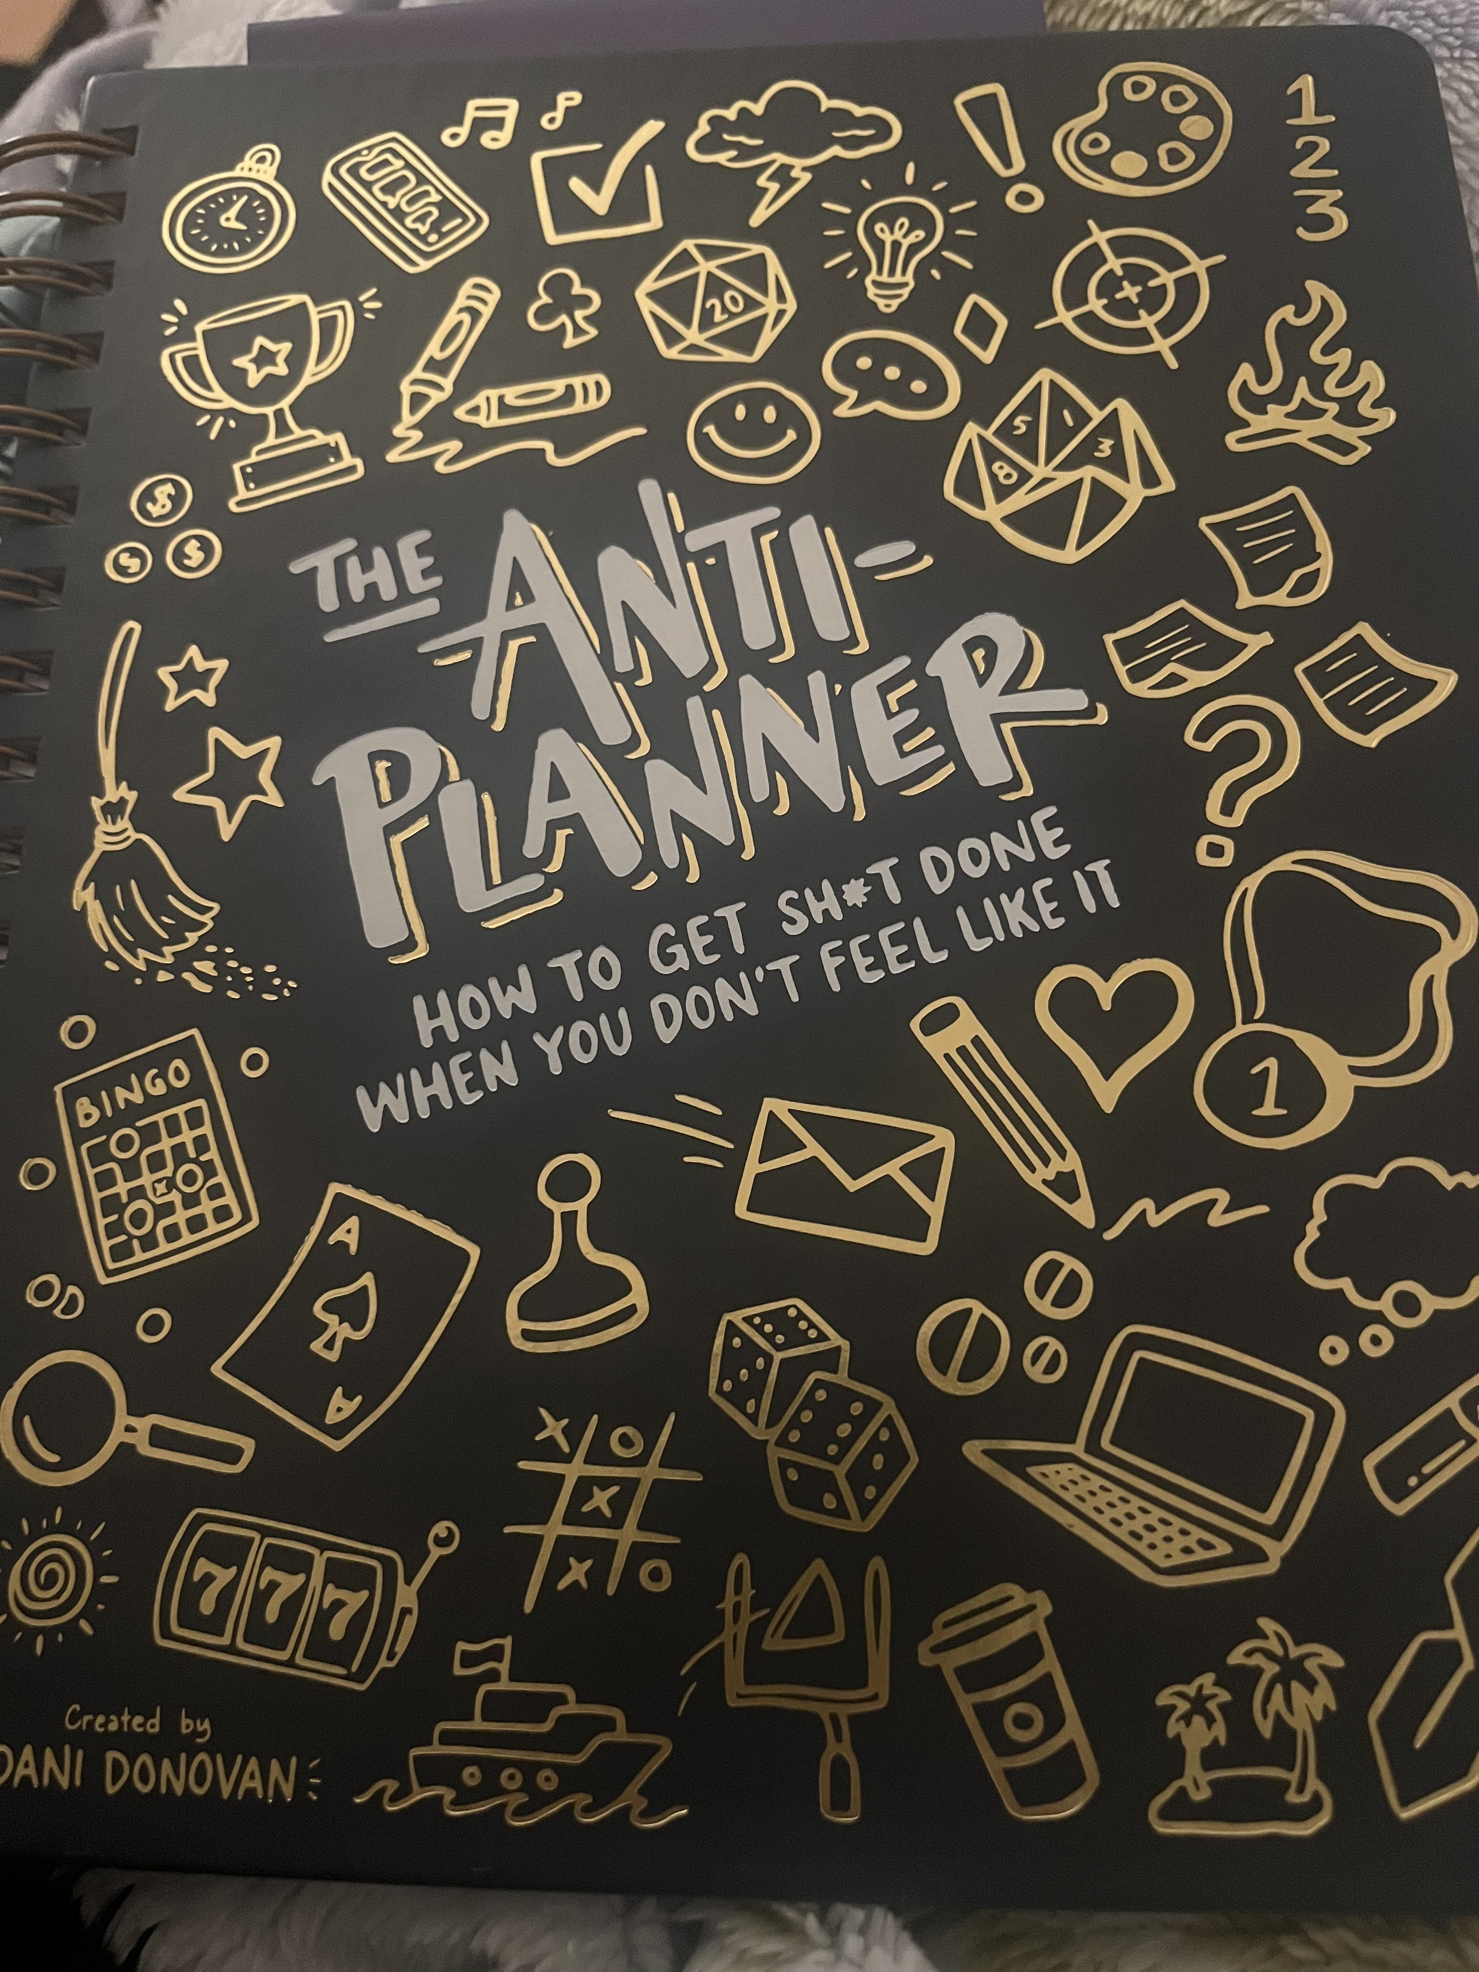
#TechIntersections23
@erinjerri

Slide 13
There will be no live demos in this talk
and we will try to avoid the fail whales.
#TechIntersections
@erinjerri

Slide 14
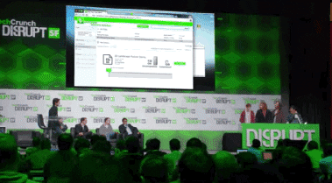

Slide 15
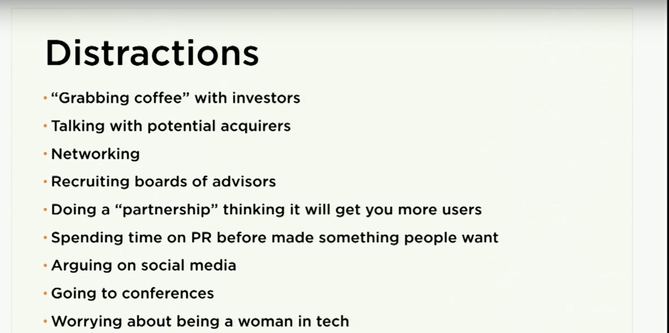
#TechIntersections23
@erinjerri
Notes:
Anyone who told you differently, is lying to you, or has not lived this life or was probably rich and famous before it due to privilege, or years of long and grueling hard work and has forgotten where they come from and that this period of a pandemic has sucked like no other.

Slide 16
Today is not a distraction.
It is an investment in your personal and professional growth.
Anyone telling you any different is living in a false reality (fantasy), is backwards, and perpetuates the reality of the world that in unjust, unequal and out of touch. And they probably are not successful in the terms that you value.
Worrying is ok. You can be concerned, raise concern, pray or reflect, and take action.
#TechIntersections
@erinjerri

Slide 17
Take us on a journey, teach us something, and help us set the tone for the day. As you know, the economy and the world continue to feel unstable and uncertain even well before the pandemic, and since 2020, it has not felt much better. Women of color have gotten hit the hardest in this economy.
As we are trying to trailblaze, we are still having challenges that are unfelt by others. How do you encourage people to have confidence in themselves during uncertain times?
How do you encourage people to develop themselves and keep going for their dreams in technology, regardless of how much life throws their way? How do you continue to be hopeful and develop yourself?
Take these questions as a suggestion, but we think you are so inspirational; we are sure anything you share with our community will be incredible.
#TechIntersections
@erinjerri

Slide 18
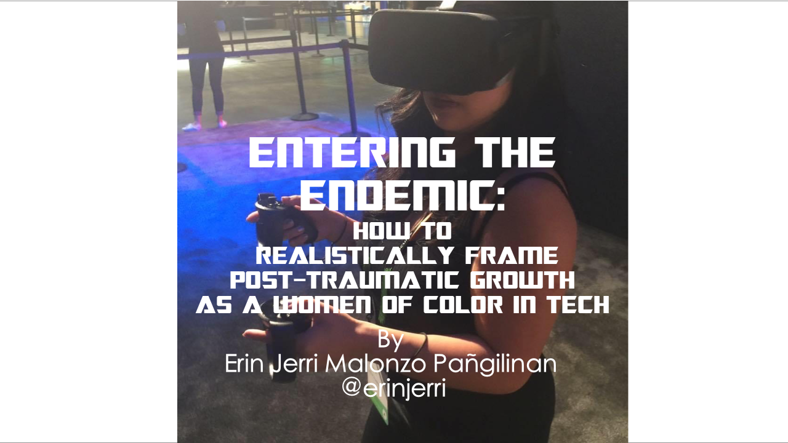
#TechIntersections
@erinjerri

Slide 19
PTSD vs PTSG
Post Traumatic Stress Disorder
vs
Post Traumatic Growth
STORY OF NOW
@erinjerri
Notes:
Anyone who told you differently, is lying to you, or has not lived this life or was probably rich and famous before it due to privilege, or years of long and grueling hard work and has forgotten where they come from and that this period of a pandemic has sucked like no other.

Slide 20
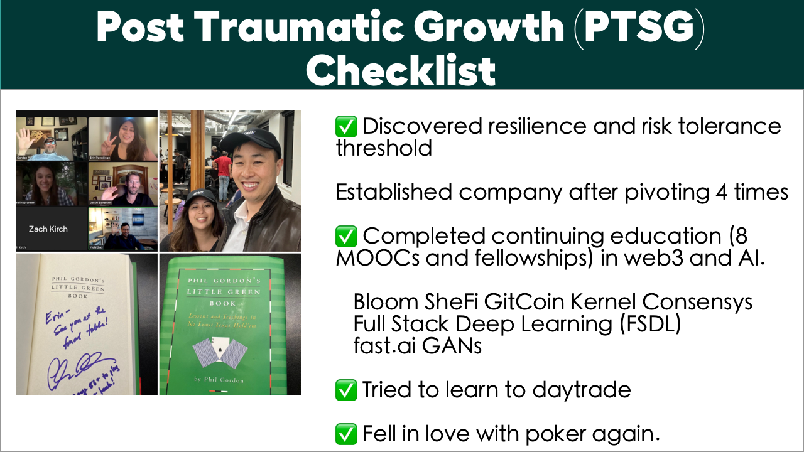
#TechIntersections
@erinjerri
Notes:
Anyone who told you differently, is lying to you, or has not lived this life or was probably rich and famous before it due to privilege, or years of long and grueling hard work and has forgotten where they come from and that this period of a pandemic has sucked like no other.

Slide 21
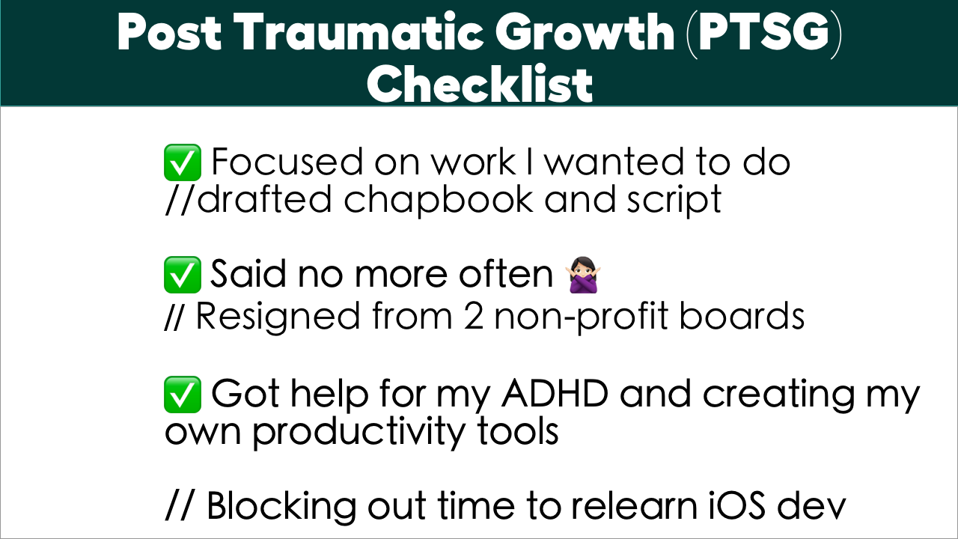
@erinjerri
Notes:
Anyone who told you differently, is lying to you, or has not lived this life or was probably rich and famous before it due to privilege, or years of long and grueling hard work and has forgotten where they come from and that this period of a pandemic has sucked like no other.

Slide 22
In our productivity driven society and industry, how do we realistically measure our drive and direction?
#TechIntersections
@erinjerri

Slide 23
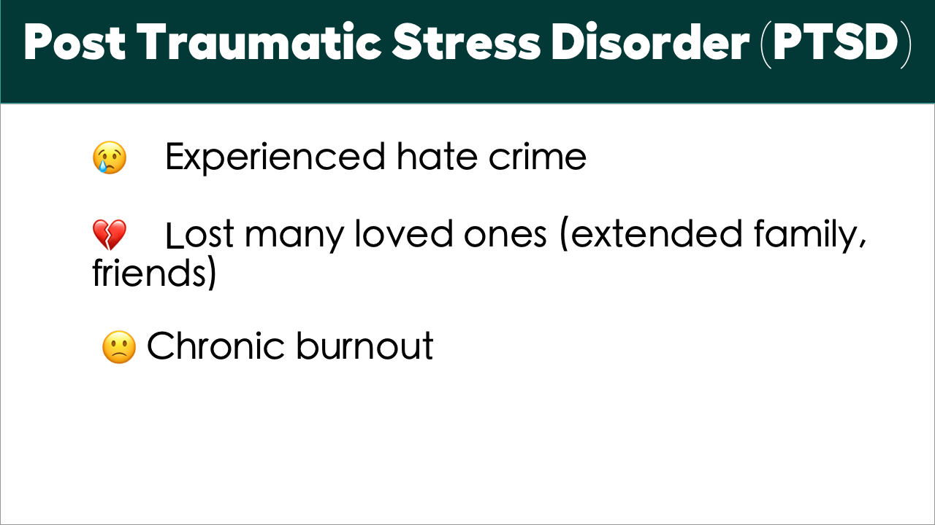
#TechIntersections
@erinjerri
Notes:
Anyone who told you differently, is lying to you, or has not lived this life or was probably rich and famous before it due to privilege, or years of long and grueling hard work and has forgotten where they come from and that this period of a pandemic has sucked like no other.

Slide 24
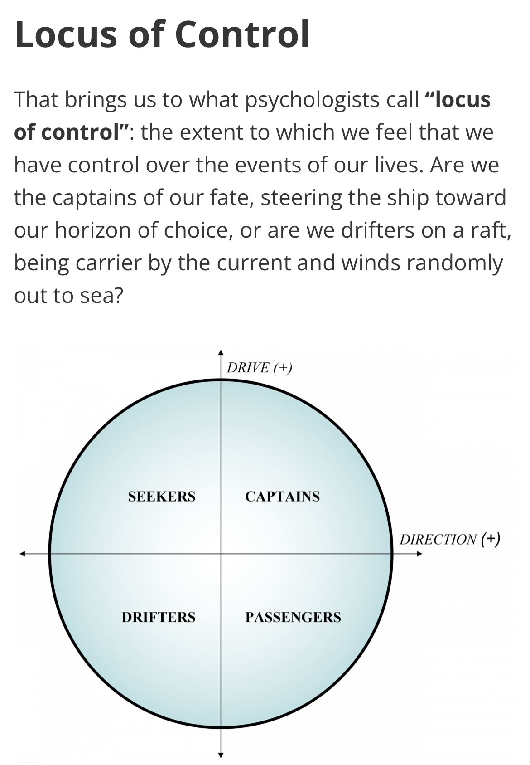
Credit: Drive and Direction Matrix from the book
Life Entrepreneurs by Christopher Gergen and Gregg Vanourek
YOUR SHIP
@erinjerri
Notes:
Anyone who told you differently, is lying to you, or has not lived this life or was probably rich and famous before it due to privilege, or years of long and grueling hard work and has forgotten where they come from and that this period of a pandemic has sucked like no other.

Slide 25
Your career journey and exploration is not a race to end at one point and because you are not in the quadrant of a captain all the time does not mean you lose all direction, it just means slowing down in various points of your career to wayfind to your next destination. It is a process.
Explorers
Aspiring / Searching
Founders Builders
Racers/Drifters (High-Risk)
Building, Steering
Vacationers
Chillin’
Those in a sabbatical /recovery before entering into another quadrant
First Mates/
Early Employees
Riding
You can still be a builder or driver on a ship as a part of the crew
YOUR MOTHERSHIP
// Note: This terminology is not intended to evoke memories of colonial conquest, but rather instead use an analogy of any type of ship (rocket ship, spaceship, boat, or vehicle) to indicate something that involves an engine and direction one can take
@erinjerri

Slide 26
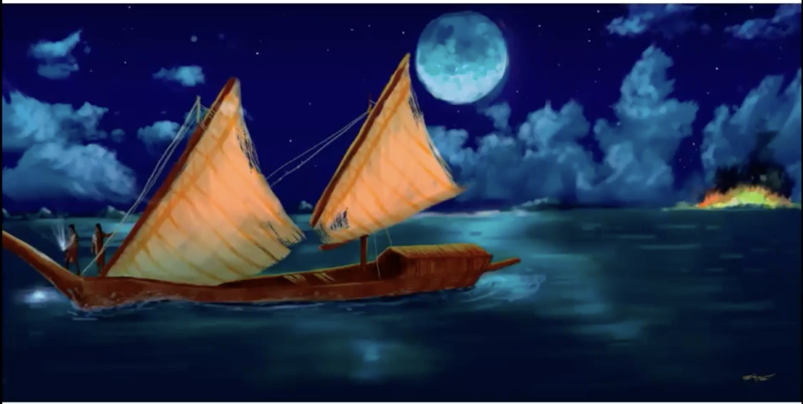
The speed of your boat is not dependent on a Eurocentric understanding of capitalism, rather it is more like what is connected to your inner rhythm to yourself, your nature, your community, and the seasons. Photo credit: Eva Marie Wang
YOUR MOTHERSHIP
@erinjerri

Slide 27
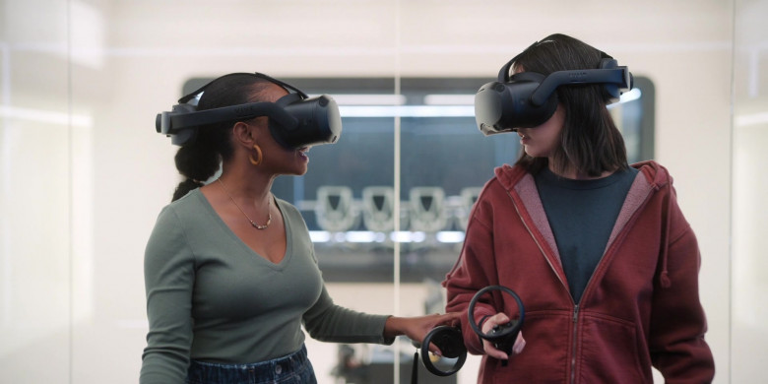
FICTIONAL METAVERSE
COVID19 DYSTOPIA?
#TechIntersections
@erinjerri

Slide 28

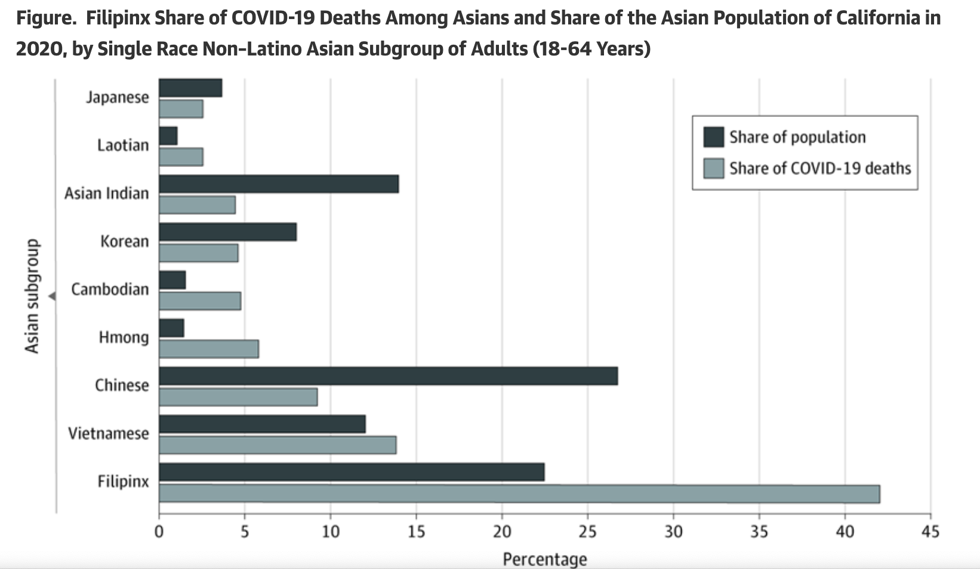
Loss of life as a result of COVID-19 pandemic is disproportionately affecting communities of color.
#TechIntersections
@erinjerri
Notes:
These are not things companies should ignore, or dismiss as completely irrelevant to them.
If companies want to examine metrics beyond just the bottom line (talking to users, making revenue) and want to prioritize setting a culture, we need it to be normalized and integrated that this is what customers, users, and employees work about and is a priority in having a healthy and safe work culture.
Not only as a separate metric as ESG or womxn founded or owned company merely, but holistic approach to redefine what success looks like for a company as a whole.

Slide 29

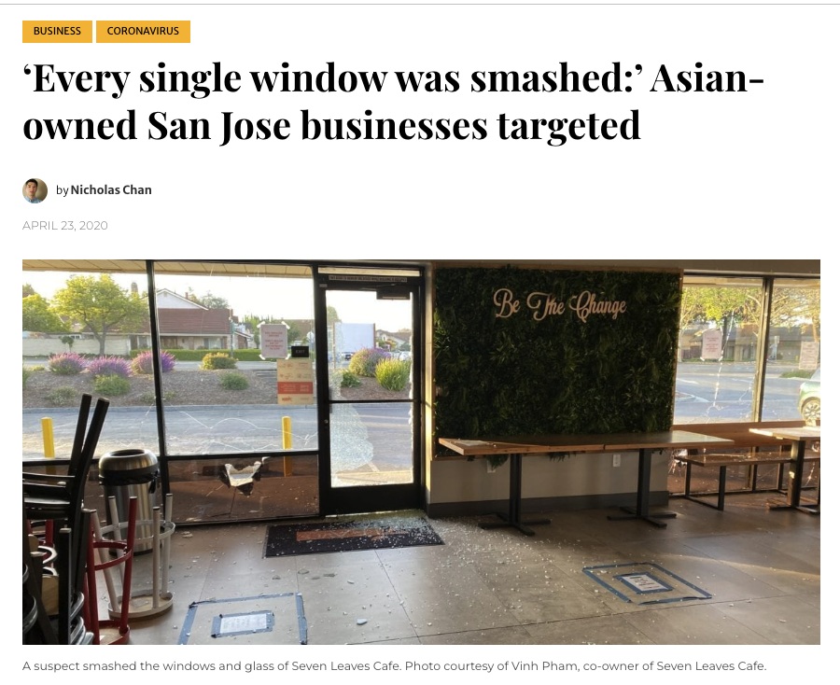
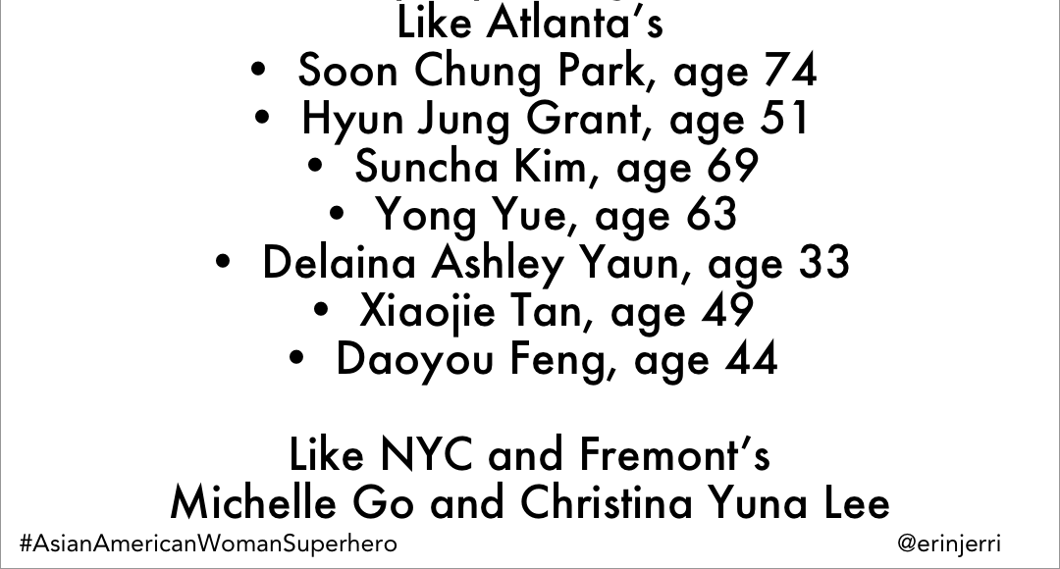
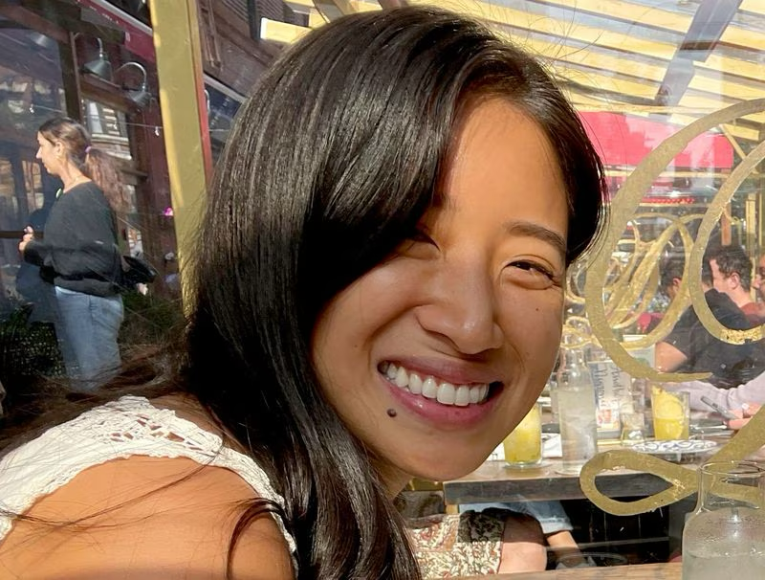
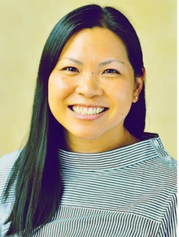
#TechIntersections
@erinjerri
Notes:
-My car windows were smashed and items stolen around the same week as the SJ and Milpitas businesses, Lee’s Sandwiches and 7 Leaves Boba Shop during the height of anti-Asian violent crimes in 2020. Asian Americans often the scapegoat for COVID19 with racial slurs (Kung Flu Virus, Chinese Virus), and TX family targeted for wearing masks at Sam’s Club. Atlanta spa shootings in 2021. Michelle Go is from my hometown, Chrisitna Yuna Lee was also another professional working in creative.

Slide 30
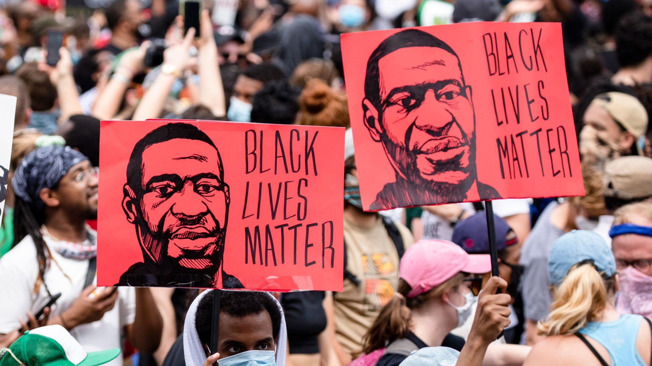
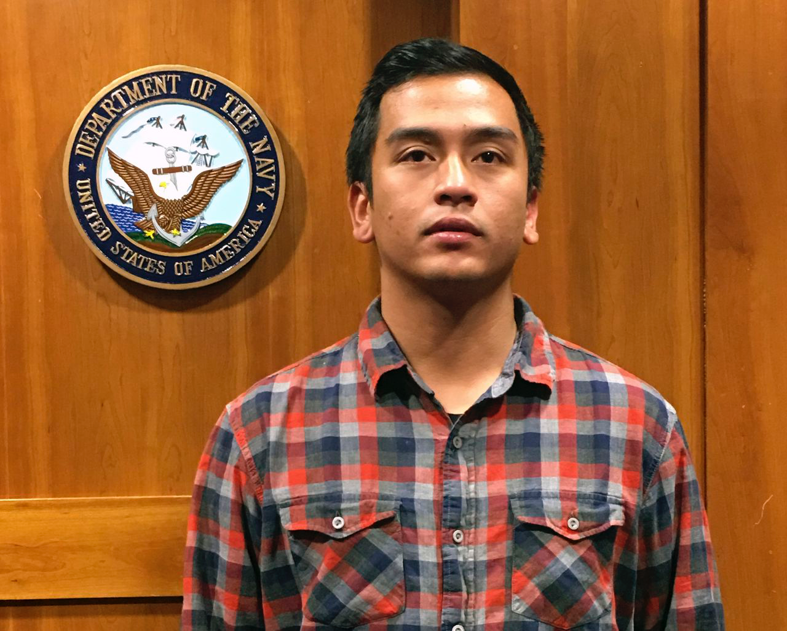
George Floyd
Breonna Taylor
Oscar Grant
Angelo Quinto
and many, many, more…
Asian American hate crimes
From Atlanta, NYC, TX Bay Area, outside of the United States, diaspora
#TechIntersections23
@erinjerri
Notes:
In Antioch, CA in December 2021, Angelo Quinto, a Filipino American aspiring game designer was kneeled on by police, same method used in killing George Floyd. Man Black folx and folx of color have had a long history of hate crimes and distrust of authorities due to injustice, and companies are finally paying attention.

Slide 31
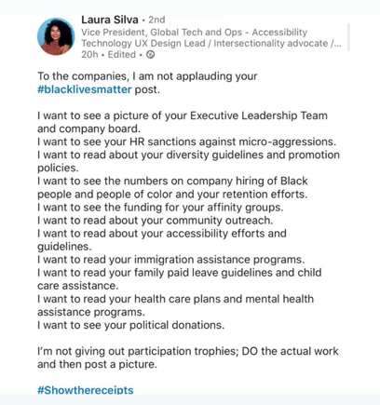
#TechIntersections
#ShowTheReceipts
@erinjerri
Notes:
Justice Diversity Equity Inclusion and Belonging can feel overly performative, but not necessarily truly challenging disparity at its core to show really effective and significant impact for combating underrepresentation and gender gap.
These are not things companies should ignore, or dismiss as completely irrelevant to them.
If companies want to examine metrics beyond just the bottom line (talking to users, making revenue) and want to prioritize setting a culture, we need it to be normalized and integrated that this is what customers, users, and employees work about and is a priority in having a healthy and safe work culture.
Not only as a separate metric as ESG or womxn founded or owned company merely, but holistic approach to redefine what success looks like for a company as a whole. Culture is a part of the multibottom line

Slide 32
PRIORITIZE HOW YOU WANT TO SHOW UP
1
What can I do personally as a human, as a member of my community, ally?
2
What can I do in my professional role?
3
What can I encourage the companies I work for to do?
#TechIntersections
@erinjerri
Notes:
Anyone who told you differently, is lying to you, or has not lived this life or was probably rich and famous before it due to privilege, or years of long and grueling hard work and has forgotten where they come from and that this period of a pandemic has sucked like no other.

Slide 33

SOLUTIONS
Show Real Solidarity, Investment
⬛ Call for accountability that shows real stories that show both societal and business reach to impact the multi-bottom line.
⬛ Show continued sustainable and real solidarity of the company.
⬛ More than celebrate a single heritage month or one-time donation.
⬛ Year round support for more equal representation and liberation for POC, womxn, LGBTQ+ communities: investors, board members, hiring across senior executive, manager, leadership roles, pay equity and financial transparency for compensation, budget allocations for work, initiatives for Justice Diversity Equity Inclusion and Belonging.
#TechIntersections
@erinjerri
Notes:
Anyone who told you differently, is lying to you, or has not lived this life or was probably rich and famous before it due to privilege, or years of long and grueling hard work and has forgotten where they come from and that this period of a pandemic has sucked like no other.

Slide 34

#TechIntersections
@erinjerri

Slide 35
Tl;dr – it’s hella hard
to be a women of color in tech in 2023.
#TechIntersections
@erinjerri
Notes:
Justice Diversity Equity Inclusion and Belonging can feel overly performative, but not necessarily truly challenging disparity at its core to show really effective and significant impact for combating underrepresentation and gender gap.
These are not things companies should ignore, or dismiss as completely irrelevant to them.
If companies want to examine metrics beyond just the bottom line (talking to users, making revenue) and want to prioritize setting a culture, we need it to be normalized and integrated that this is what customers, users, and employees work about and is a priority in having a healthy and safe work culture.
Not only as a separate metric as ESG or womxn founded or owned company merely, but holistic approach to redefine what success looks like for a company as a whole. Culture is a part of the multibottom line

Slide 36
THE PANDEMIC TO ENDEMIC REALITY
40% of womxn started businesses during the pandemic
…
we have a lot to work on
#TechIntersections
@erinjerri

Slide 37
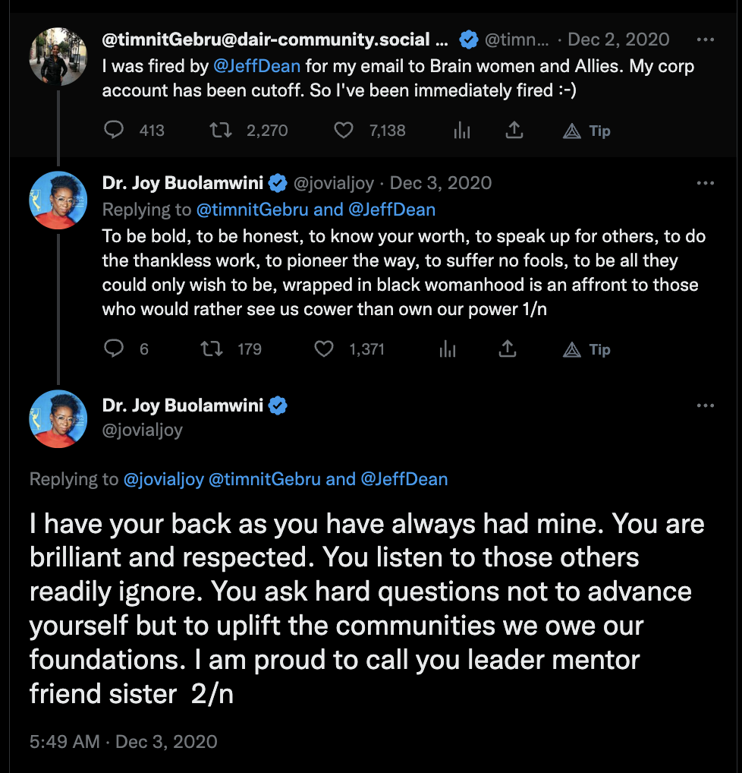
THE REALITY
Deltas
Even seminal womxn of color technologists are often under attack and seen as replaceable tokenized objects.
This must change.
#TechIntersections23
@erinjerri

Slide 38
THE PANDEMIC TO ENDEMIC REALITY
PROBLEMS
Income inequality
Microaggressions at the workplace
SOLUTIONS
⬛ Use comprehensive.io and negotiation to combat the pay gap
⬛ Womxn of color technologists are often under attack and seen as replaceable tokenized objects. This must change.
#TechIntersections
@erinjerri

Slide 39
TECHNOLOGISTS MAKING HXSTORY.
MOVEMENTS AND MOMENTS.
#TechIntersections
@erinjerri

Slide 40
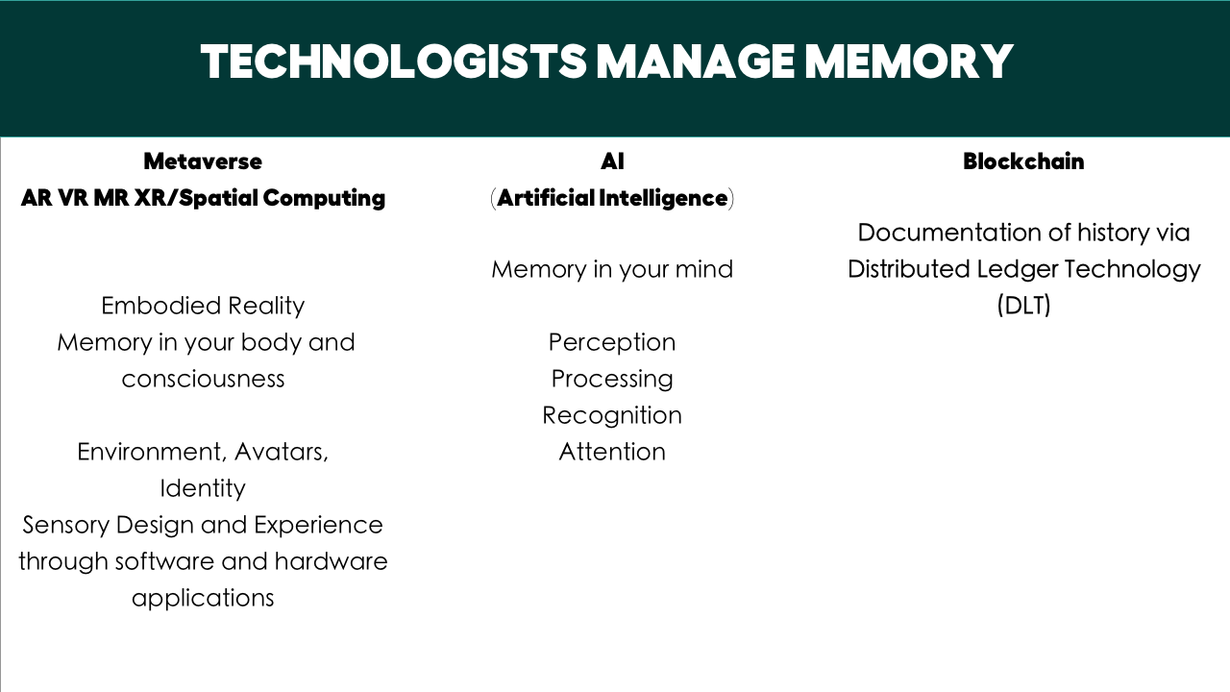
#TechIntersections
@erinjerri
Notes:
Anyone who told you differently, is lying to you, or has not lived this life or was probably rich and famous before it due to privilege, or years of long and grueling hard work and has forgotten where they come from and that this period of a pandemic has sucked like no other.

Slide 41
HXSTORY
Technology is a marker of various points in time and space, movements and moments.
How do we view our role in cultural preservation in content, in being on the “right” side of hxstory?
How do we create technology solutions to mark our story?
#TechIntersections
@erinjerri
Notes:
Anyone who told you differently, is lying to you, or has not lived this life or was probably rich and famous before it due to privilege, or years of long and grueling hard work and has forgotten where they come from and that this period of a pandemic has sucked like no other.

Slide 42
High Level User Experience Design
with Humans In Mind (from the beginning)
Design with virtual environments (ex. Tiltbrush, Gravity Sketch, Blocks)
Design for virtual environments…(affordances for the user)
Design of virtual environments… (the actual synthetic thing) – focuses on content creation
(Jason Jerald, the VR Book, 383)
Create/Engineer/Design/Develop technology businesses with people
Create/Engineer/Design/Develop technology businesses for people
Create/Engineer/Design/Develop technology businesses of people
#TechIntersections
@erinjerri
Notes:
Anyone who told you differently, is lying to you, or has not lived this life or was probably rich and famous before it due to privilege, or years of long and grueling hard work and has forgotten where they come from and that this period of a pandemic has sucked like no other.

Slide 43
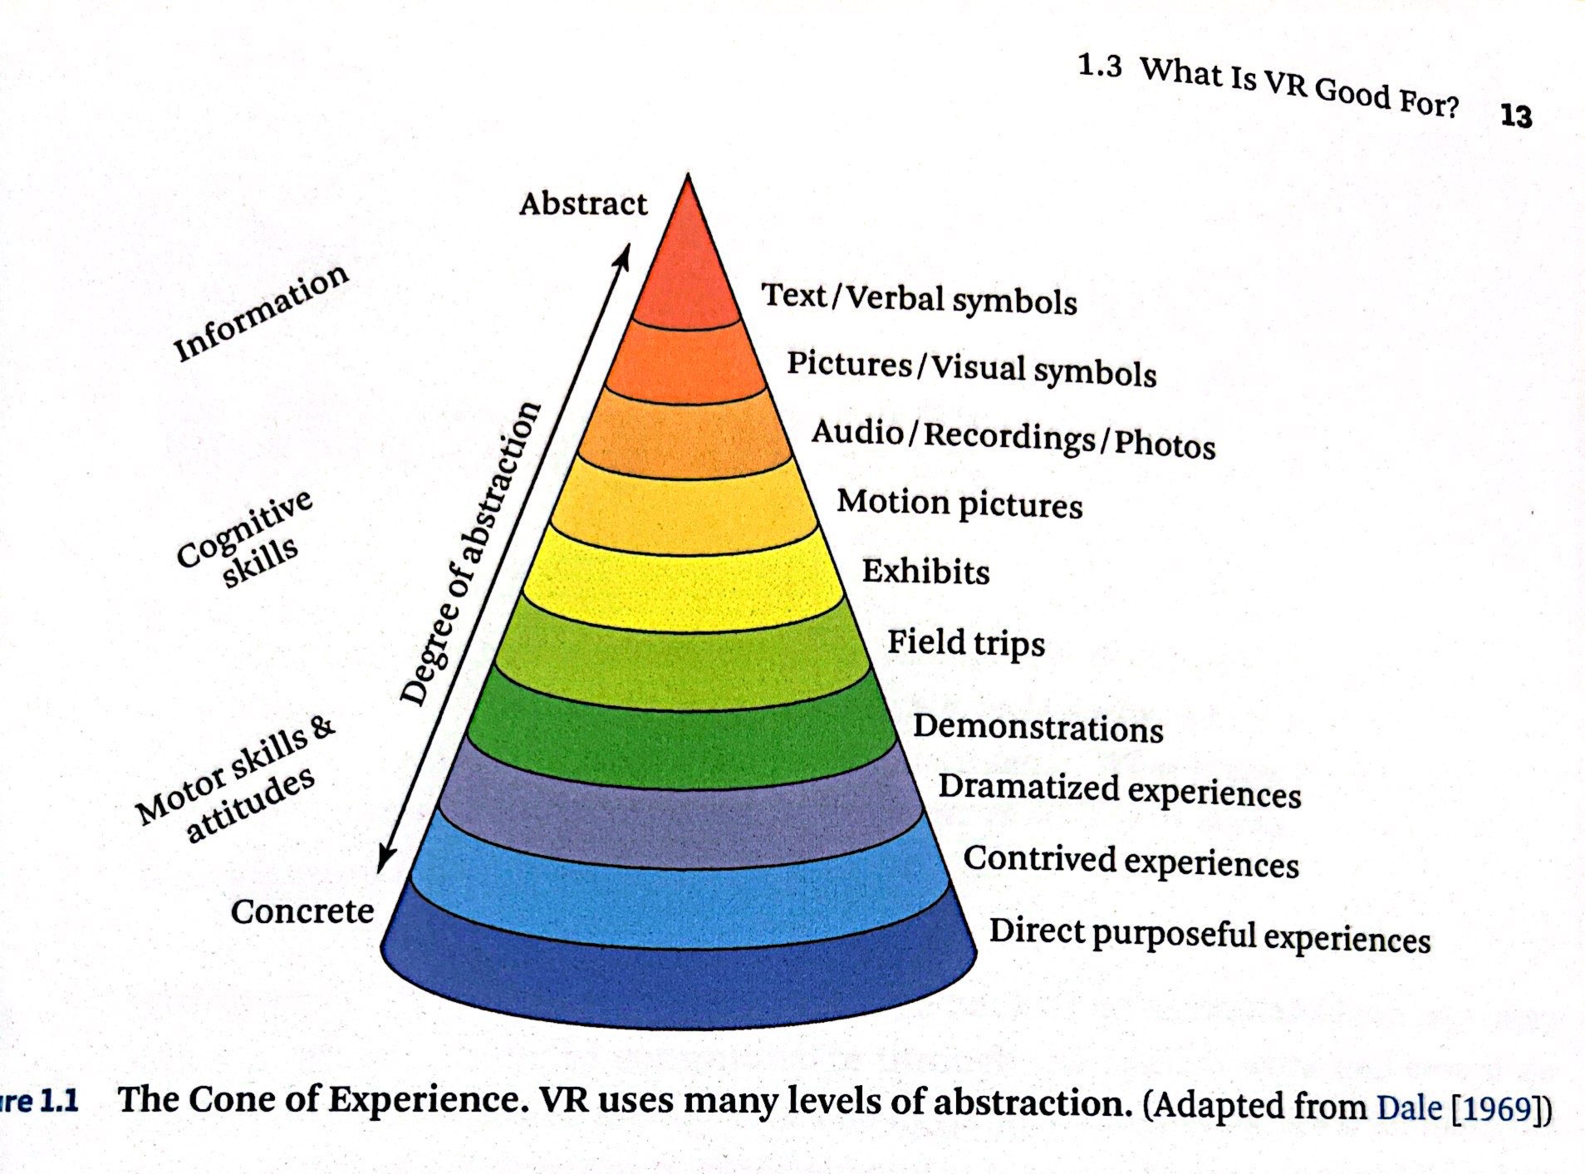
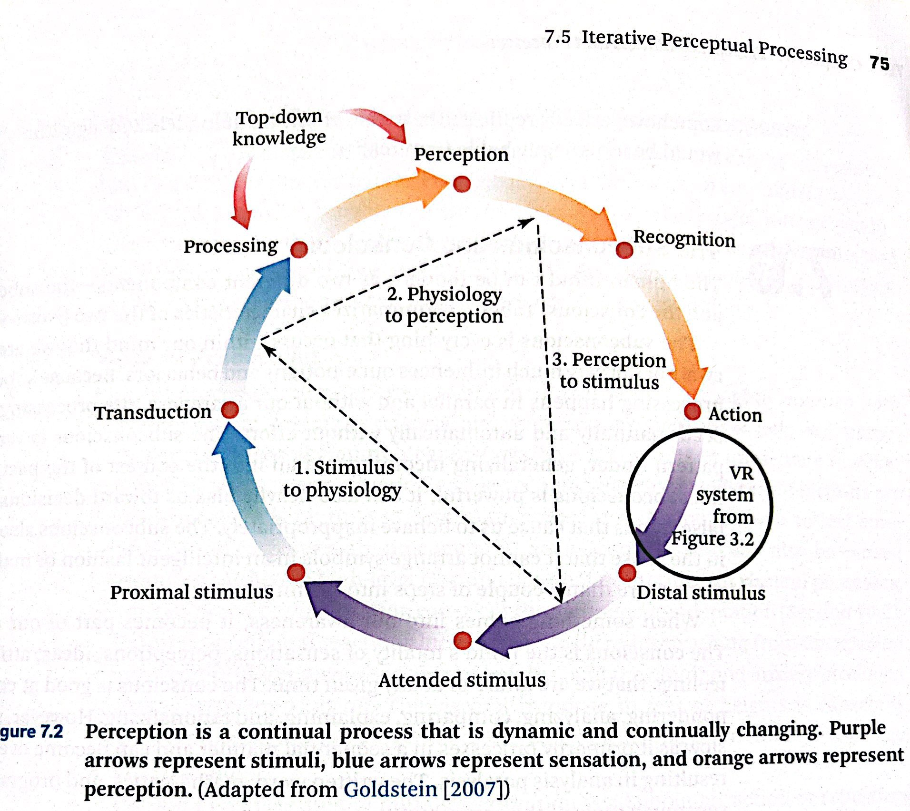
DEFINE YOUR STORY
CREATING MEMORY PERCEPTION
The Cone of Experience.
(Jason Jerald, the VR Book).
#TechIntersections
@erinjerri
Notes:
Anyone who told you differently, is lying to you, or has not lived this life or was probably rich and famous before it due to privilege, or years of long and grueling hard work and has forgotten where they come from and that this period of a pandemic has sucked like no other.

Slide 44
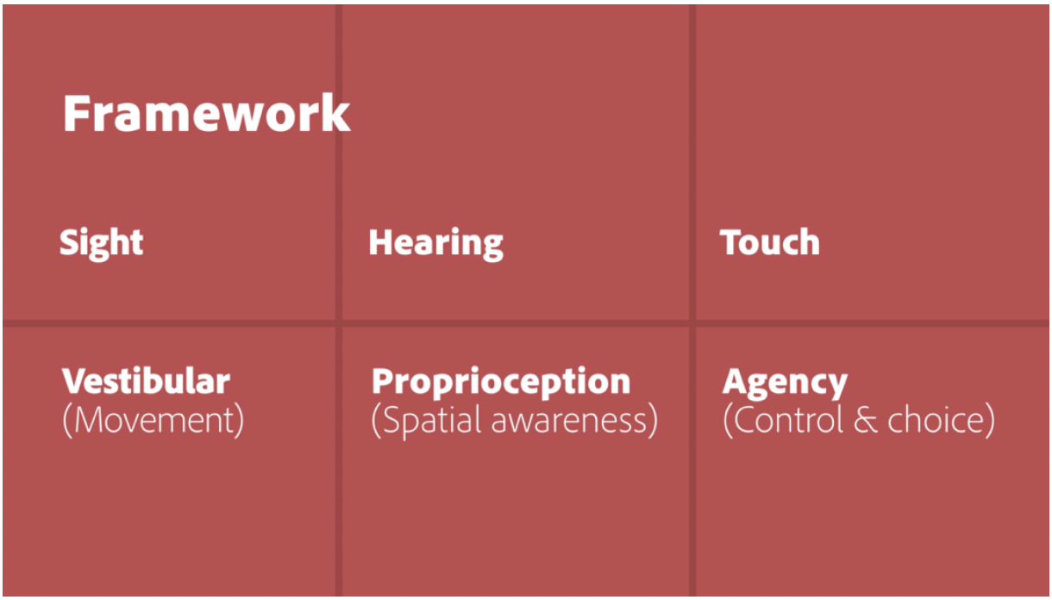
SENSORY DESIGN
Silka Sietsma, former Head of Emerging Design, Adobe
“ Designing for Our Senses, Not Our Devices. Creating Augmented and Virtual Realities. O’Reilly Media. Pg 36. 2019.
#TechIntersections
@erinjerri
Notes:
Anyone who told you differently, is lying to you, or has not lived this life or was probably rich and famous before it due to privilege, or years of long and grueling hard work and has forgotten where they come from and that this period of a pandemic has sucked like no other.

Slide 45
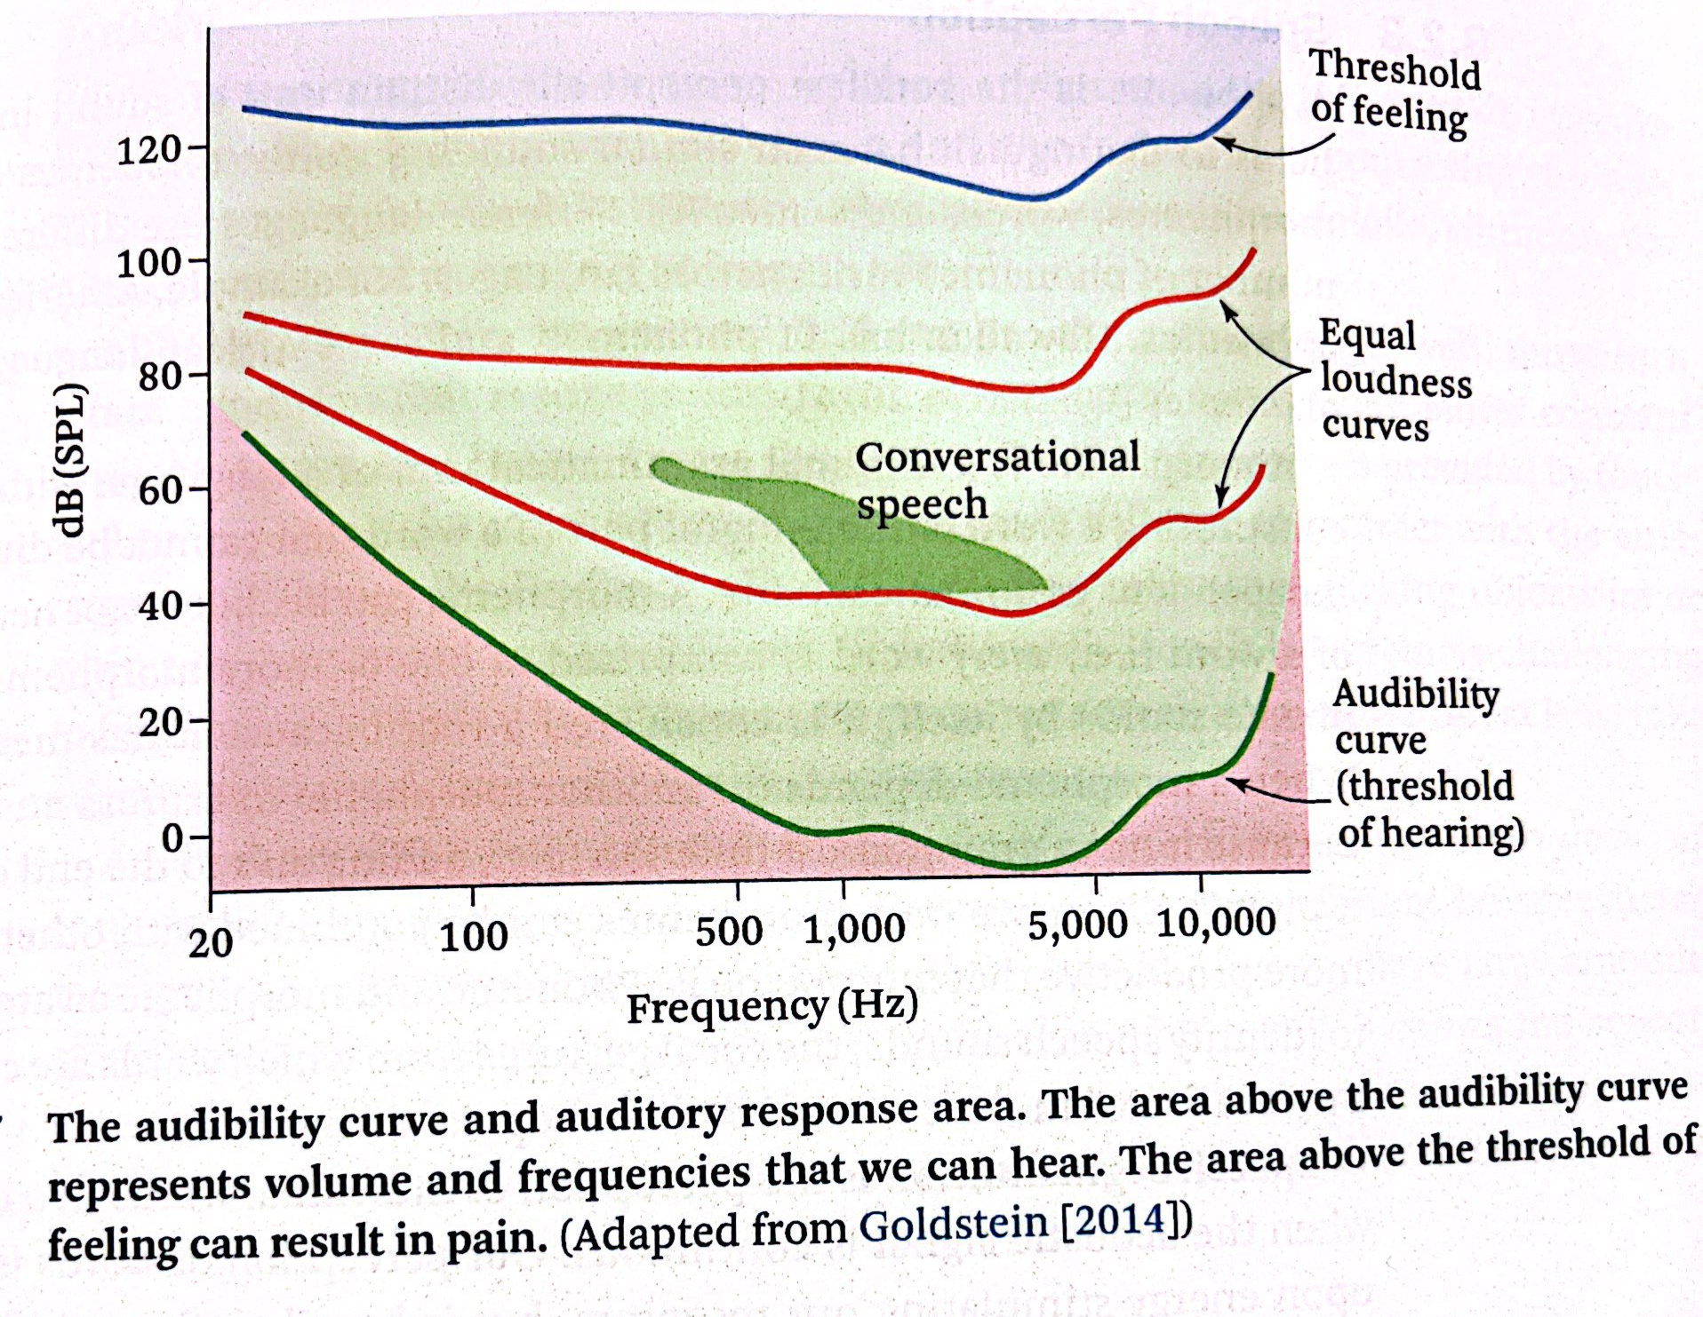
FEELING AND HEARING
Jason Jerald, The VR Book, Audibility Curve
#TechIntersections
@erinjerri
Notes:
Anyone who told you differently, is lying to you, or has not lived this life or was probably rich and famous before it due to privilege, or years of long and grueling hard work and has forgotten where they come from and that this period of a pandemic has sucked like no other.

Slide 46
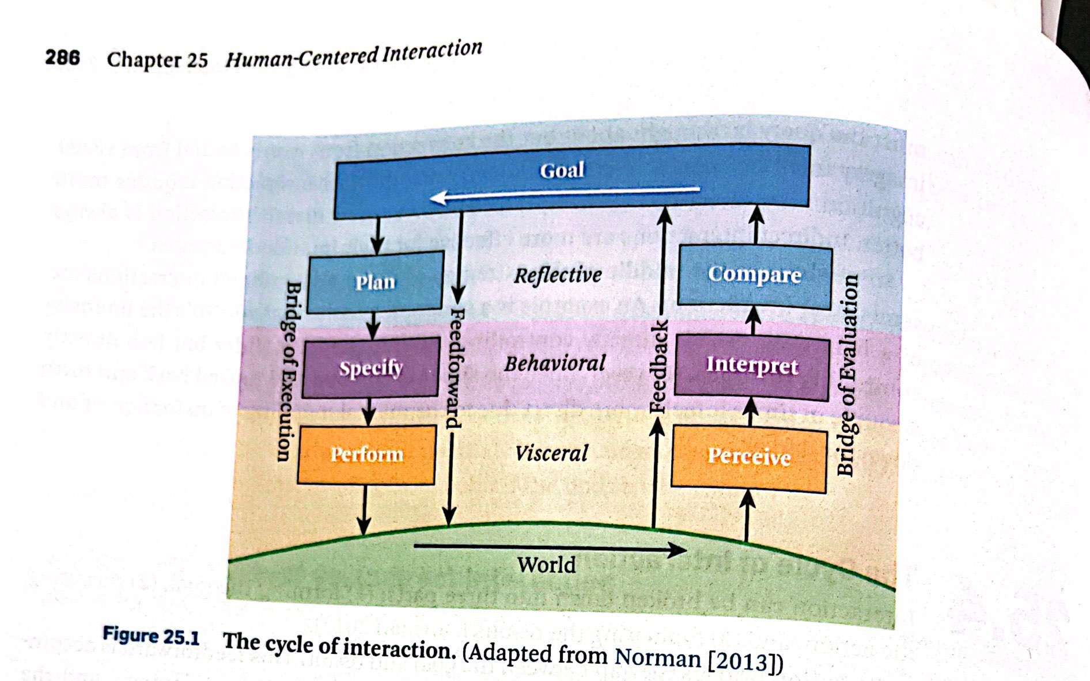
CYCLE OF INTERACTION
Interaction Cycle
(Jason Jerald, the VR Book, Don Norman inspired graphic).
#TechIntersections
@erinjerri
Notes:
Anyone who told you differently, is lying to you, or has not lived this life or was probably rich and famous before it due to privilege, or years of long and grueling hard work and has forgotten where they come from and that this period of a pandemic has sucked like no other.

Slide 47

1
STORY OF SELF
STORY OF SELF
MY STORY

Slide 48


Silicon Valley born (in Santa Clara) and raised (in Fremont).
My Pilipinx Heritage: Mom is from Pampanga and Dad is from Manila
WHO WHAT WHERE WHEN
@erinjerri

Slide 49
What do you want to be when you grow up?
#TechIntersections
@erinjerri

Slide 50
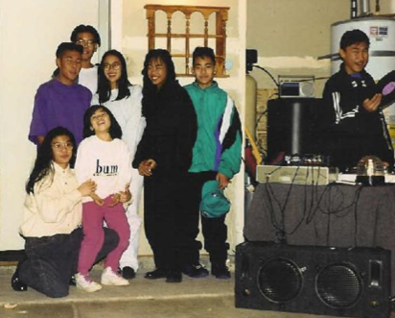
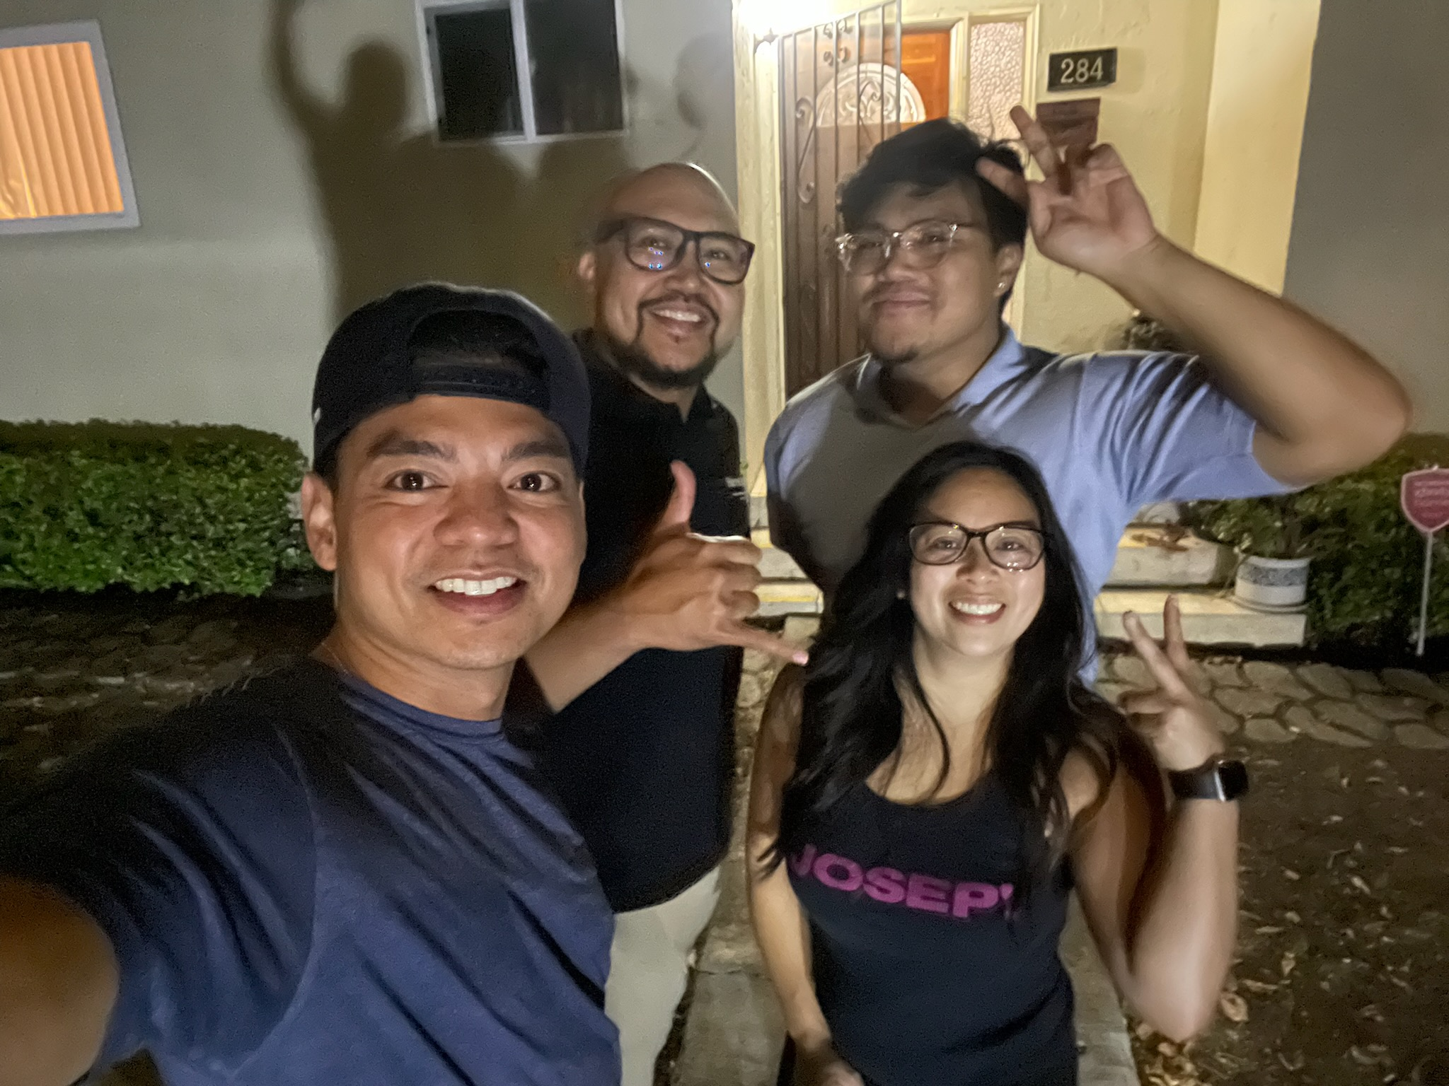
The 90s to Present
@erinjerri

Slide 51


Yes, I’m that girl in the video.
CAMEOS IN RUBY IBARRA’S MUSIC VIDEO “US” and LUMPIA 2
#TechIntersections
@erinjerri

Slide 52
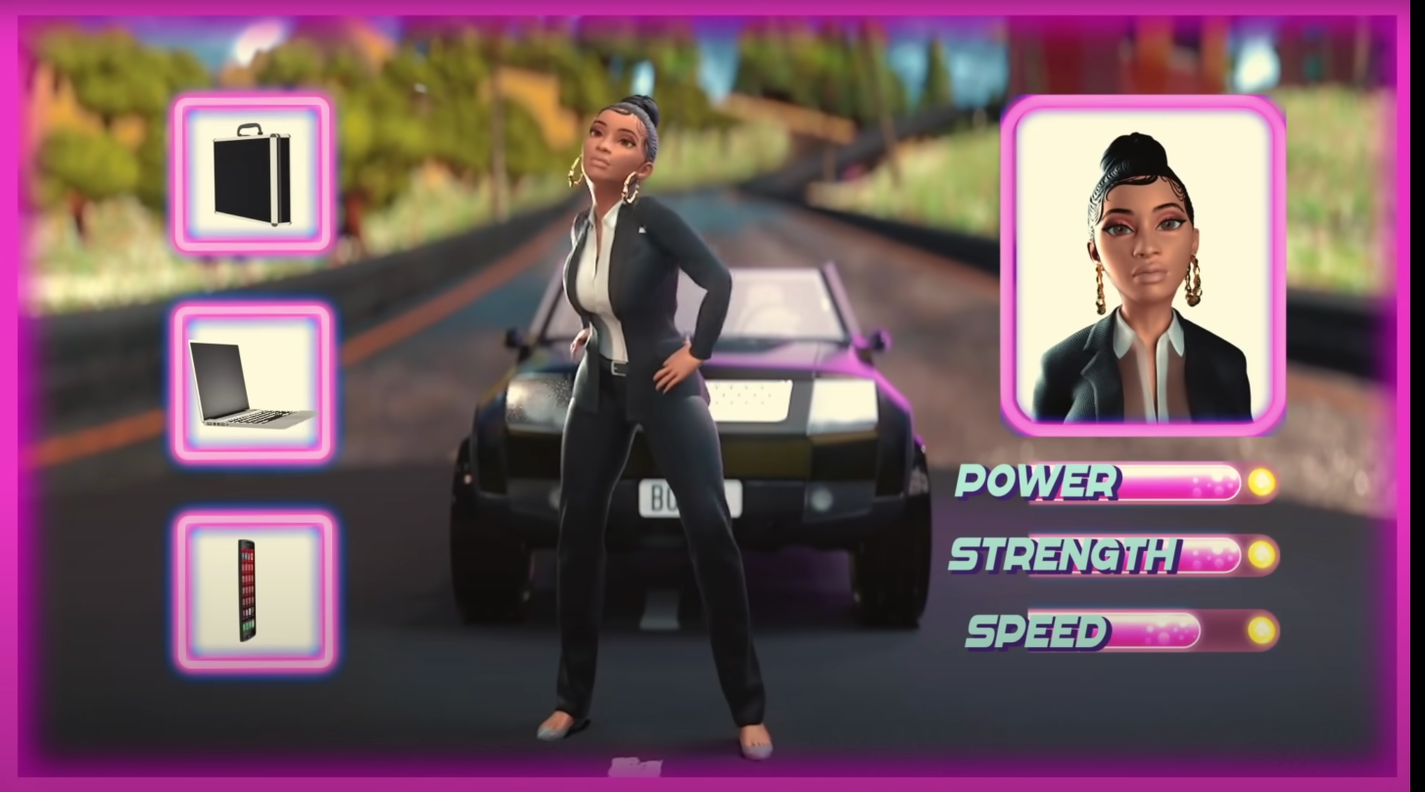
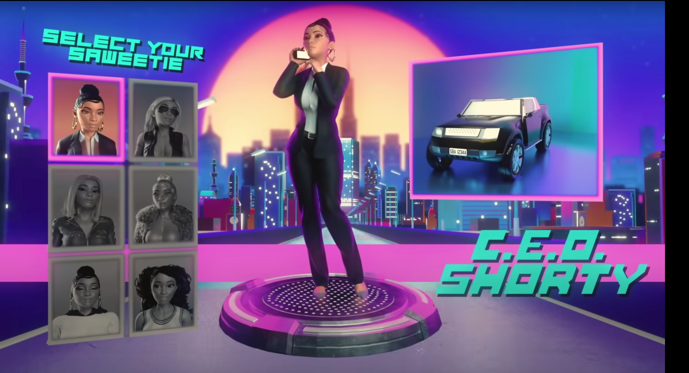
What’s your style?
Choose your own adventure/hat you wear
#TechIntersections

Slide 53

#TechIntersections
@erinjerri
Notes:
Anyone who told you differently, is lying to you, or has not lived this life or was probably rich and famous before it due to privilege, or years of long and grueling hard work and has forgotten where they come from and that this period of a pandemic has sucked like no other.

Slide 54
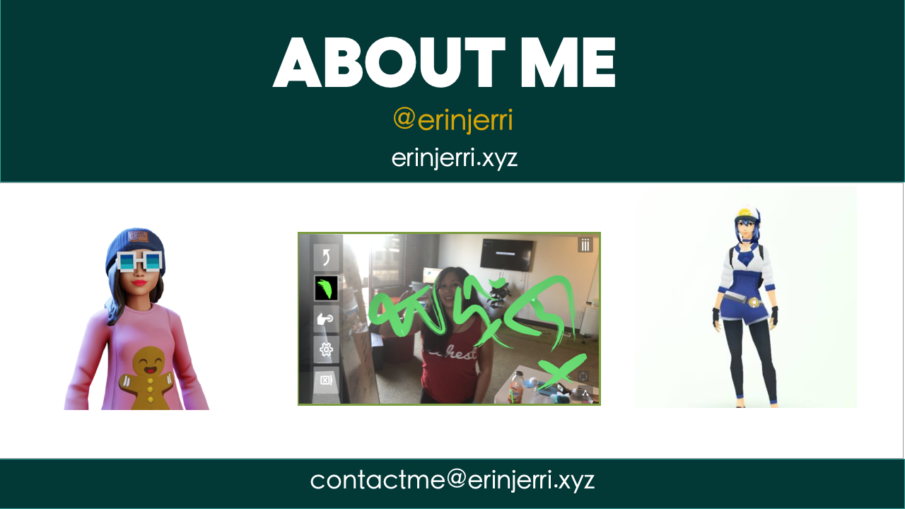

Slide 55
👩🏻‍💻
I write code and design experiences for 👾metaverse I 🎮games I web3💎I 🤖AI
📚
I write books
🎥 📺
I write scripts for TV/film
WHO

Slide 56
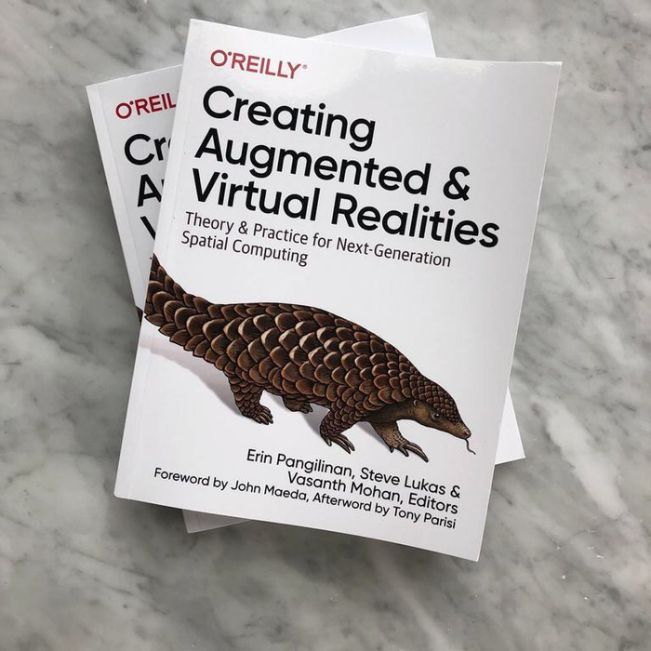

#TechIntersections
@erinjerri

Slide 57
How many people come from families who previously worked in tech prior to entering the industry?
#TechIntersections
@erinjerri
Notes:
Anyone who told you differently, is lying to you, or has not lived this life or was probably rich and famous before it due to privilege, or years of long and grueling hard work and has forgotten where they come from and that this period of a pandemic has sucked like no other.

Slide 58

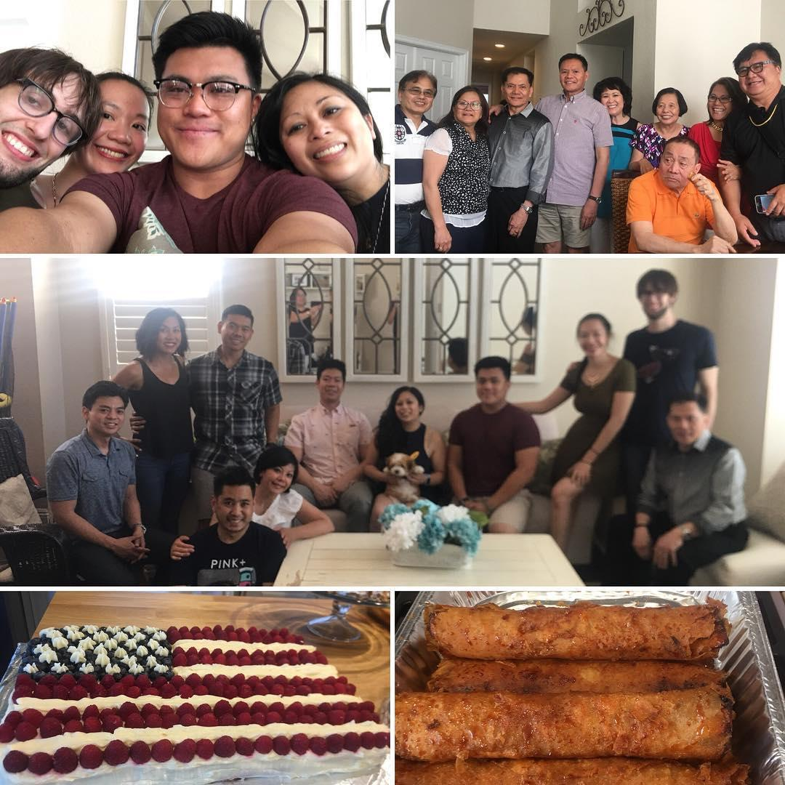
My cousin: previously worked at WordPress
Not pictured:
My brother was a game tester at EA and works in healthtech at UCLA Medical Center as a software engineer on EHR (electronic healthcare records).
My cousin: sold a company after 5 years at Salesforce and running things in the cloud
My Auntie worked at Oracle in hospitality
My Mom is a molecular biologist, veterinarian who previously worked in R&D for prostate cancer in tech startups in the 90s.
My Dad is toxicologist and currently works on COVID19 vaccines on FDA approvals.
My Auntie and Uncle worked in semiconductor manufacturing in the 1990s on the assembly line at Selectron.

Slide 59


#TechIntersections
@erinjerri

Slide 60
@erinjerri

Slide 61
#TechIntersections
@erinjerri

Slide 62
Notes:
Anyone who told you differently, is lying to you, or has not lived this life or was probably rich and famous before it due to privilege, or years of long and grueling hard work and has forgotten where they come from and that this period of a pandemic has sucked like no other.

Slide 63
Me in 2008, 2018
Campaigns to Computer Science
Publishing my first book

Slide 64
#TechIntersections
@erinjerri

Slide 65
What is my job like?
#TechIntersections
@erinjerri
Notes:
Anyone who told you differently, is lying to you, or has not lived this life or was probably rich and famous before it due to privilege, or years of long and grueling hard work and has forgotten where they come from and that this period of a pandemic has sucked like no other.

Slide 66




Team with extensive industry experience in television, film, the metaverses, and community organizing.
Ardees Rabang
Erin Pañgilinan
Co-Founder and Chief Production Officer
Co-Founder and Chief Technology Officer
#TechIntersections
@erinjerri

Slide 67
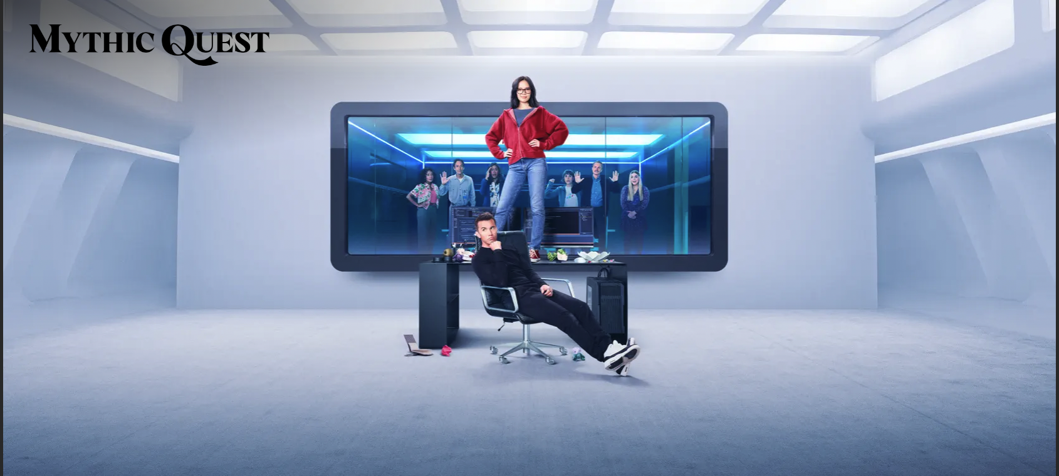
#TechIntersections
@erinjerri

Slide 68


When coding and designing, project management, screenwriting
#TechIntersections
@erinjerri

Slide 69
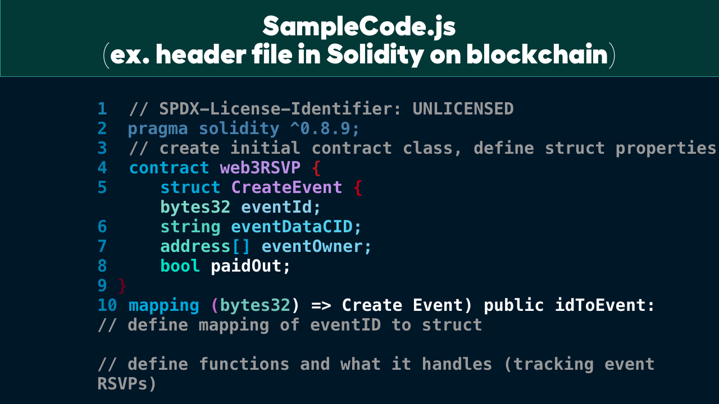

When debugging…
Notes:
Anyone who told you differently, is lying to you, or has not lived this life or was probably rich and famous before it due to privilege, or years of long and grueling hard work and has forgotten where they come from and that this period of a pandemic has sucked like no other.

Slide 70
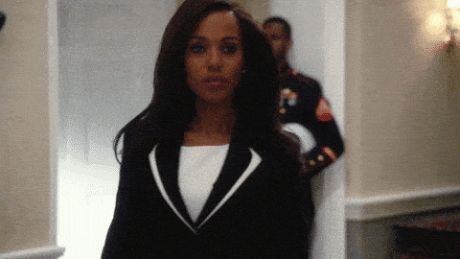
#TechIntersections
@erinjerri

Slide 71

#TechIntersections
@erinjerri

Slide 72

WE
ARE ALL
GONNA
MAKE
IT
(WAGMI)
#TechIntersections
@erinjerri

Slide 73
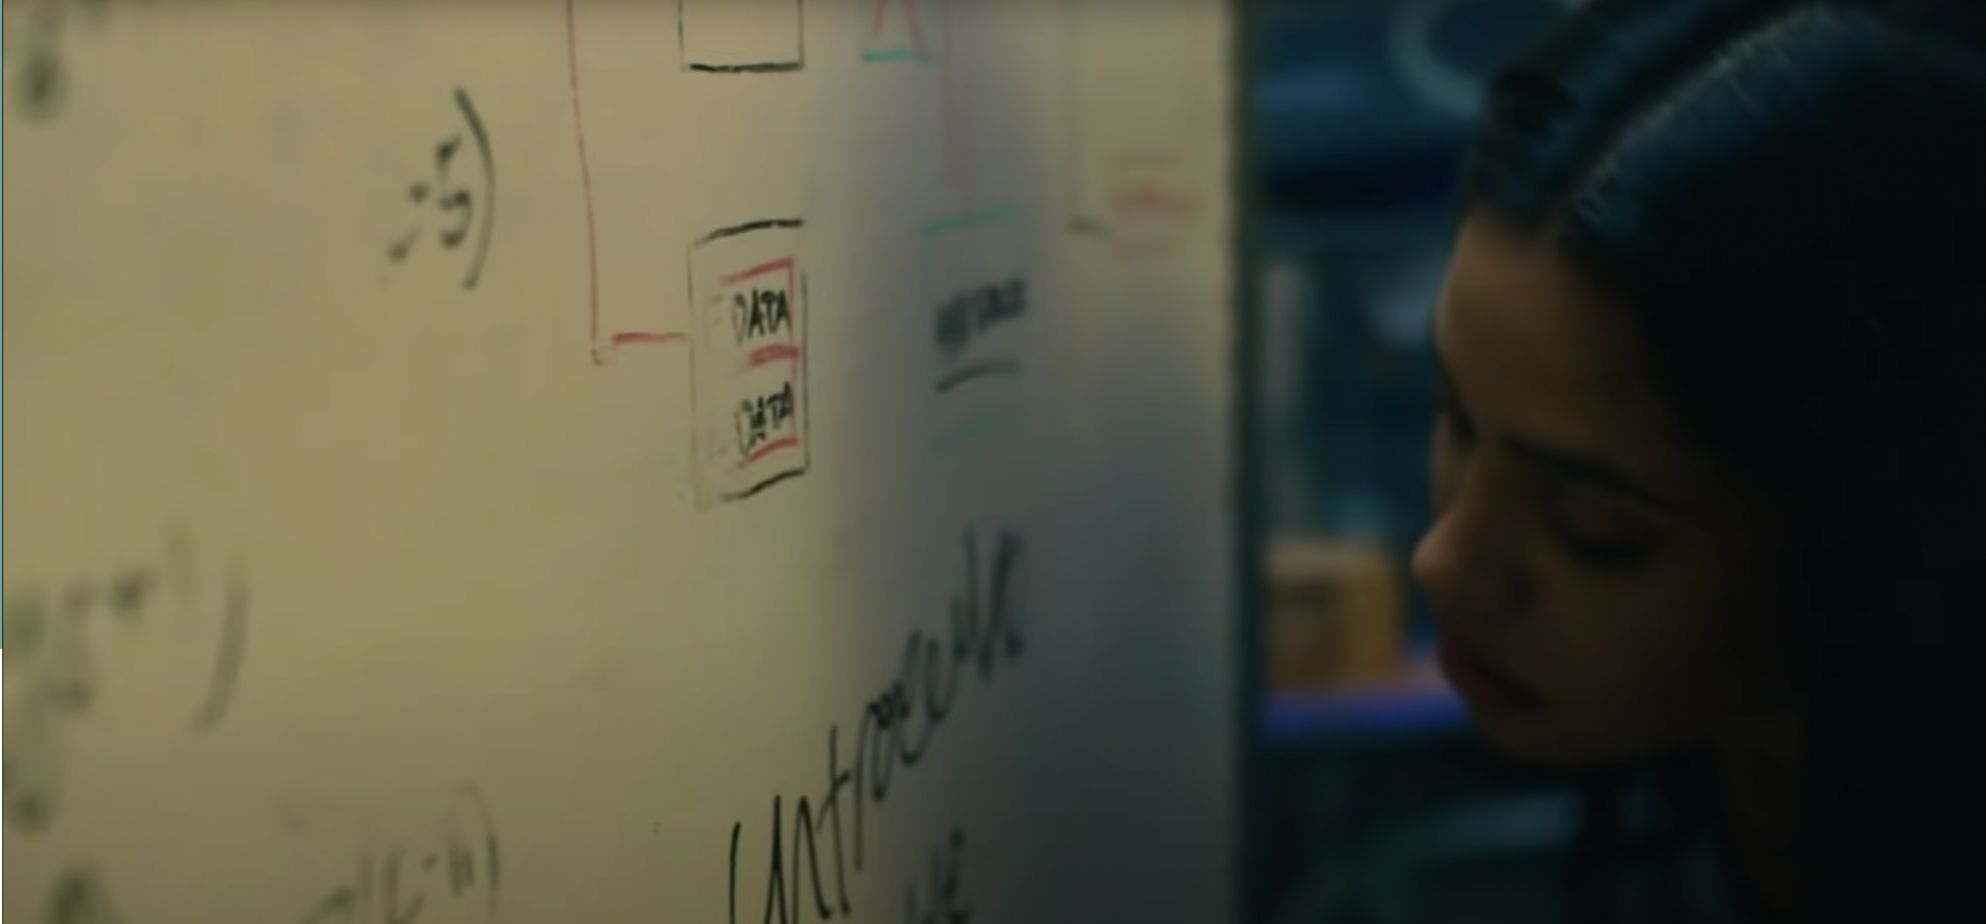
#TechIntersections
@erinjerri

Slide 74

#TechIntersections
@erinjerri

Slide 75
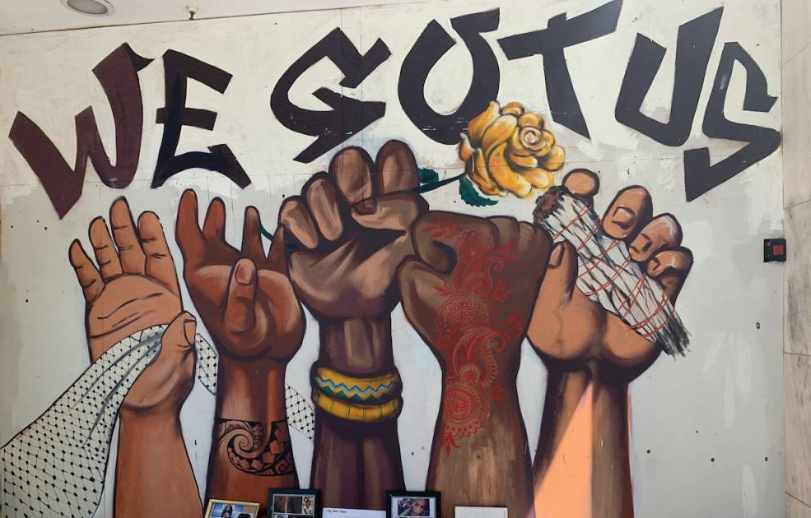
2
STORY OF US
STORY OF US
OUR STORY

Slide 76

As women of color in tech, how do we reframe expectations of our profession to serve and create new ideas and framework for creating solutions relevant to our communities?
#TechIntersections
@erinjerri
Notes:
Anyone who told you differently, is lying to you, or has not lived this life or was probably rich and famous before it due to privilege, or years of long and grueling hard work and has forgotten where they come from and that this period of a pandemic has sucked like no other.

Slide 77
ASK GOOD QUESTIONS
What are the engineering tradeoffs, financial tradeoffs, ethical/moral dilemmas if we choose a specific path?
#TechIntersections
@erinjerri

Slide 78
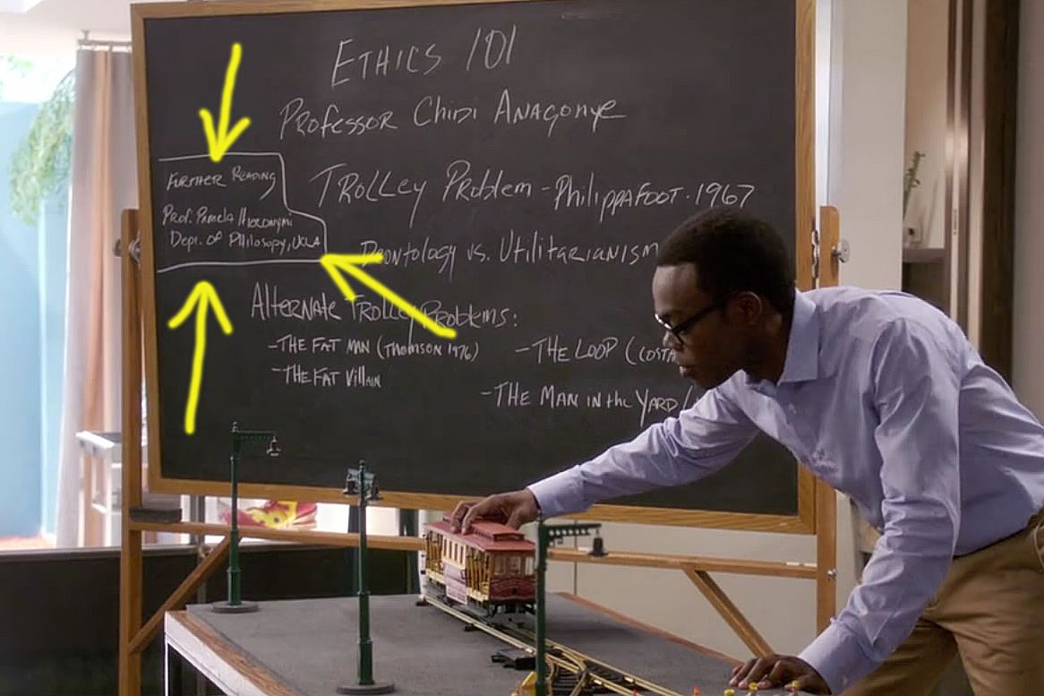
#TechIntersections
@erinjerri
Notes:
Anyone who told you differently, is lying to you, or has not lived this life or was probably rich and famous before it due to privilege, or years of long and grueling hard work and has forgotten where they come from and that this period of a pandemic has sucked like no other.

Slide 79
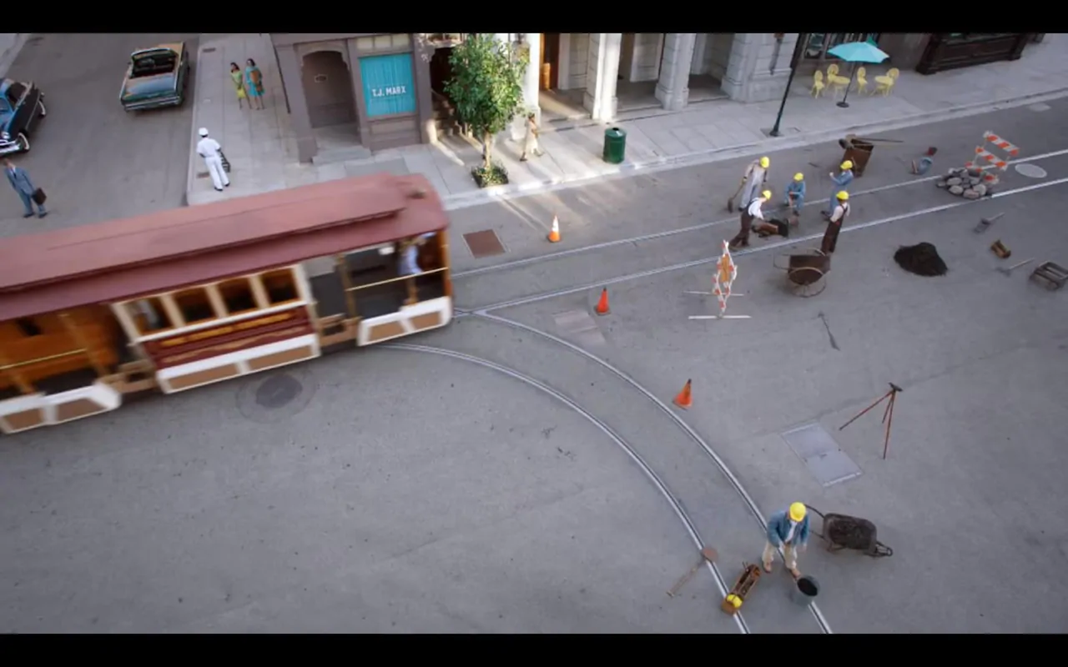
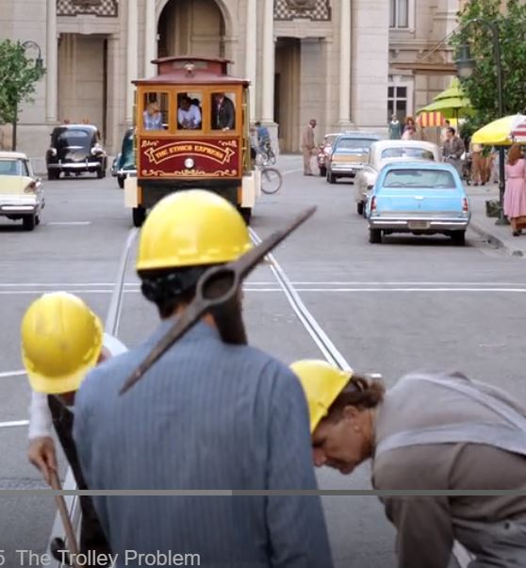
#TechIntersections
@erinjerri
Notes:
Anyone who told you differently, is lying to you, or has not lived this life or was probably rich and famous before it due to privilege, or years of long and grueling hard work and has forgotten where they come from and that this period of a pandemic has sucked like no other.

Slide 80
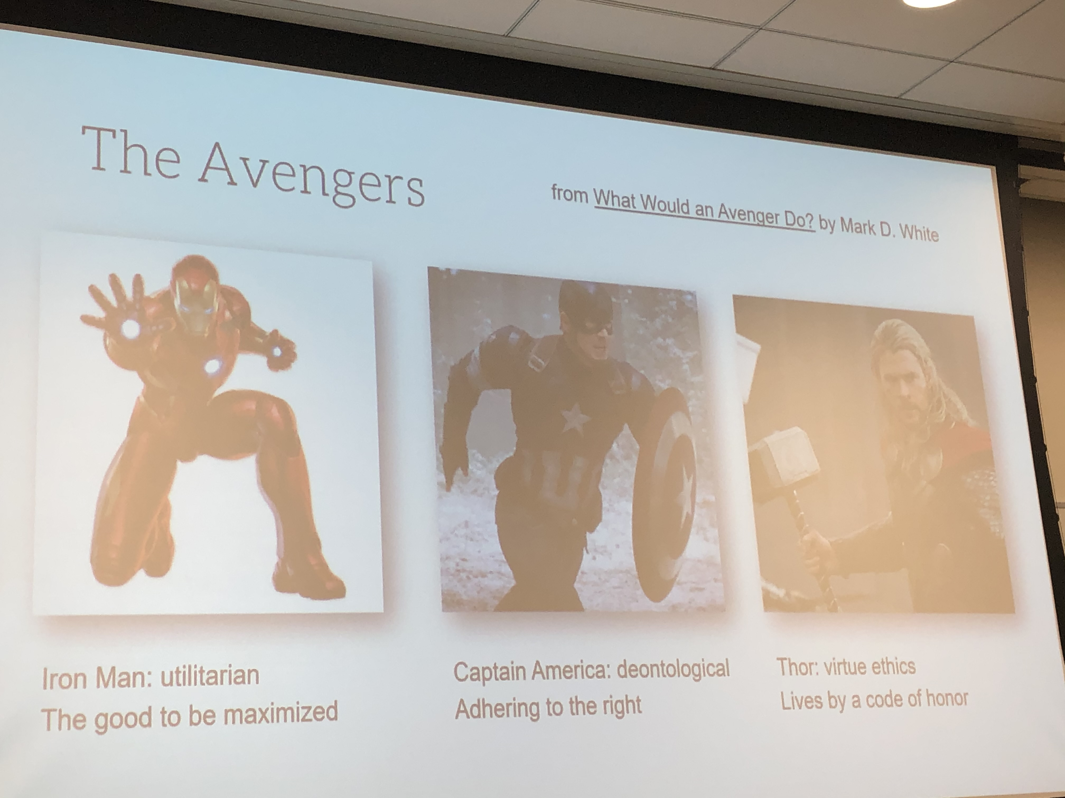
#TechIntersections
@erinjerri
Notes:
Anyone who told you differently, is lying to you, or has not lived this life or was probably rich and famous before it due to privilege, or years of long and grueling hard work and has forgotten where they come from and that this period of a pandemic has sucked like no other.

Slide 81
WHAT’S YOUR JAM? WHAT’S YOUR STACK?
Create Tech Solutions to Challenges
#TechIntersections
@erinjerri

Slide 82

WHAT’S YOUR JAM?
1
23
Self-Care and Healing
Rest as Resistance
Finding Your Joy
Create solutions
Write your own story.
Create your own framework.
Share your innovations.
#TechIntersections
@erinjerri
Notes:
Anyone who told you differently, is lying to you, or has not lived this life or was probably rich and famous before it due to privilege, or years of long and grueling hard work and has forgotten where they come from and that this period of a pandemic has sucked like no other.

Slide 83

FUTURE COMPUTING STACK
Experience layer
Automation layer
Ownership layer
#TechIntersections
@erinjerri

Slide 84
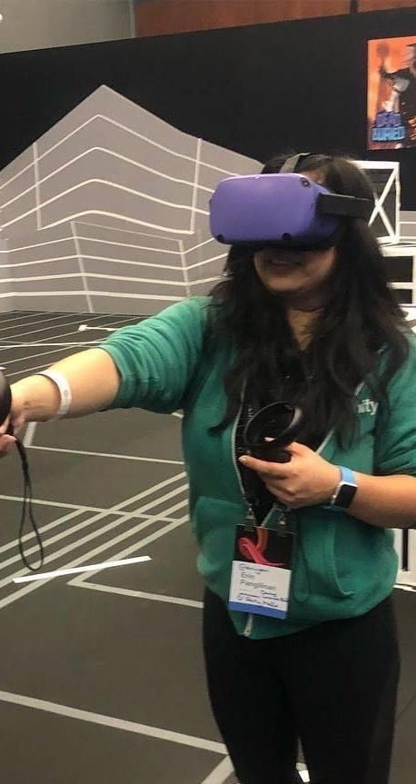
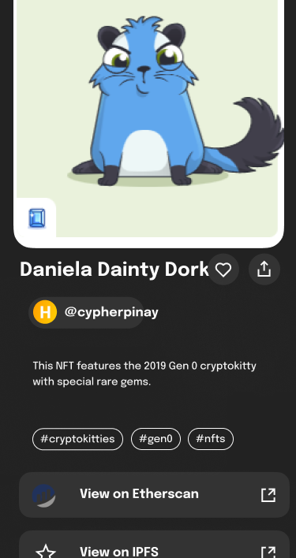
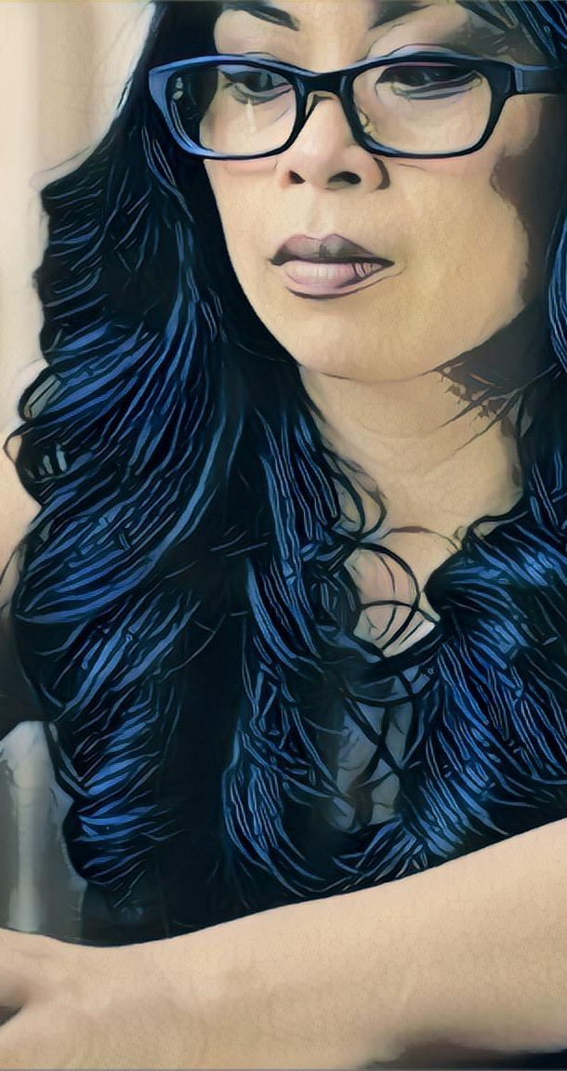
SOLUTION
Our Collective Solutions
Together, we create technology solutions to the challenges our society.
Metaverse
Web3
AI
Embodied Reality
Shared Collective Ownership
Human Augmentation
#TechIntersections
@erinjerri

Slide 85
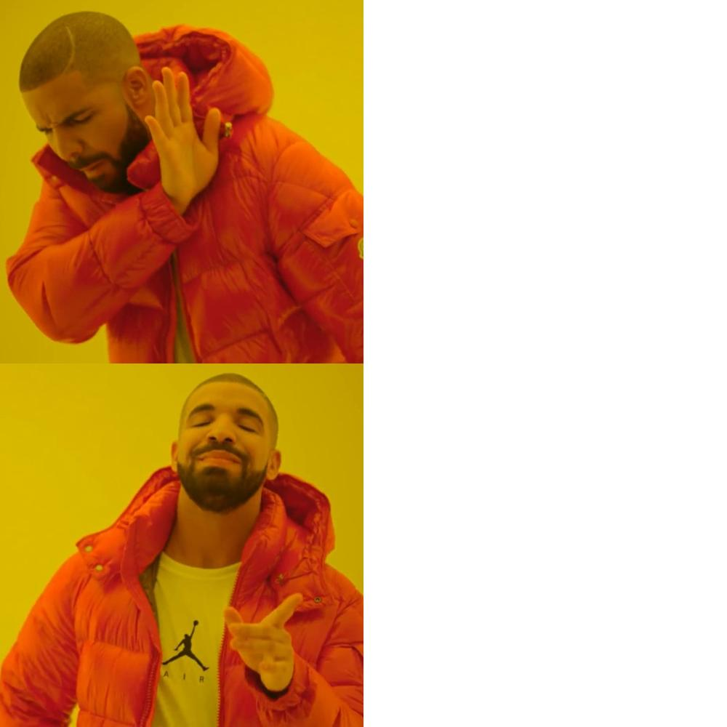
CHALLENGES
🔲 Ergonomics.
🔲 Affordability/Accessibility.
🔲 Dominant violent and oversexualized content.
METAVERSE
SOLUTIONS
✅ Improved Human Centered Design practices, more inclusive UX testing,
✅ Price drops and rental programs.
✅ Holograms in public spaces.
✅ Culturally relevant content.
@erinjerri

Slide 86
CHALLENGES
🔲 Displacement from automation.
🔲 Lack of data governance and oversight, lack of accountability or ownership by subjects of datasets.
🔲 High level of inaccuracy.
AI
SOLUTIONS
✅ Creation of new jobs that work in collaboration with AI, human tasks will be more creative and less mundane.
✅ Data DAOs in web3.
✅ We are smarter than robots, AI will need humans
to improve.
@erinjerri

Slide 87
CHALLENGES
🔲 Bad actors like SBF and FTX, Terra, 3AC, Celsius.
🔲 Identity theft, hacking, stealing of money.
🔲 Silk Road.
WEB3
SOLUTIONS
✅ Defining securities law, enforcement, regulation
✅ Teaching privacy, cybersecurity best practices
✅ Collectively owned and run companies
✅ Regenerative creator economy
✅ Transparent hxstorical record
@erinjerri

Slide 88

#TechIntersections
@erinjerri

Slide 89
OUR MISSION
“
Find a mission,
not a job.
”
Sheila Marcelo | Founder of Care.com
#TechIntersections
@erinjerri

Slide 90
Who are you being in your role?
Who are you serving?
Identify your consumers, users, audience.
Ex. Software Engineer helping customers with a solution
WHO
@erinjerri
Notes:
Anyone who told you differently, is lying to you, or has not lived this life or was probably rich and famous before it due to privilege, or years of long and grueling hard work and has forgotten where they come from and that this period of a pandemic has sucked like no other.

Slide 91
NEXT STEPS
1) BE DO HAVE
LAW OF ATTRACTION
2) DO: 3P’s
PLAN: PURPOSE, PRODUCT, PEOPLE
3) 5W’s & H
STORY OF US
@erinjerri
Notes:
Anyone who told you differently, is lying to you, or has not lived this life or was probably rich and famous before it due to privilege, or years of long and grueling hard work and has forgotten where they come from and that this period of a pandemic has sucked like no other.

Slide 92
5W’S and H
WHO
WHAT
WHERE
WHEN
WHY
HOW
STORY OF US
@erinjerri
Notes:
Anyone who told you differently, is lying to you, or has not lived this life or was probably rich and famous before it due to privilege, or years of long and grueling hard work and has forgotten where they come from and that this period of a pandemic has sucked like no other.

Slide 93
What is your purpose?
WHAT
@erinjerri
Notes:
Anyone who told you differently, is lying to you, or has not lived this life or was probably rich and famous before it due to privilege, or years of long and grueling hard work and has forgotten where they come from and that this period of a pandemic has sucked like no other.

Slide 94
What platforms are you targeting?
Identify space constraints.
WHERE
@erinjerri
Notes:
Anyone who told you differently, is lying to you, or has not lived this life or was probably rich and famous before it due to privilege, or years of long and grueling hard work and has forgotten where they come from and that this period of a pandemic has sucked like no other.

Slide 95
When will you start, experiment, release, and iterate?
Identify time constraints.
WHEN
@erinjerri
Notes:
Anyone who told you differently, is lying to you, or has not lived this life or was probably rich and famous before it due to privilege, or years of long and grueling hard work and has forgotten where they come from and that this period of a pandemic has sucked like no other.

Slide 96
Why is this important to you? Personally? Professionally?
WHY
#TechIntersections
@erinjerri
Notes:
Anyone who told you differently, is lying to you, or has not lived this life or was probably rich and famous before it due to privilege, or years of long and grueling hard work and has forgotten where they come from and that this period of a pandemic has sucked like no other.

Slide 97
Choose your method
✅ Select subsector
✅ Select challenge
✅ Get feedback, test, and iterate
HOW
@erinjerri
Notes:
Anyone who told you differently, is lying to you, or has not lived this life or was probably rich and famous before it due to privilege, or years of long and grueling hard work and has forgotten where they come from and that this period of a pandemic has sucked like no other.

Slide 98
After 5W’s and H identify:
✅ Your resource and capacity constraints
✅ Your anticipated considerations and challenges
✅ Your a back-up plan
GROW CHARTING
@erinjerri
Notes:
Anyone who told you differently, is lying to you, or has not lived this life or was probably rich and famous before it due to privilege, or years of long and grueling hard work and has forgotten where they come from and that this period of a pandemic has sucked like no other.

Slide 99
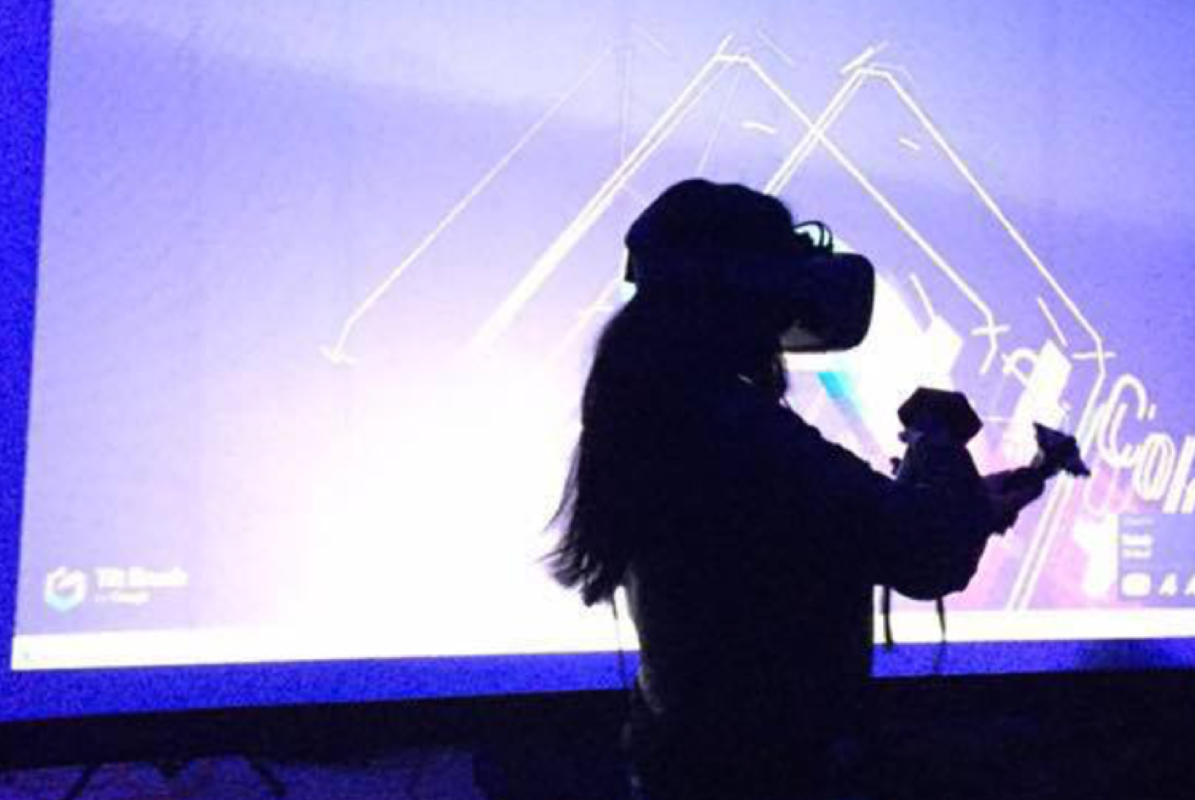
“
Enter the oasis
”
Ready Player One
#TechIntersections
@erinjerri

Slide 100
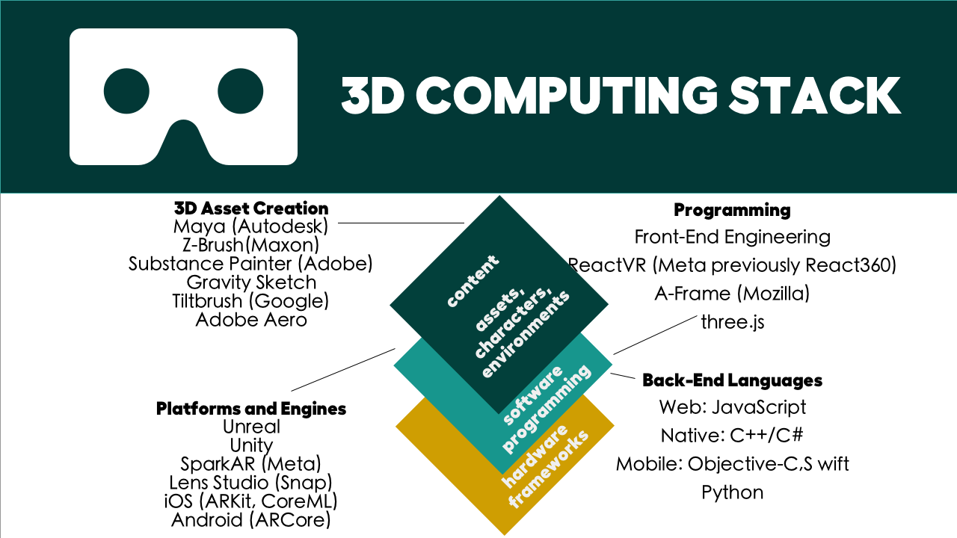
@erinjerri

Slide 101

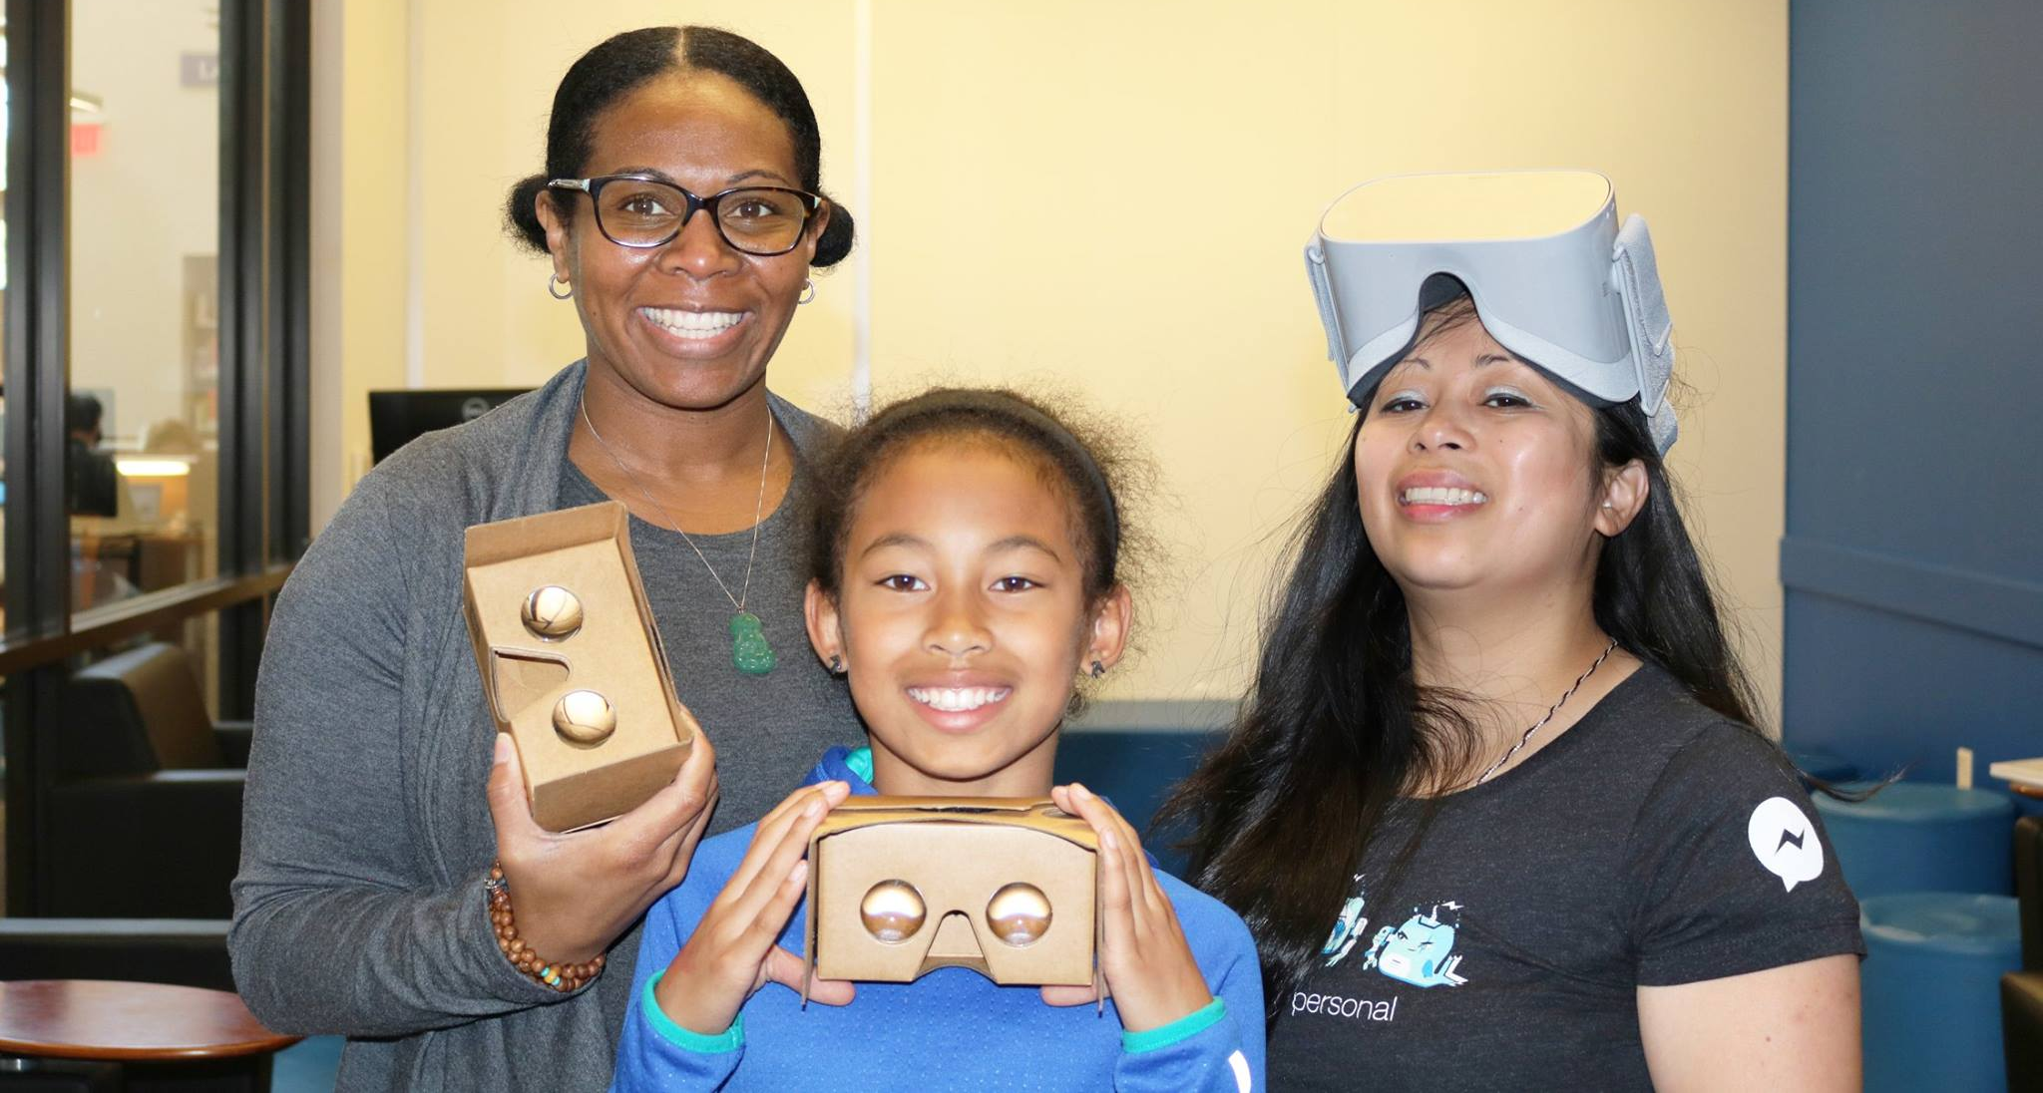


Teaching next generation spatial computing
Cisco 2016
Girls Who Code 2018
PixelHacks 2019
#TechIntersections
@erinjerri
Notes:
Anyone who told you differently, is lying to you, or has not lived this life or was probably rich and famous before it due to privilege, or years of long and grueling hard work and has forgotten where they come from and that this period of a pandemic has sucked like no other.

Slide 102
OUR STACK
“
AI is the new electricity.
”
Paraphrase of Andrew Ng | Founder of Coursera.com I Stanford Professor
#TechIntersections
@erinjerri

Slide 103

AI PRAXIS
#TechIntersections
@erinjerri

Slide 104

Courses and Books
How to Speak Machine by John Maeda
Data Feminism by Catherine D’Ignazio and Lauren F. Klein
Data Ethics
Deep Learning
Stanford CS 231N - Computer Vision
fast.ai - Deep Learning
Andrew Ng - Machine Yearning (book)
deeplearning.ai (Andrew Ng)
Full Stack Deep Learning (UC Berkeley)
Geometric Deep Learning - Book and YouTube Course
(Michael Bronstein, head of ML, Twitter, DeepMind Professor College of London)
@erinjerri

Slide 105


AI PRODUCT FEASIBILITY
#TechIntersections
@erinjerri

Slide 106

AI PRODUCT DEVELOPMENT
#TechIntersections
@erinjerri

Slide 107

A REALISTIC APPROACH TO
“
We Are All Gonna Make It (WAGMI).
”
#Web3
#TechIntersections
@erinjerri

Slide 108

But I’m just a crypto n00b how do I get started?
You can just buy and HODL.
“Do more than HODL, push on chain”
Satoshi Nakamoto - BitCoin Whitepaper
Cypherpunks
#TechIntersections
@erinjerri

Slide 109

#TechIntersections

Slide 110

#TechIntersections23
@erinjerri

Slide 111

#TechIntersections
@erinjerri

Slide 112
Our CollectiveSolutions
Human Centered Design
Collective Ownership
Augmentation
Making humans a part of and primary to the product design process from conception, ideation, creation, deployment, and testing.
It takes a distributed network state to run the world.
Some AI will replace entire industries and jobs, but it will also help create new ones for humans and redefine the future of work.
#TechIntersections
@erinjerri

Slide 113

It takes a network state.
#TechIntersections
@erinjerri

Slide 114

TIME AUDIT
#TechIntersections
@erinjerri
Notes:
Anyone who told you differently, is lying to you, or has not lived this life or was probably rich and famous before it due to privilege, or years of long and grueling hard work and has forgotten where they come from and that this period of a pandemic has sucked like no other.

Slide 115

New technology
STORY OF NOW
#TechIntersections
@erinjerri

Slide 116

STORY OF NOW
#TechIntersections
@erinjerri

Slide 117

BREONNA TAYLOR METAVERSE EXPERIENCE By Breonna Taylor Family and Lady Pheonix
STORY OF NOW
#TechIntersections #SayHerName
@erinjerri

Slide 118


Slide 119

#TechIntersections23
@erinjerri

Slide 120

3
STORY OF NOW
STORY OF NOW
YOUR STORY
@erinjerri

Slide 121

Identify to Act
✅ Cause / Passion / Purpose / Mission
✅ Create Solution
✅ Compose Expression
#TechIntersections
@erinjerri
#TechIntersections
@erinjerri
Notes:
Anyone who told you differently, is lying to you, or has not lived this life or was probably rich and famous before it due to privilege, or years of long and grueling hard work and has forgotten where they come from and that this period of a pandemic has sucked like no other.

Slide 122
Post Traumatic Growth (PTSG) Checklist - To Thrive
✅ Find and define your JAM and your STACK.
✅ Augment your workflow so you can optimize for joy and flow.
✅ Write or be written. Own your story when you get on the screen.
✅ Learn the rules so you can break them, redefine, recodify them, and unlearn.
✅ Be more humane. No person is an island. If anything, we are more like an archipelago and. Understand being a good neighbor and allyship strengthens the culture, the collective community and the world.
#TechIntersections
@erinjerri
#TechIntersections
@erinjerri
Notes:
Anyone who told you differently, is lying to you, or has not lived this life or was probably rich and famous before it due to privilege, or years of long and grueling hard work and has forgotten where they come from and that this period of a pandemic has sucked like no other.

Slide 123
We are the new electricity.
#TechIntersections
@erinjerri

Slide 124
WACMI.
We All Can try and Make It.
All
Can Try
Make
It.
#TechIntersections
@erinjerri

Slide 125






We can rule
over as queens
and princesses
of the universe.
THE FANTASY IS REAL.

Slide 126

We can lead
the country.
THE REALITY IS BETTER.

Slide 127

We can build
and lead
the metaverse
grounded in reality.
THE REALITY IS BETTER.
#TechIntersections
@erinjerri

Slide 128
REFERENCES
Jerald, Jason. The VR Book: Human Centered Design for Virtual Reality. ACM. 2016.
Lynch, Shana “Andrew Ng: Why AI Is the New Electricity” 2017, 11 March.
https://www.gsb.stanford.edu/insights/andrew-ng-why-ai-new-electricity
Nakamoto, Satoshi. “BitCoin: A Peer-to-Peer Electronic Cash System.”2008, 31 October.
https://bitcoin.org/bitcoin.pdf
Oronce, Carlos. “US Health Care Relies on Filipinxs While Ignoring Their Health Needs Disguised Disparities and the COVID-19 Pandemic.” 2021, 23, July.
https://jamanetwork.com/journals/jama-health-forum/fullarticle/2782408
Sietsma, Silka. “ Designing for Our Senses, Not Our Devices.” Creating Augmented and Virtual Realities. O’Reilly Media. Pg 36. 2019.
Vanourek, Gregg.“The Power of Taking Full Responsibility for Your Life.”22 March 2022.
https://greggvanourek.com/full-responsibility/
Wang, Eva Marie.“Paglalayag sa Balangay as Methodology A Decolonial Journey of Re-Imaging Our Research, International Extramural Conference, University of the Philippines, Cebu. 2021 Oct 256. https://www.facebook.com/UPCebuSocSci/videos/329426628986894
#TechIntersections
@erinjerri

Slide 129

ISANG BAGSAK!
@erinjerri

Slide 130


#TechIntersections
@erinjerri

Slide 131

THANK
YOU
.
©2022

Slide 132

#TechIntersections
@erinjerri

